Slide 1
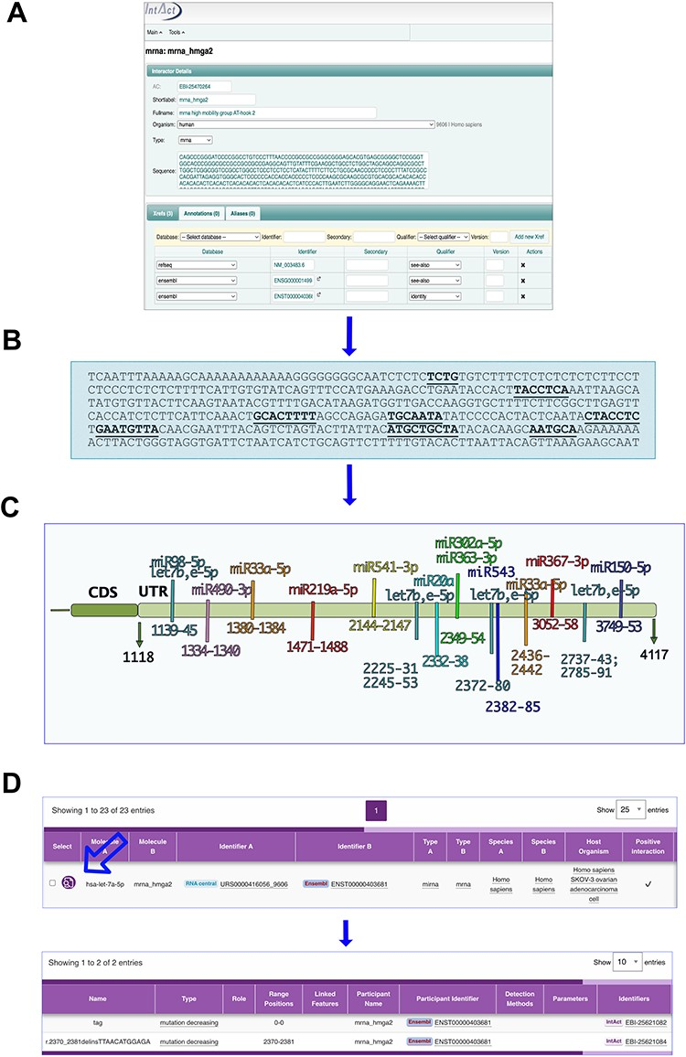
Figure 2. MicroRNA binding sites on mRNA_hmga2 entry. (A) and (B) The annotation process. (A) mRNA_hmga2 entry in ...
Notes:
Figure 2. MicroRNA binding sites on mRNA_hmga2 entry. (A) and (B) The annotation process. (A) mRNA_hmga2 entry in IntAct is annotated with the sequence and ID of the main transcript of the gene (identified by GIFT), together with the Ensembl gene ID and a RefSeq. (B) Mutations affecting the interactions are mapped on the transcript sequence. (C) Hmga2-3ʹUTR regions identified as necessary for the microRNA binding. (D) The interaction viewer in the webpage: the arrow indicates the lens to select to see the features.
Unless provided in the caption above, the following copyright applies to the content of this slide: © The Author(s) 2023. Published by Oxford University Press.This is an Open Access article distributed under the terms of the Creative Commons Attribution License (https://creativecommons.org/licenses/by/4.0/), which permits unrestricted reuse, distribution, and reproduction in any medium, provided the original work is properly cited.

