Slide 1
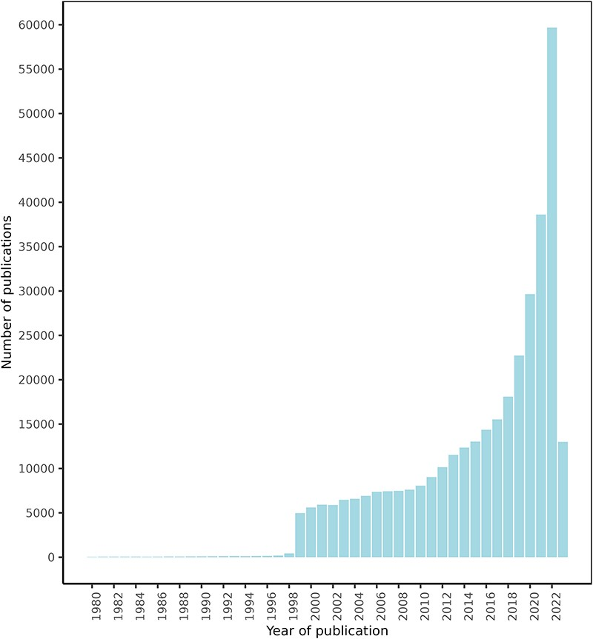
Figure 4. FooDrugs PubMed articles distribution by publication date. Articles with publication dates between 1980 and ...
Notes:
Figure 4. FooDrugs PubMed articles distribution by publication date. Articles with publication dates between 1980 and 2023 are shown. 779 articles published before 1980 are excluded from the figure. Search date was 28 July 2023.
Unless provided in the caption above, the following copyright applies to the content of this slide: © The Author(s) 2023. Published by Oxford University Press.This is an Open Access article distributed under the terms of the Creative Commons Attribution License (https://creativecommons.org/licenses/by/4.0/), which permits unrestricted reuse, distribution, and reproduction in any medium, provided the original work is properly cited.

