Slide 1
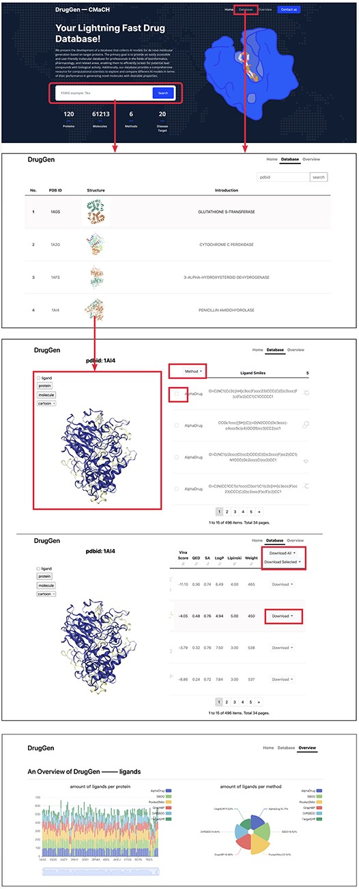
Figure 3. Quick tutorials about utilizing the website to obtain molecules on specific protein targets. We highlighted ...
Notes:
Figure 3. Quick tutorials about utilizing the website to obtain molecules on specific protein targets. We highlighted main interfaces with rectangular boxes. The bottom image displays part of the ‘overview’ page, which delivers a comprehensive evaluation of each method. Alt text: The image shows a guide for navigating the database, detailing the steps to search for and visualize the binding pose between a molecule and a target protein.
Unless provided in the caption above, the following copyright applies to the content of this slide: © The Author(s) 2023. Published by Oxford University Press.This is an Open Access article distributed under the terms of the Creative Commons Attribution License (https://creativecommons.org/licenses/by/4.0/), which permits unrestricted reuse, distribution, and reproduction in any medium, provided the original work is properly cited.

