Slide 1
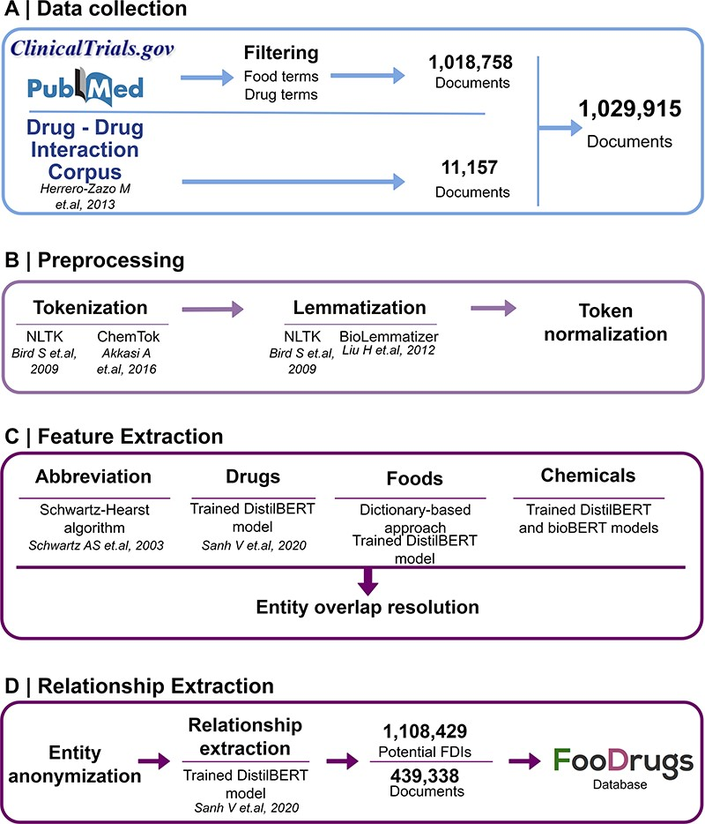
Figure 1. General overview of the NLP approach. (A) Data collection was performed by collecting documents containing at ...
Notes:
Figure 1. General overview of the NLP approach. (A) Data collection was performed by collecting documents containing at least one food and drug term in their titles and abstracts, as well as the whole DDI corpus. (B) Data preprocessing step is applied to the documents for better integration in the pipeline. (C) In the feature extraction step, different entities are recognized in the text via different methods, and entity overlap resolution is done when necessary. (D) Finally, for relationship extraction, entities are anonymized to work with the relationship extraction model used, and the resulting FDIs and documents are stored in the FooDrugs database.
Unless provided in the caption above, the following copyright applies to the content of this slide: © The Author(s) 2023. Published by Oxford University Press.This is an Open Access article distributed under the terms of the Creative Commons Attribution License (https://creativecommons.org/licenses/by/4.0/), which permits unrestricted reuse, distribution, and reproduction in any medium, provided the original work is properly cited.

