Slide 1
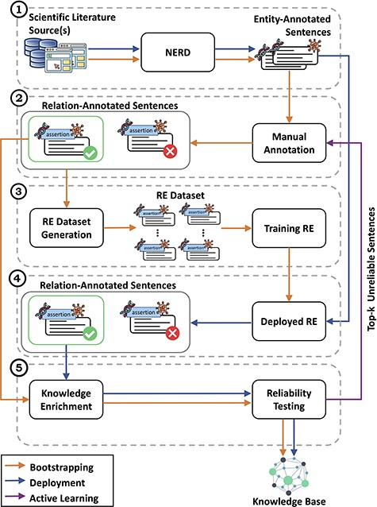
Figure 2. Detailed view of the CORE architecture. In module (1), CORE acquires text from biomedical literature and then ...
Notes:
Figure 2. Detailed view of the CORE architecture. In module (1), CORE acquires text from biomedical literature and then performs NERD to generate entity-annotated sentences. These sentences are then manually annotated by experts in module (2) to produce relation-annotated sentences, which are used to generate the datasets for training RE methods in module (3). Once trained, in module (4), the RE methods are deployed over entity-annotated sentences to automatically generate relation-annotated sentences. Finally, in module (5), relation-annotated sentences undergo a knowledge enrichment component, which generates facts, and a reliability testing component, which tags facts as ‘reliable’ or ‘unreliable’. Facts tagged as ‘reliable’ are used to populate the KB, whereas ‘unreliable’ facts are returned to experts for re-annotation.
Unless provided in the caption above, the following copyright applies to the content of this slide: © The Author(s) 2023. Published by Oxford University Press.This is an Open Access article distributed under the terms of the Creative Commons Attribution License (https://creativecommons.org/licenses/by/4.0/), which permits unrestricted reuse, distribution, and reproduction in any medium, provided the original work is properly cited.

