Slide 1
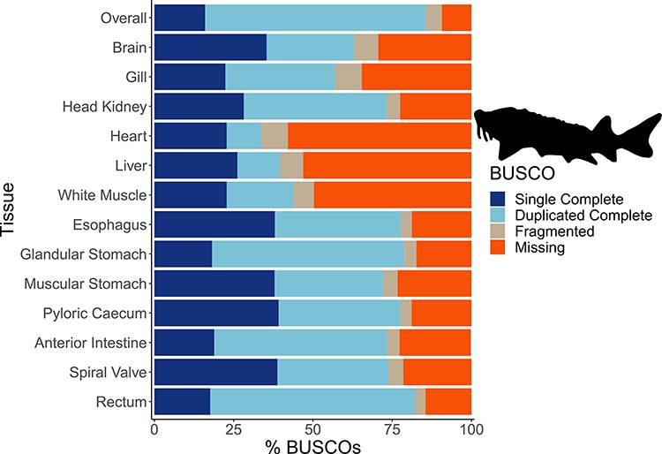
Figure 2. The transcriptome completeness assessed with BUSCO. Single complete represents orthologs that were present ...
Notes:
Figure 2. The transcriptome completeness assessed with BUSCO. Single complete represents orthologs that were present singly in a transcriptome, while duplicated complete represents orthologs duplicated in the transcriptome that matched the BUSCO profile. Fragmented orthologs were present in the transcriptomes, but not within the expected range of alignments in the BUSCO profile. Missing orthologs were those present in the BUSCO profile but missing in the transcriptome completely. The tissue-specific transcriptomes are labeled by tissue, while the transcriptome labeled ‘Overall’ refers to an assembly that included all data from the 13 tissues. The BUSCO profile used in the present analysis was the Actinopterygii odb10 dataset. The lake sturgeon icon and colors used were from the fishualize package in R.
Unless provided in the caption above, the following copyright applies to the content of this slide: © The Author(s) 2023. Published by Oxford University Press.This is an Open Access article distributed under the terms of the Creative Commons Attribution License (https://creativecommons.org/licenses/by/4.0/), which permits unrestricted reuse, distribution, and reproduction in any medium, provided the original work is properly cited.

