Slide 1
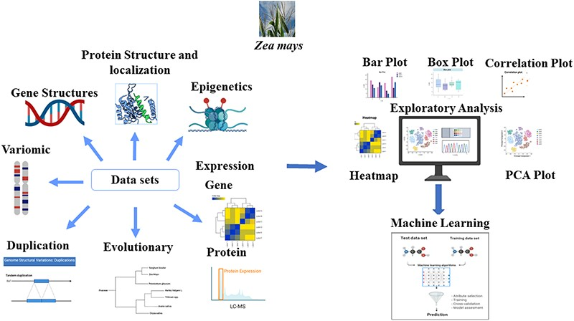
Figure 1. Module description: The MFS consists of three main modules: Features, Downstream Analysis, and Modeling. We ...
Notes:
Figure 1. Module description: The MFS consists of three main modules: Features, Downstream Analysis, and Modeling. We assembled the omics features associated with each gene model in Zea mays (B73v5) based on various sources as indicated by the ‘Data sets’ arrows of the figure. Many preliminary and advanced exploratory analyses can be performed on the generated features as indicated by the ‘Exploratory analysis’ module of the figure. Systematic evaluation of machine learning (ML) approaches is used in the Modeling section to solve complex biological problems, such as pan-genome prediction. The Graphical Overview was created using BioRender.com.
Unless provided in the caption above, the following copyright applies to the content of this slide: Published by Oxford University Press 2023. This work is written by (a) US Government employee(s) and is in the public domain in the US.This work is written by (a) US Government employee(s) and is in the public domain in the US.

