Slide 1
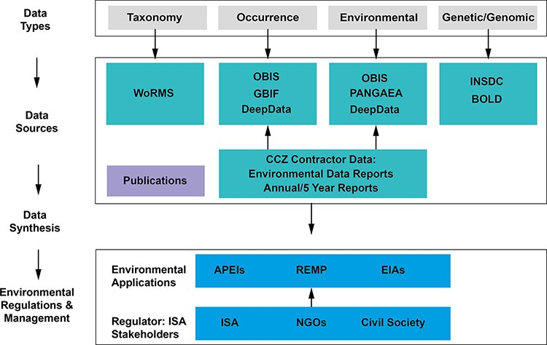
Figure 1. The Clarion-Clipperton Zone biodiversity data landscape, showing relevant key data types: taxonomy, ...
Notes:
Figure 1. The Clarion-Clipperton Zone biodiversity data landscape, showing relevant key data types: taxonomy, occurrence, environmental and genetic/genomic data; key data sources: databases, publications and contractor data; and how these data, once synthesized in publications and meta-analyses, could contribute to environmental management applications, with input by the regulator, the ISA and wider stakeholders. Key databases as listed: WoRMS, OBIS, GBIF, PANGAEA (Data Publisher for Earth & Environmental Science), INSDC and BOLD (Barcode Of Life Data System). Environmental applications: APEIs, REMP and EIAs (environmental impact assessments).
Unless provided in the caption above, the following copyright applies to the content of this slide: © The Author(s) 2023. Published by Oxford University Press.This is an Open Access article distributed under the terms of the Creative Commons Attribution License (https://creativecommons.org/licenses/by/4.0/), which permits unrestricted reuse, distribution, and reproduction in any medium, provided the original work is properly cited.

Slide 2
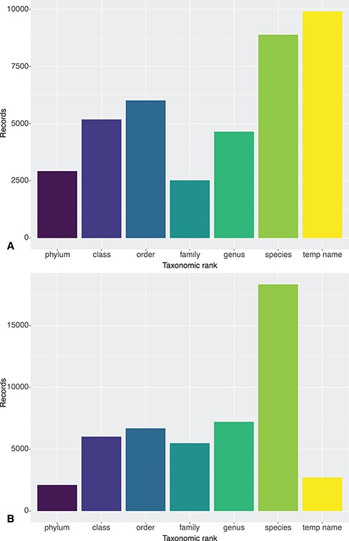
Figure 2. Taxonomic resolution of Clarion-Clipperton Zone DeepData records as published on 12 July 2021: (A) from ...
Notes:
Figure 2. Taxonomic resolution of Clarion-Clipperton Zone DeepData records as published on 12 July 2021: (A) from DeepData itself and (B) via the OBIS ISA node. The record sets primarily differ in the number of temporary name records (9936 on DeepData and 2715 on OBIS) and species-level records (8883 on DeepData and 18 329 on OBIS). These differences are the result of mismapping of DwC by the ISA Secretariat, discussed in section 4.5. Note that temporary names here may include names at levels higher than species, i.e. temporary/informal species names (morphospecies), and also temporary names for higher taxon ranks, e.g. undescribed genera and incomplete identifications using open nomenclature. See Rabone et al. (2022) (39) for further discussion of informal names.
Unless provided in the caption above, the following copyright applies to the content of this slide: © The Author(s) 2023. Published by Oxford University Press.This is an Open Access article distributed under the terms of the Creative Commons Attribution License (https://creativecommons.org/licenses/by/4.0/), which permits unrestricted reuse, distribution, and reproduction in any medium, provided the original work is properly cited.

Slide 3
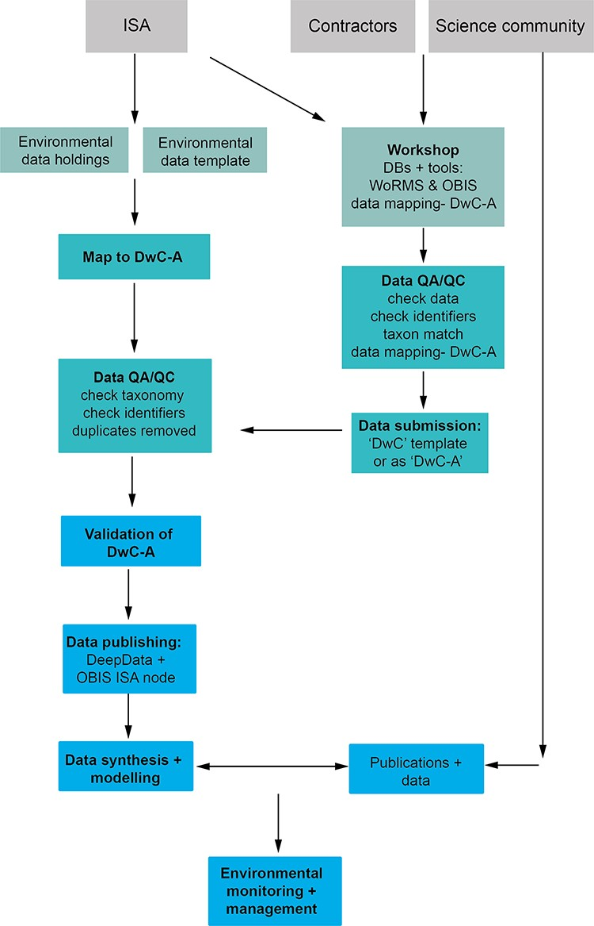
Figure 3. A proposed data management workflow for the ISA (processes shown in bold text). First, the current ...
Notes:
Figure 3. A proposed data management workflow for the ISA (processes shown in bold text). First, the current environmental contractor data template is replaced with a DwC compliant version with all fields (column headings) in DwC format, and contractors/data providers can alternatively submit data as a Darwin Core Archile (DwC-A) file. Existing environmental data holdings are remapped comprehensively to DwC terms as a batch process and undergo QA/QC prior to publication. Concurrently, a public workshop is delivered by the ISA with input from the contractors, the science community and other stakeholders (with full documentation available), covering DwC, databases, in particular WoRMS and OBIS, and tools such as taxon match in WoRMS and the GBIF DwC validator and assistant. Here, contractors undertake QA/QC checks and submit new data (in a new DwC compliant template or as a DwC-A). After QA/QC, datasets are published (as a DwC-A) on both DeepData and the OBIS ISA node. These data subsequently can be utilized for data synthesis and modelling and environmental policy applications.
Unless provided in the caption above, the following copyright applies to the content of this slide: © The Author(s) 2023. Published by Oxford University Press.This is an Open Access article distributed under the terms of the Creative Commons Attribution License (https://creativecommons.org/licenses/by/4.0/), which permits unrestricted reuse, distribution, and reproduction in any medium, provided the original work is properly cited.

Slide 4
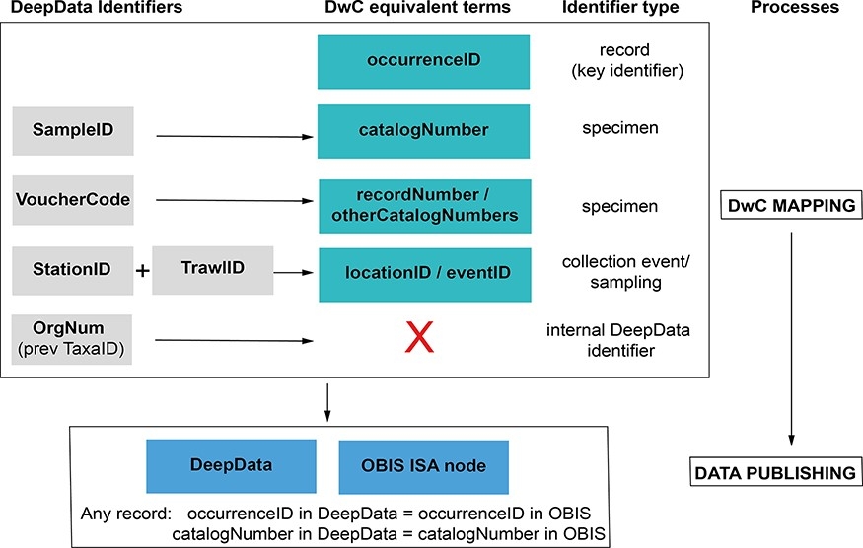
Figure 4. Identifier fields in DeepData, and recommended revision of usage and mapping to equivalent DwC terms. ...
Notes:
Figure 4. Identifier fields in DeepData, and recommended revision of usage and mapping to equivalent DwC terms. Currently, there is no unique record identifier (occurrenceID) in DeepData or a requirement to include one in the current (2022) environmental data template. This key identifier is needed for the data template, database export and within the database itself. SampleID, a specimen identifier, is currently the key identifier in DeepData and used as a proxy record identifier (although it is neither unique nor persistent) and currently mapped to occurrenceID (as recorded in the ISA DwC guidance; File S5B), but catalogNumber is in fact the equivalent DwC term. VoucherCode instead is currently mapped to catalogNumber but would be correctly mapped to recordNumber (or otherCatalogNumber). Many other non-identifier DeepData fields not shown could be better mapped to DwC terms with less ambiguity and more precision, for example ‘Morphotype’ in the template replaced with ‘taxonConceptID’ (see Recommendations: Darwin Core and usage of identifiers).
Unless provided in the caption above, the following copyright applies to the content of this slide: © The Author(s) 2023. Published by Oxford University Press.This is an Open Access article distributed under the terms of the Creative Commons Attribution License (https://creativecommons.org/licenses/by/4.0/), which permits unrestricted reuse, distribution, and reproduction in any medium, provided the original work is properly cited.

