Slide 1
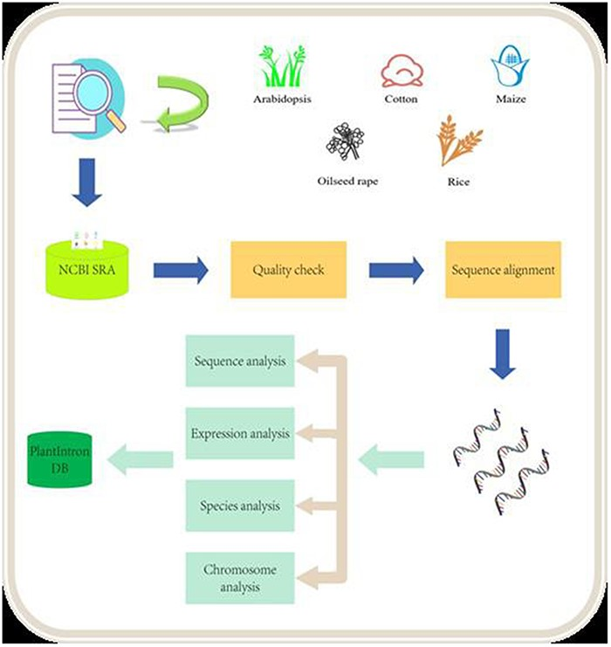
Figure 1. Data analysis pipeline. The raw data from NCB SRA were downloaded and processed after quality check. The ...
Notes:
Figure 1. Data analysis pipeline. The raw data from NCB SRA were downloaded and processed after quality check. The alignment data were then analyzed for identifying functional introns. The final results were deposited into the PlantIntronDB.
Unless provided in the caption above, the following copyright applies to the content of this slide: © The Author(s) 2023. Published by Oxford University Press.This is an Open Access article distributed under the terms of the Creative Commons Attribution License (https://creativecommons.org/licenses/by/4.0/), which permits unrestricted reuse, distribution, and reproduction in any medium, provided the original work is properly cited.

