Slide 1
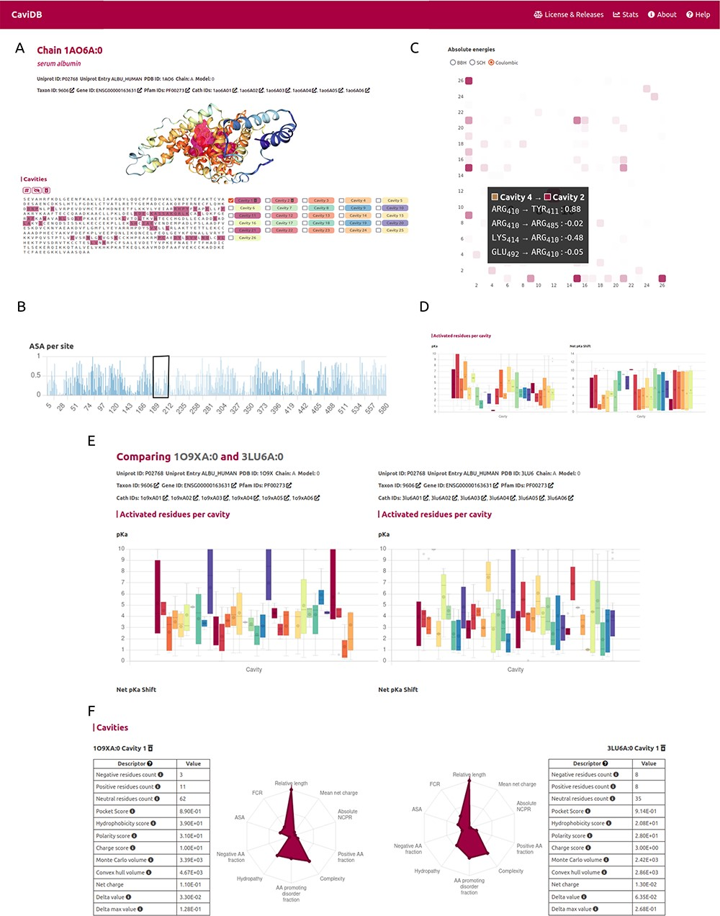
Figure 2. CaviDB display of HSA (PDB ID: 1AO6, chain: A, model: 0). (A) Display of protein and residues per cavity, ...
Notes:
Figure 2. CaviDB display of HSA (PDB ID: 1AO6, chain: A, model: 0). (A) Display of protein and residues per cavity, with Cavities 1 and 2 highlighted in the sequence (magenta and pink, respectively). (B) Bar plot of normalized accessible surface area per site. A box highlights a local minimum of ASA in the vicinity of Lys199. (C) Interactive heat map display of all possible pairwise contacts established between residues in different cavities. A popup window provides details on the absolute energies of the selected interaction. Heat map colors correspond to the number of interactions per cavity, the larger the interaction number is, the darker the color. (D) Boxplot distribution of pKa values (left) and pKa shifts (right) per residue in each detected cavity. (E) Comparison of HSA conformers with high RMSD. The panel shows important changes in acid–base properties in Cavity 1 resulting from the conformational changes (mean pKa = 3.99 in 3LU6_A vs. mean pKa = 5.16 in 1O9X_A), along with changes in other physicochemical features such as the number of charged amino acids, hydrophobicity and charge of residues (F).
Unless provided in the caption above, the following copyright applies to the content of this slide: © The Author(s) 2023. Published by Oxford University Press.This is an Open Access article distributed under the terms of the Creative Commons Attribution License (https://creativecommons.org/licenses/by/4.0/), which permits unrestricted reuse, distribution, and reproduction in any medium, provided the original work is properly cited.

