Slide 1
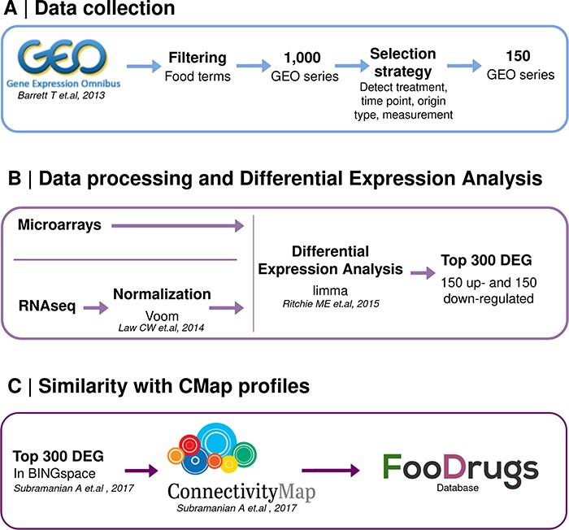
Figure 2. Schematic representation of the overall transcriptomic approach. (A) Data collection consists of the search ...
Notes:
Figure 2. Schematic representation of the overall transcriptomic approach. (A) Data collection consists of the search of food transcriptomic studies with food keywords. (B) Data processing and differential expression analysis are performed with limma to get 150 up- and down-regulated genes in food condition vs control. (C) Genes present in BING space sent to CMap to compute similarity scores with drug transcriptomic profiles.
Unless provided in the caption above, the following copyright applies to the content of this slide: © The Author(s) 2023. Published by Oxford University Press.This is an Open Access article distributed under the terms of the Creative Commons Attribution License (https://creativecommons.org/licenses/by/4.0/), which permits unrestricted reuse, distribution, and reproduction in any medium, provided the original work is properly cited.

