Slide 1
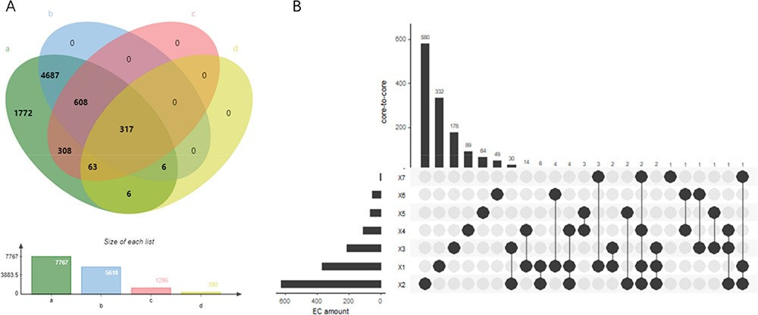
Figure 3. (A) Wynn diagram of four database coverage of EC number, a: sequence amount in UniProt, b: reaction amount in ...
Notes:
Figure 3. (A) Wynn diagram of four database coverage of EC number, a: sequence amount in UniProt, b: reaction amount in Rhea, c: family classification amount in PROSITE, d: 3D structure amount in Protein Data Bank. (B) The overall distribution of core-to-core across the seven types of enzyme.
Unless provided in the caption above, the following copyright applies to the content of this slide: © The Author(s) 2020. Published by Oxford University Press.This is an Open Access article distributed under the terms of the Creative Commons Attribution License (http://creativecommons.org/licenses/by/4.0/), which permits unrestricted reuse, distribution, and reproduction in any medium, provided the original work is properly cited.

