Slide 1
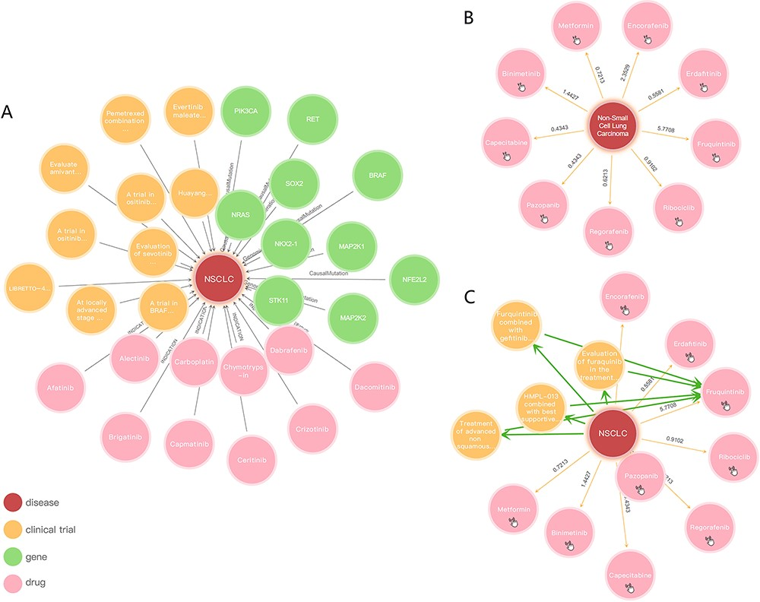
Figure 4. Knowledge graph presentation of NSCLC: (A) NSCLC relationships between genes, drugs and clinical trials, ...
Notes:
Figure 4. Knowledge graph presentation of NSCLC: (A) NSCLC relationships between genes, drugs and clinical trials, respectively; (B) inferred relationships of NSCLC; (C) reasoning between NSCLC and Fruquintinib.
Unless provided in the caption above, the following copyright applies to the content of this slide: © The Author(s) 2023. Published by Oxford University Press.This is an Open Access article distributed under the terms of the Creative Commons Attribution License (https://creativecommons.org/licenses/by/4.0/), which permits unrestricted reuse, distribution, and reproduction in any medium, provided the original work is properly cited.

