Slide 1
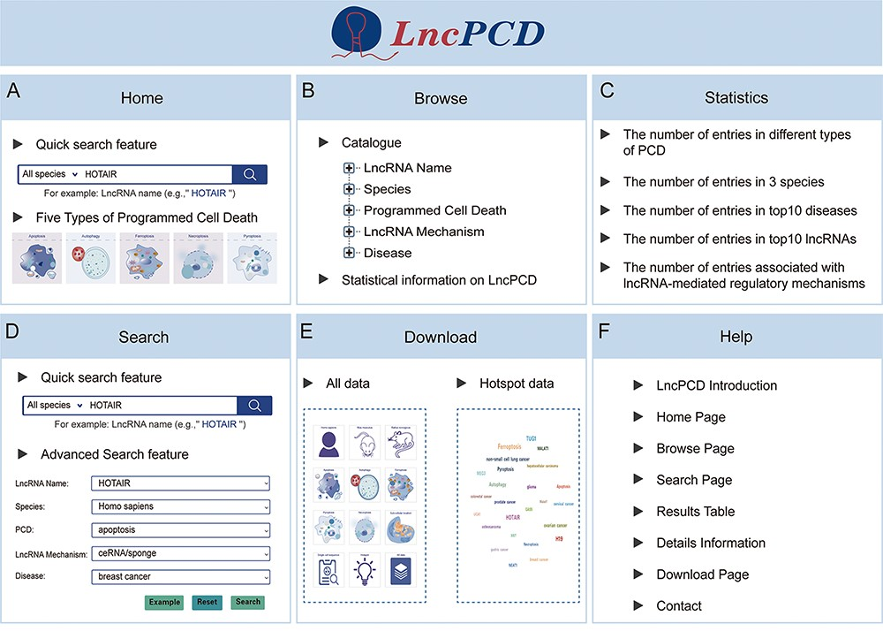
Figure 3. Overview of the LncPCD web interface. (A) Overview of the Home page. (B) Overview of the Browse page. (C) ...
Notes:
Figure 3. Overview of the LncPCD web interface. (A) Overview of the Home page. (B) Overview of the Browse page. (C) Overview of the Statistics page. (D) Overview of the Search page. (E) Overview of the Download page. (F) Overview of the Help page.
Unless provided in the caption above, the following copyright applies to the content of this slide: © The Author(s) 2023. Published by Oxford University Press.This is an Open Access article distributed under the terms of the Creative Commons Attribution License (https://creativecommons.org/licenses/by/4.0/), which permits unrestricted reuse, distribution, and reproduction in any medium, provided the original work is properly cited.

