Slide 1
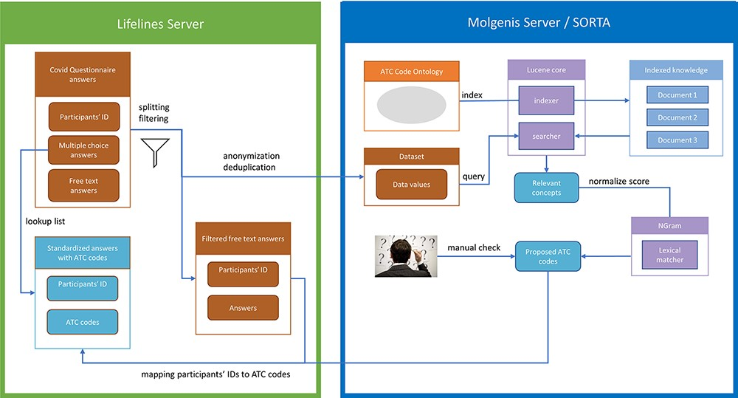
Figure 2. Process overview. Pre-processing and anonymization occurs on the Lifelines server. Actual mapping with SORTA ...
Notes:
Figure 2. Process overview. Pre-processing and anonymization occurs on the Lifelines server. Actual mapping with SORTA takes place on the Molgenis server. Finally, the results are mapped back using the pre-processed answers. Adapted from Pang et al., 2015 (9).
Unless provided in the caption above, the following copyright applies to the content of this slide: © The Author(s) 2023. Published by Oxford University Press.This is an Open Access article distributed under the terms of the Creative Commons Attribution License (https://creativecommons.org/licenses/by/4.0/), which permits unrestricted reuse, distribution, and reproduction in any medium, provided the original work is properly cited.

Slide 2
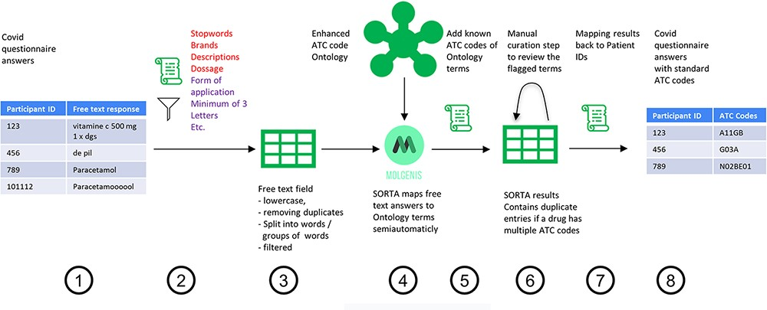
Figure 1. Process overview on how to get from the free-text answers to ATC codes. We pre-processed the COVID-19 ...
Notes:
Figure 1. Process overview on how to get from the free-text answers to ATC codes. We pre-processed the COVID-19 questionnaire answers (Step 1) by first removing participant IDs to anonymize the data, then removing duplicates and unnecessary information and splitting the answer into single terms (Step 2). The result is a list of slightly filtered, unique free-text answers (Step 3). Expert users can then use SORTA to assign ontology terms to each free-text answer (Step 4). Based on a confidence threshold, users can automatically accept assignments. The extended SORTA 2.0 user interface also has the option to flag terms for manual curation, to fix less confident assignments afterwards. After downloading SORTA results, a script can automatically assign the ATC codes (Step 5) to the ontology terms. The cases that could not be solved within SORTA and therefore were flagged for manual curation can be processed by a human expert (Step 6). After manual curation of the more complex cases, the final step (Step 7) recombines the ATC codes with the participant IDs to produce a table with participant IDs and corresponding medication’s standardized ATC code(s) (Step 8).
Unless provided in the caption above, the following copyright applies to the content of this slide: © The Author(s) 2023. Published by Oxford University Press.This is an Open Access article distributed under the terms of the Creative Commons Attribution License (https://creativecommons.org/licenses/by/4.0/), which permits unrestricted reuse, distribution, and reproduction in any medium, provided the original work is properly cited.

Slide 3
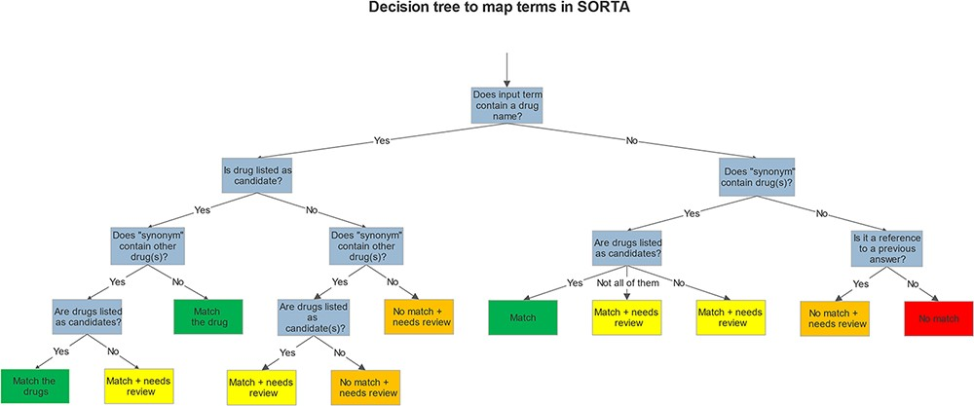
Figure 3. Decision tree shows how we mapped and flagged terms in SORTA.
Notes:
Figure 3. Decision tree shows how we mapped and flagged terms in SORTA.
Unless provided in the caption above, the following copyright applies to the content of this slide: © The Author(s) 2023. Published by Oxford University Press.This is an Open Access article distributed under the terms of the Creative Commons Attribution License (https://creativecommons.org/licenses/by/4.0/), which permits unrestricted reuse, distribution, and reproduction in any medium, provided the original work is properly cited.

Slide 4
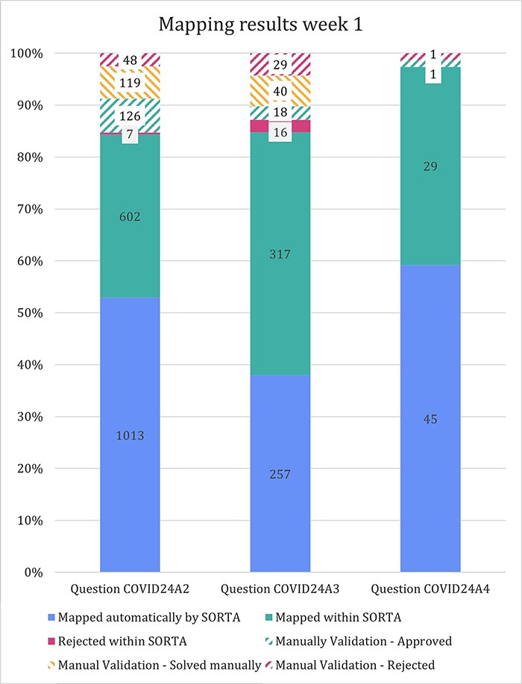
Figure 5. Stacked bar diagram showing the input terms of the first three free-text questions for the first week of ...
Notes:
Figure 5. Stacked bar diagram showing the input terms of the first three free-text questions for the first week of Lifeline’s COVID-19 questionnaire responses.
Unless provided in the caption above, the following copyright applies to the content of this slide: © The Author(s) 2023. Published by Oxford University Press.This is an Open Access article distributed under the terms of the Creative Commons Attribution License (https://creativecommons.org/licenses/by/4.0/), which permits unrestricted reuse, distribution, and reproduction in any medium, provided the original work is properly cited.

Slide 5
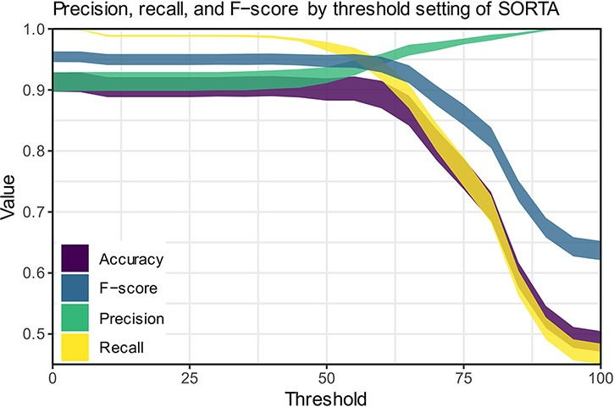
Figure 6. Precision, recall and F-scores for different threshold settings within SORTA. (Based on the automatic mapping ...
Notes:
Figure 6. Precision, recall and F-scores for different threshold settings within SORTA. (Based on the automatic mapping of the answers for question COVID24A2 by SORTA compared to manual curation).
Unless provided in the caption above, the following copyright applies to the content of this slide: © The Author(s) 2023. Published by Oxford University Press.This is an Open Access article distributed under the terms of the Creative Commons Attribution License (https://creativecommons.org/licenses/by/4.0/), which permits unrestricted reuse, distribution, and reproduction in any medium, provided the original work is properly cited.

Slide 6
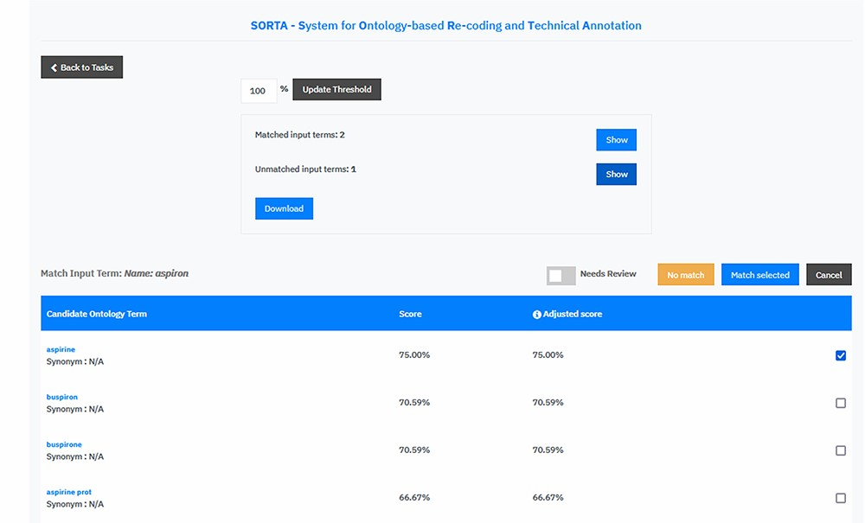
Figure 4. Screen capture of the SORTA 2.0 user interface. In contrast to the original version of SORTA, the SORTA 2.0 ...
Notes:
Figure 4. Screen capture of the SORTA 2.0 user interface. In contrast to the original version of SORTA, the SORTA 2.0 user interface allows users to map multiple terms at once and to flag a term for a manual review.
Unless provided in the caption above, the following copyright applies to the content of this slide: © The Author(s) 2023. Published by Oxford University Press.This is an Open Access article distributed under the terms of the Creative Commons Attribution License (https://creativecommons.org/licenses/by/4.0/), which permits unrestricted reuse, distribution, and reproduction in any medium, provided the original work is properly cited.

Slide 7
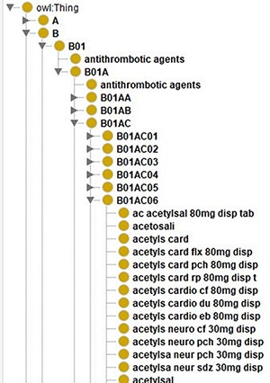
Figure 7. Screenshot of the class hierarchy of the ATC code ontology in Protégé (13). It shows that different names of ...
Notes:
Figure 7. Screenshot of the class hierarchy of the ATC code ontology in Protégé (13). It shows that different names of aspirin as leaves of the ATC code hierarchy’s tree structure.
Unless provided in the caption above, the following copyright applies to the content of this slide: © The Author(s) 2023. Published by Oxford University Press.This is an Open Access article distributed under the terms of the Creative Commons Attribution License (https://creativecommons.org/licenses/by/4.0/), which permits unrestricted reuse, distribution, and reproduction in any medium, provided the original work is properly cited.

