Slide 1
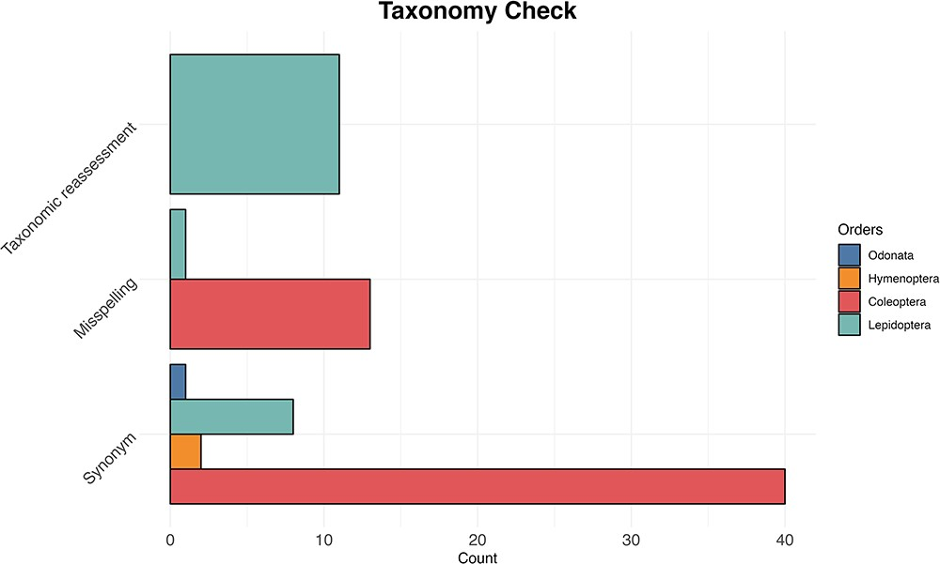
Figure 5. The bar plot shows for each examined taxon the count of the three most common reasons (synonyms, misspelling ...
Notes:
Figure 5. The bar plot shows for each examined taxon the count of the three most common reasons (synonyms, misspelling and taxonomic reassessment) for taxonomic discrepancy between the IUCN Red Lists and the reference taxonomy of GenBank and BOLD databases.
Unless provided in the caption above, the following copyright applies to the content of this slide: © The Author(s) 2024. Published by Oxford University Press.This is an Open Access article distributed under the terms of the Creative Commons Attribution License (https://creativecommons.org/licenses/by/4.0/), which permits unrestricted reuse, distribution, and reproduction in any medium, provided the original work is properly cited.

