Slide 1
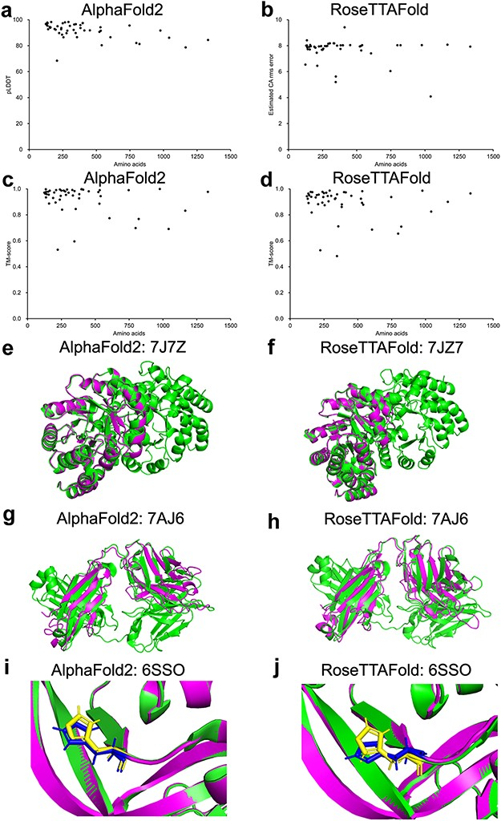
Figure 1. Model confidence profiling for validation genes. (a–d) The corresponding pLDDT (estimated CA rms error) and ...
Notes:
Figure 1. Model confidence profiling for validation genes. (a–d) The corresponding pLDDT (estimated CA rms error) and TM-score of each prediction generated by AlphaFold2 and RoseTTAFold were plotted. (e–h) Structural alignments of prediction of 7JZ7 and 7AJ6. (i–j) Similar geometry of the side chains of 6SSO.
Unless provided in the caption above, the following copyright applies to the content of this slide: © The Author(s) 2023. Published by Oxford University Press.This is an Open Access article distributed under the terms of the Creative Commons Attribution License (https://creativecommons.org/licenses/by/4.0/), which permits unrestricted reuse, distribution, and reproduction in any medium, provided the original work is properly cited.

