Slide 1
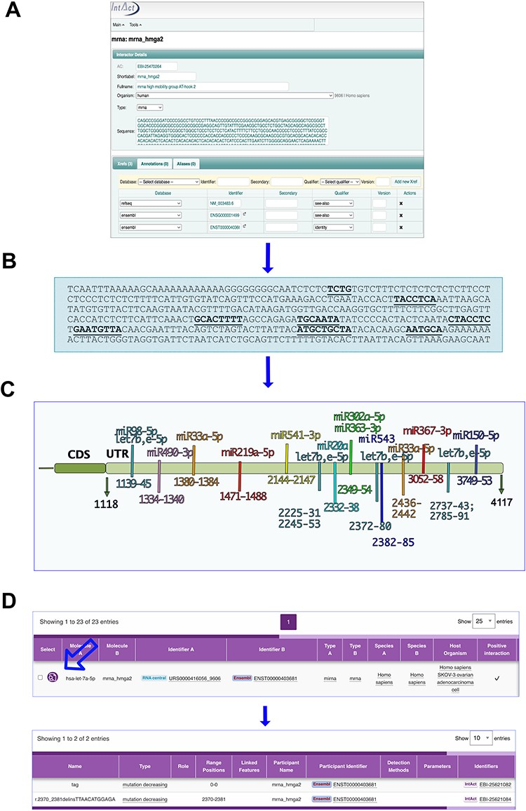
Figure 2. MicroRNA binding sites on mRNA_hmga2 entry. (A) and (B) The annotation process. (A) mRNA_hmga2 entry in ...
Notes:
Figure 2. MicroRNA binding sites on mRNA_hmga2 entry. (A) and (B) The annotation process. (A) mRNA_hmga2 entry in IntAct is annotated with the sequence and ID of the main transcript of the gene (identified by GIFT), together with the Ensembl gene ID and a RefSeq. (B) Mutations affecting the interactions are mapped on the transcript sequence. (C) Hmga2-3ʹUTR regions identified as necessary for the microRNA binding. (D) The interaction viewer in the webpage: the arrow indicates the lens to select to see the features.
Unless provided in the caption above, the following copyright applies to the content of this slide: © The Author(s) 2023. Published by Oxford University Press.This is an Open Access article distributed under the terms of the Creative Commons Attribution License (https://creativecommons.org/licenses/by/4.0/), which permits unrestricted reuse, distribution, and reproduction in any medium, provided the original work is properly cited.

Slide 2
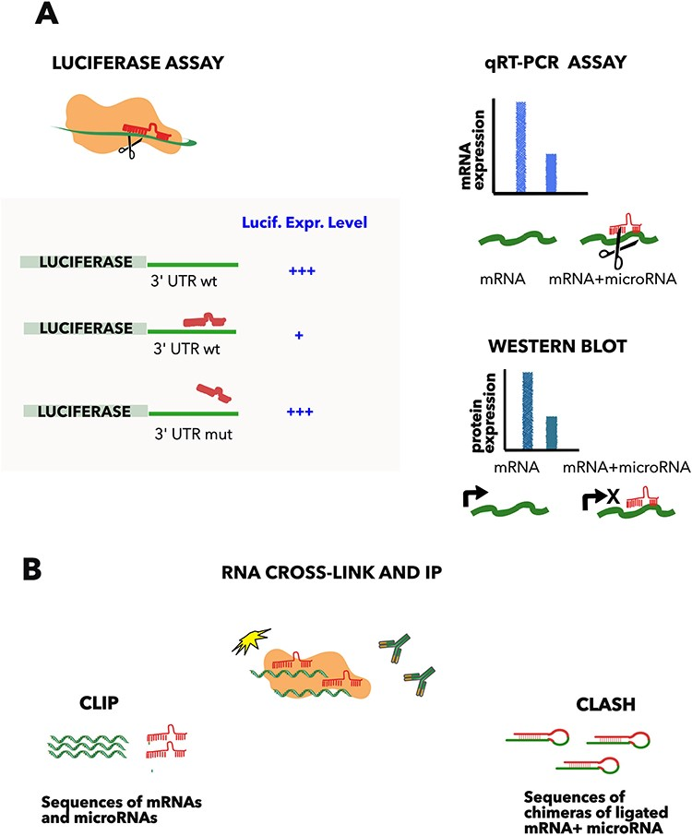
Figure 1. Methods commonly used to detect microRNA–mRNA interactions. (A) Luciferase assay comprises the fusion of the ...
Notes:
Figure 1. Methods commonly used to detect microRNA–mRNA interactions. (A) Luciferase assay comprises the fusion of the luciferase gene to the 3ʹ UTR of the microRNA target gene and the subsequent transfection of the construct with or without the microRNA. The approach demonstrates the direct interaction, compared to a mutated copy of the predicted complementary region, which acts as a negative control. Quantification of the mRNA (qRT-PCR) or protein level (western blot) helps to distinguish between the mRNA degradation and the translation inhibition, but is not proof of an interaction when used in isolation. (B) CLIP and CLASH. Cross-linking and immunoprecipitation of a RNA binding protein (such as AGO2), followed by RNA sequencing, allows the determination of all the RNAs bound to the protein. These approaches demonstrate direct RNA–RNA binding, if the two interacting RNAs are ligated in a hybrid before sequencing (CLASH (9)).
Unless provided in the caption above, the following copyright applies to the content of this slide: © The Author(s) 2023. Published by Oxford University Press.This is an Open Access article distributed under the terms of the Creative Commons Attribution License (https://creativecommons.org/licenses/by/4.0/), which permits unrestricted reuse, distribution, and reproduction in any medium, provided the original work is properly cited.

Slide 3
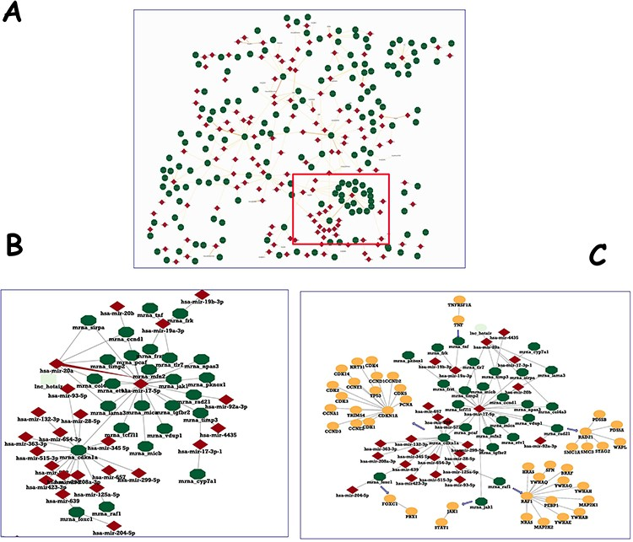
Figure 3. Human microRNA network in IntAct. (A) The section of the human microRNA network, showing hubs of both entry ...
Notes:
Figure 3. Human microRNA network in IntAct. (A) The section of the human microRNA network, showing hubs of both entry types. (B) Enlargement of a detail to show two nodes and their interactors. (C) PPI network for the genes targeted by hsa-mir-17-5p was downloaded and filtered to a molecular interaction (MI) score (24) of ⋝0.7 and merged with microRNA–mRNA interactions.
Unless provided in the caption above, the following copyright applies to the content of this slide: © The Author(s) 2023. Published by Oxford University Press.This is an Open Access article distributed under the terms of the Creative Commons Attribution License (https://creativecommons.org/licenses/by/4.0/), which permits unrestricted reuse, distribution, and reproduction in any medium, provided the original work is properly cited.

Slide 4
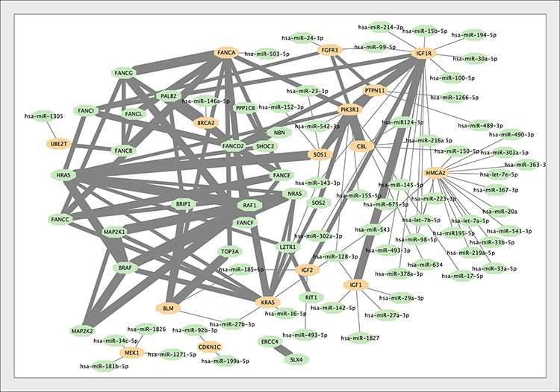
Figure 4. The interaction network of the genes associated with Growth Failure in Early Childhood (GFEC). Interactions ...
Notes:
Figure 4. The interaction network of the genes associated with Growth Failure in Early Childhood (GFEC). Interactions within proteins associated with GFEC merged into the microRNA–mRNA network. Proteins regulated by microRNAs are indicated. The thickness of the edge between proteins is proportional to the MI score (i.e. reliability) of the interaction (24).
Unless provided in the caption above, the following copyright applies to the content of this slide: © The Author(s) 2023. Published by Oxford University Press.This is an Open Access article distributed under the terms of the Creative Commons Attribution License (https://creativecommons.org/licenses/by/4.0/), which permits unrestricted reuse, distribution, and reproduction in any medium, provided the original work is properly cited.

Slide 5
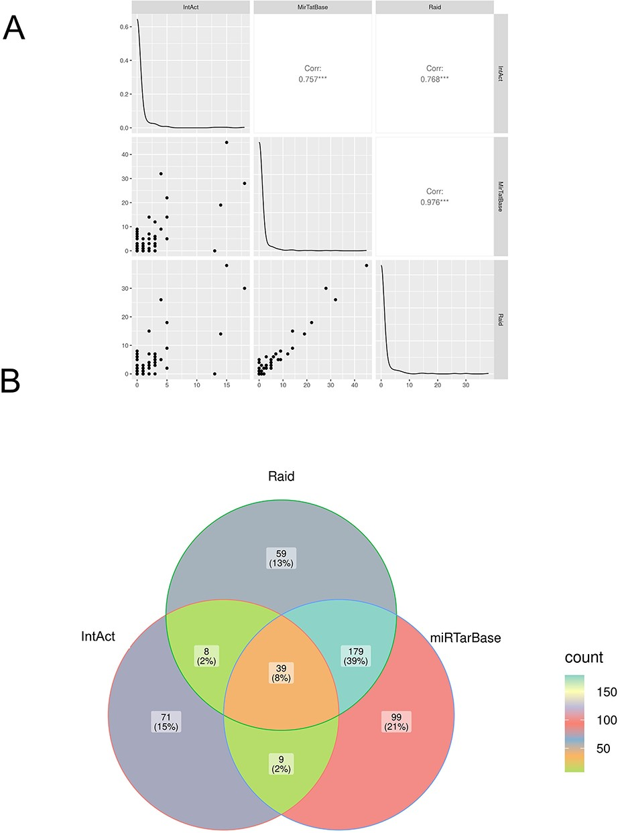
Figure 5. Comparison of microRNA–mRNA interactions annotated in IntAct, MirTarBase and RAID. (A) Correlation analysis: ...
Notes:
Figure 5. Comparison of microRNA–mRNA interactions annotated in IntAct, MirTarBase and RAID. (A) Correlation analysis: the number of microRNA-regulating genes associated with the diseases in the three datasets was compared (see also Supplementary Table 1). (B) Venn diagram comparing interacting pairs of microRNA–mRNA annotated in the three datasets. The Jaccard similarity coefficient (in parentheses) is calculated as intersection over union and indicates that only 8% of the interactions are annotated in all the datasets and that each resource contains some exclusive information.
Unless provided in the caption above, the following copyright applies to the content of this slide: © The Author(s) 2023. Published by Oxford University Press.This is an Open Access article distributed under the terms of the Creative Commons Attribution License (https://creativecommons.org/licenses/by/4.0/), which permits unrestricted reuse, distribution, and reproduction in any medium, provided the original work is properly cited.

