Slide 1
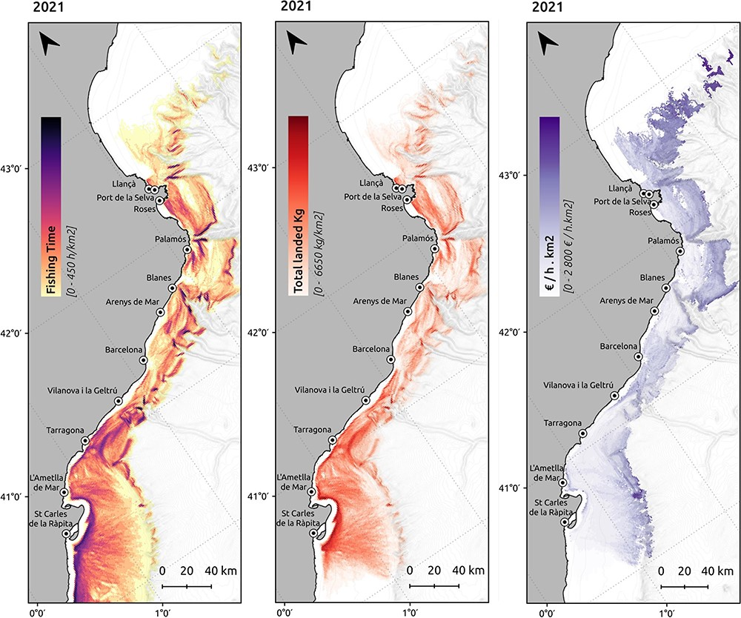
Figure 4. Spatial distribution of the fishing effort (h/km²), landings (km/km²) and revenues per ...
Notes:
Figure 4. Spatial distribution of the fishing effort (h/km2), landings (km/km2) and revenues per unit of effort (€/h· km2) produced by the bottom trawling fishing fleet in 2021.
Unless provided in the caption above, the following copyright applies to the content of this slide: © The Author(s) 2023. Published by Oxford University Press.This is an Open Access article distributed under the terms of the Creative Commons Attribution License (https://creativecommons.org/licenses/by/4.0/), which permits unrestricted reuse, distribution, and reproduction in any medium, provided the original work is properly cited.

