Slide 1
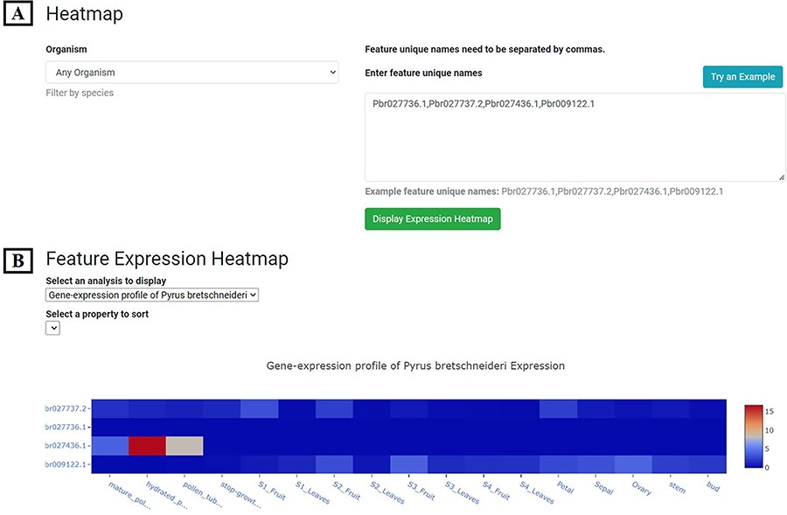
Figure 6. Expression Heatmap page. (A) The block for organism selection and gene id input. (B) Gene expression profile ...
Notes:
Figure 6. Expression Heatmap page. (A) The block for organism selection and gene id input. (B) Gene expression profile of example genes in 17 tissues or development stages of P. bretschneideri cv. ‘Dangshansuli’.
Unless provided in the caption above, the following copyright applies to the content of this slide: © The Author(s) 2023. Published by Oxford University Press.This is an Open Access article distributed under the terms of the Creative Commons Attribution License (https://creativecommons.org/licenses/by/4.0/), which permits unrestricted reuse, distribution, and reproduction in any medium, provided the original work is properly cited.

