Slide 1
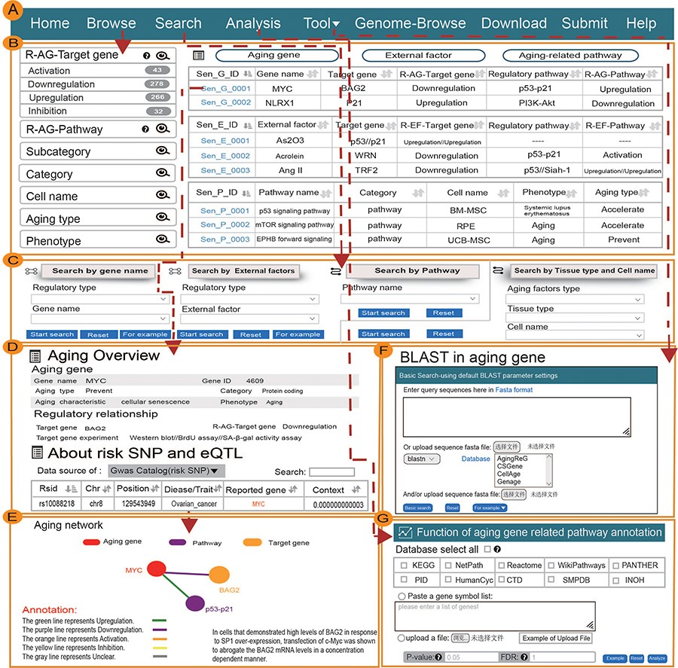
Figure 1. Main function and uses of AgingReG. (A) The top navigation bar helps users use the functions of AgingReG. (B) ...
Notes:
Figure 1. Main function and uses of AgingReG. (A) The top navigation bar helps users use the functions of AgingReG. (B) The snapshot showing the AgingReG browser. (C) Four paths enable searching of specific aging factors and related regulatory relationships. (D) The overview of the details of an aging gene. (E) Target genes potentially associated with aging genes are shown on the basis of five regulatory strategies. Network diagram showing gene–target relationships. (F) BLAST sequences of aging-related genes. (G) Functional annotation of the aging pathway of input data by the hypergeometric test.
Unless provided in the caption above, the following copyright applies to the content of this slide: © The Author(s) 2023. Published by Oxford University Press.This is an Open Access article distributed under the terms of the Creative Commons Attribution License (https://creativecommons.org/licenses/by/4.0/), which permits unrestricted reuse, distribution, and reproduction in any medium, provided the original work is properly cited.

