Slide 1
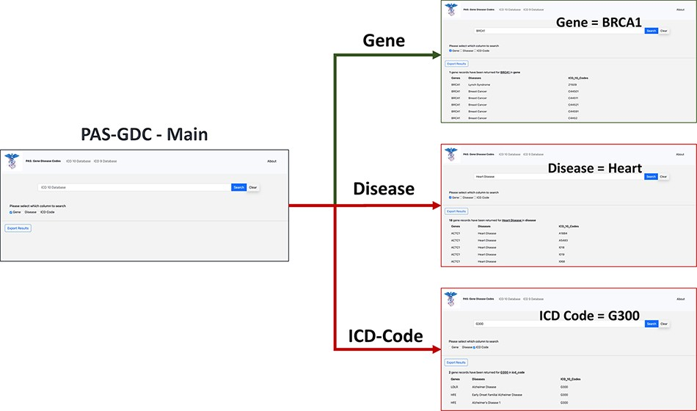
Figure 3. PAS-GDC graphical user interfaces workflow. PAS-GDC GUI includes Main, Gene, Disease and ICD Code (9 and 10) ...
Notes:
Figure 3. PAS-GDC graphical user interfaces workflow. PAS-GDC GUI includes Main, Gene, Disease and ICD Code (9 and 10) interfaces.
Unless provided in the caption above, the following copyright applies to the content of this slide: © The Author(s) 2023. Published by Oxford University Press.This is an Open Access article distributed under the terms of the Creative Commons Attribution License (https://creativecommons.org/licenses/by/4.0/), which permits unrestricted reuse, distribution, and reproduction in any medium, provided the original work is properly cited.

Slide 2
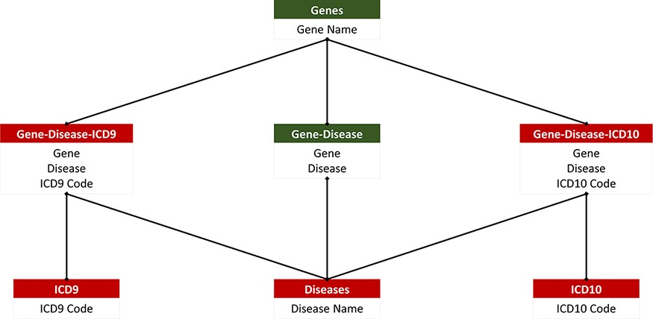
Figure 2. PAS-GDC relational database. PAS-GDC database includes six relations, genes, diseases, ICD9, ICD10, ...
Notes:
Figure 2. PAS-GDC relational database. PAS-GDC database includes six relations, genes, diseases, ICD9, ICD10, gene–disease, gene–disease–ICD-9 and gene–disease–ICD-10.
Unless provided in the caption above, the following copyright applies to the content of this slide: © The Author(s) 2023. Published by Oxford University Press.This is an Open Access article distributed under the terms of the Creative Commons Attribution License (https://creativecommons.org/licenses/by/4.0/), which permits unrestricted reuse, distribution, and reproduction in any medium, provided the original work is properly cited.

Slide 3
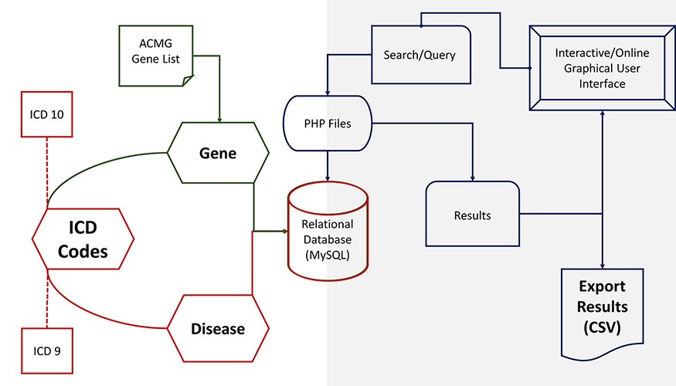
Figure 1. PAS-GDC components’ design, development and data flow. PAS-GDC is an online application developed using MySQL ...
Notes:
Figure 1. PAS-GDC components’ design, development and data flow. PAS-GDC is an online application developed using MySQL database, PHP scripting language and UNIX-based web and database servers.
Unless provided in the caption above, the following copyright applies to the content of this slide: © The Author(s) 2023. Published by Oxford University Press.This is an Open Access article distributed under the terms of the Creative Commons Attribution License (https://creativecommons.org/licenses/by/4.0/), which permits unrestricted reuse, distribution, and reproduction in any medium, provided the original work is properly cited.

Slide 4
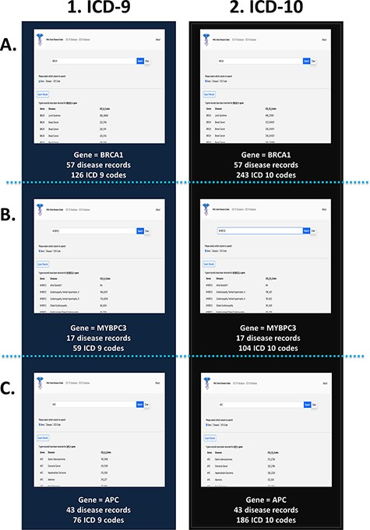
Figure 4. PAS-GDC use case—gene. This figure presents three different case studies exploring the ‘gene’ search feature: ...
Notes:
Figure 4. PAS-GDC use case—gene. This figure presents three different case studies exploring the ‘gene’ search feature: BRCA1 (A), MYBPC3 (B) and APC (C).
Unless provided in the caption above, the following copyright applies to the content of this slide: © The Author(s) 2023. Published by Oxford University Press.This is an Open Access article distributed under the terms of the Creative Commons Attribution License (https://creativecommons.org/licenses/by/4.0/), which permits unrestricted reuse, distribution, and reproduction in any medium, provided the original work is properly cited.

Slide 5
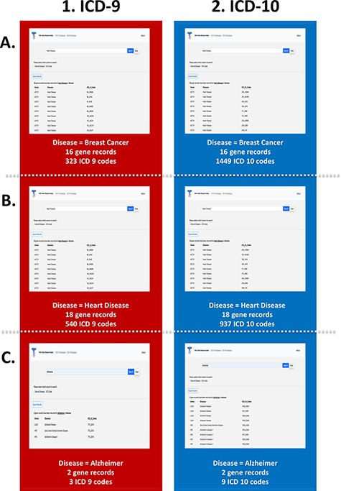
Figure 5. PAS-GDC use case—disease. This figure presents three different case studies exploring the ‘disease’ search ...
Notes:
Figure 5. PAS-GDC use case—disease. This figure presents three different case studies exploring the ‘disease’ search feature: breast cancer (A), heart disease (B), and Alzheimer’s disease (C).
Unless provided in the caption above, the following copyright applies to the content of this slide: © The Author(s) 2023. Published by Oxford University Press.This is an Open Access article distributed under the terms of the Creative Commons Attribution License (https://creativecommons.org/licenses/by/4.0/), which permits unrestricted reuse, distribution, and reproduction in any medium, provided the original work is properly cited.

Slide 6
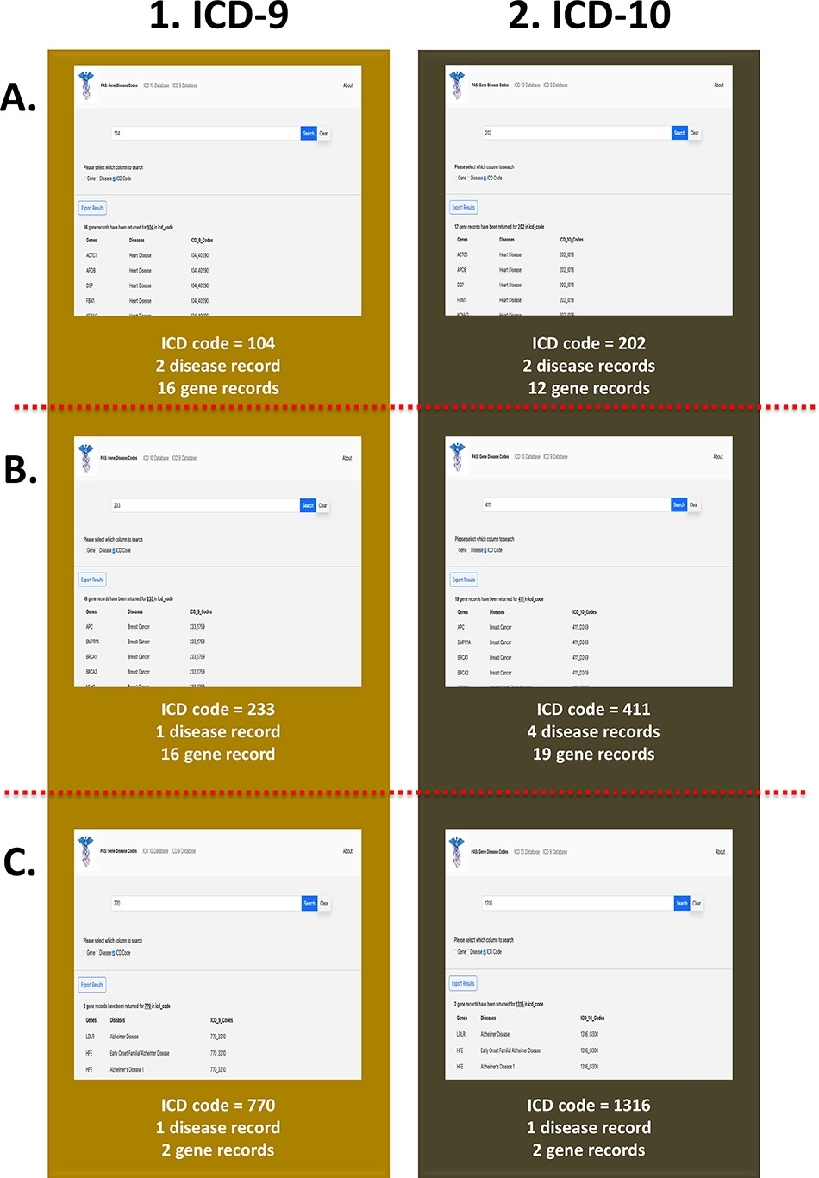
Figure 6. PAS-GDC use case—ICD code. This figure presents three different case studies exploring ICD-9 and ICD-10 ...
Notes:
Figure 6. PAS-GDC use case—ICD code. This figure presents three different case studies exploring ICD-9 and ICD-10 codes. (A) The results for ICD-9 and ICD-10 codes starting with ‘104’ and ‘202’, respectively. (B) The results for ICD-9 and ICD-10 codes starting with ‘233’ and ‘411’, respectively. (C) The results for ICD-9 and ICD-10 codes starting with ‘770’ and ‘1316’, respectively.
Unless provided in the caption above, the following copyright applies to the content of this slide: © The Author(s) 2023. Published by Oxford University Press.This is an Open Access article distributed under the terms of the Creative Commons Attribution License (https://creativecommons.org/licenses/by/4.0/), which permits unrestricted reuse, distribution, and reproduction in any medium, provided the original work is properly cited.

