Slide 1
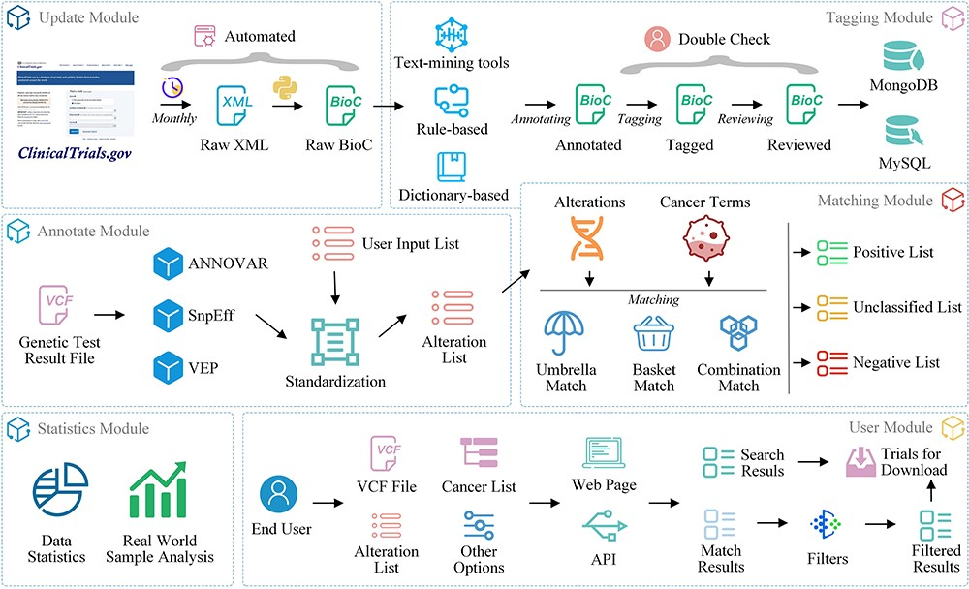
Figure 2. OncoCTMiner modules.
Notes:
Figure 2. OncoCTMiner modules. OncoCTMiner consists of several modules: 1) The update module downloads XML-formatted trial data and parses them into BioC-JSON format on a monthly basis; 2) The tagging module identifies bio-concepts using NLP-based tools with double-checking by biomedical professionals to construct the clinical trial eligibility database; 3) The annotation module assists in annotating genetic alterations detected from patient tumors; 4) The matching module utilizes cancer terms and the annotated alterations as key criteria for clinical trial matching; 5) The statistics module provides various statistical analyses of the clinical trial data; and 6) the user module allows users to interact with the system and perform various tasks.
Unless provided in the caption above, the following copyright applies to the content of this slide: © The Author(s) 2023. Published by Oxford University Press.This is an Open Access article distributed under the terms of the Creative Commons Attribution License (https://creativecommons.org/licenses/by/4.0/), which permits unrestricted reuse, distribution, and reproduction in any medium, provided the original work is properly cited.

