Slide 1
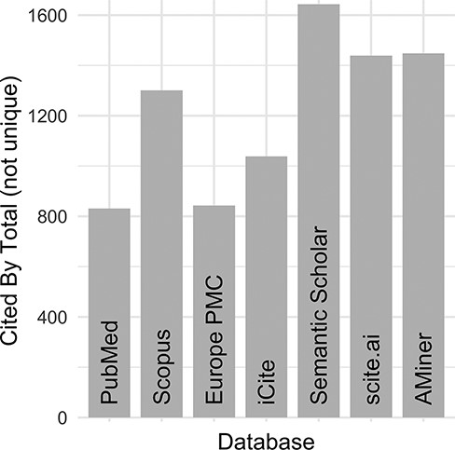
Figure 2. DO official publication ‘cited by’ counts. The total number of citations to each of the DO official ...
Notes:
Figure 2. DO official publication ‘cited by’ counts. The total number of citations to each of the DO official publications published by 2021 (total = 8, https://disease-ontology.org/community/publications) were manually obtained online from each provider in August 2021. Publications from Web of Science were excluded because the University of Maryland School of Medicine does not have institutional access.
Unless provided in the caption above, the following copyright applies to the content of this slide: © The Author(s) 2023. Published by Oxford University Press.This is an Open Access article distributed under the terms of the Creative Commons Attribution License (https://creativecommons.org/licenses/by/4.0/), which permits unrestricted reuse, distribution, and reproduction in any medium, provided the original work is properly cited.

Slide 2
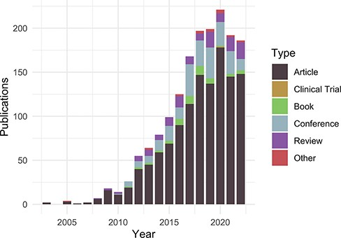
Figure 1. Publications citing the DO each year from PubMed and Scopus organized by publication type ...
Notes:
Figure 1. Publications citing the DO each year from PubMed and Scopus organized by publication type (https://disease-ontology.org/about/pubs_by_year). ‘Other’ publications include a small number of preprints indexed in PubMed and Scopus. The slight downward trend from 2020 to 2022 reflects a spike in publications due to COVID (2020) and incomplete publication information (2022). In November 2022, there were 1659 total unique citations to one or more of DO’s official publications.
Unless provided in the caption above, the following copyright applies to the content of this slide: © The Author(s) 2023. Published by Oxford University Press.This is an Open Access article distributed under the terms of the Creative Commons Attribution License (https://creativecommons.org/licenses/by/4.0/), which permits unrestricted reuse, distribution, and reproduction in any medium, provided the original work is properly cited.

Slide 3
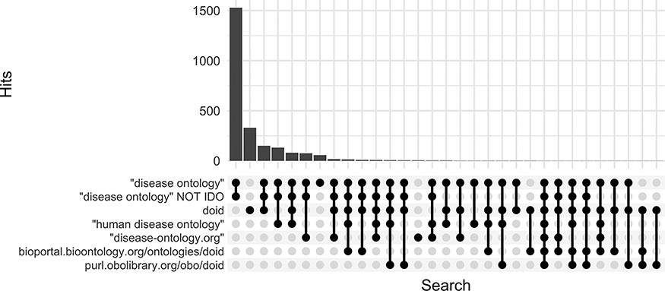
Figure 3. Comparison of keyword search hits at Europe PMC using the ‘europepmc’ R package (completed 9 November 2022).
Notes:
Figure 3. Comparison of keyword search hits at Europe PMC using the ‘europepmc’ R package (completed 9 November 2022).
Unless provided in the caption above, the following copyright applies to the content of this slide: © The Author(s) 2023. Published by Oxford University Press.This is an Open Access article distributed under the terms of the Creative Commons Attribution License (https://creativecommons.org/licenses/by/4.0/), which permits unrestricted reuse, distribution, and reproduction in any medium, provided the original work is properly cited.

Slide 4
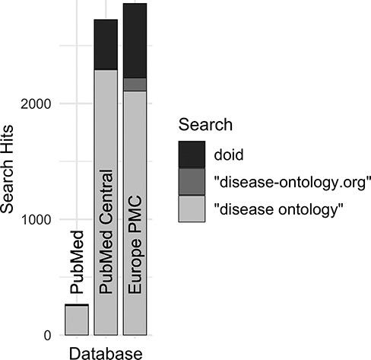
Figure 4. Comparison of search hits at different publication databases for the three keyword searches with the greatest ...
Notes:
Figure 4. Comparison of search hits at different publication databases for the three keyword searches with the greatest number of hits at Europe PMC. These case-insensitive searches identify mentions of DO’s specific identifier, the official website or the ontology itself without ‘Human’, which is often left out by users.
Unless provided in the caption above, the following copyright applies to the content of this slide: © The Author(s) 2023. Published by Oxford University Press.This is an Open Access article distributed under the terms of the Creative Commons Attribution License (https://creativecommons.org/licenses/by/4.0/), which permits unrestricted reuse, distribution, and reproduction in any medium, provided the original work is properly cited.

Slide 5
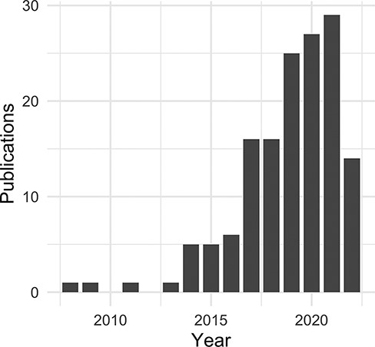
Figure 5. Non-coding RNA publications citing the DO by year.
Notes:
Figure 5. Non-coding RNA publications citing the DO by year.
Unless provided in the caption above, the following copyright applies to the content of this slide: © The Author(s) 2023. Published by Oxford University Press.This is an Open Access article distributed under the terms of the Creative Commons Attribution License (https://creativecommons.org/licenses/by/4.0/), which permits unrestricted reuse, distribution, and reproduction in any medium, provided the original work is properly cited.

