Slide 1
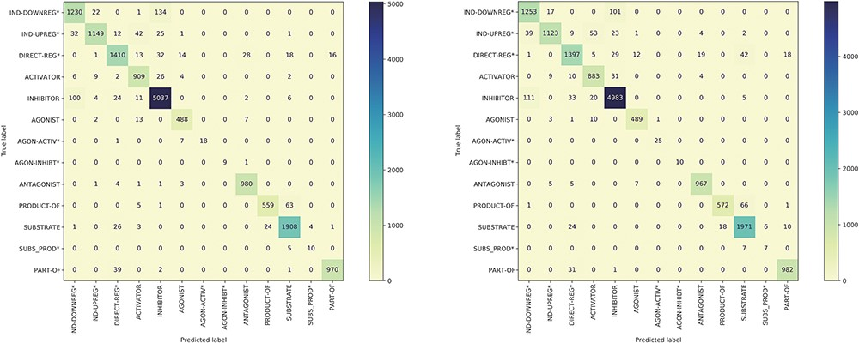
Figure 5. The confusion matrix of the model trained using the BC7DP dataset (left) and our proposed method (right) on ...
Notes:
Figure 5. The confusion matrix of the model trained using the BC7DP dataset (left) and our proposed method (right) on the development dataset.
Unless provided in the caption above, the following copyright applies to the content of this slide: © The Author(s) 2023. Published by Oxford University Press.This is an Open Access article distributed under the terms of the Creative Commons Attribution License (https://creativecommons.org/licenses/by/4.0/), which permits unrestricted reuse, distribution, and reproduction in any medium, provided the original work is properly cited.

