Slide 1
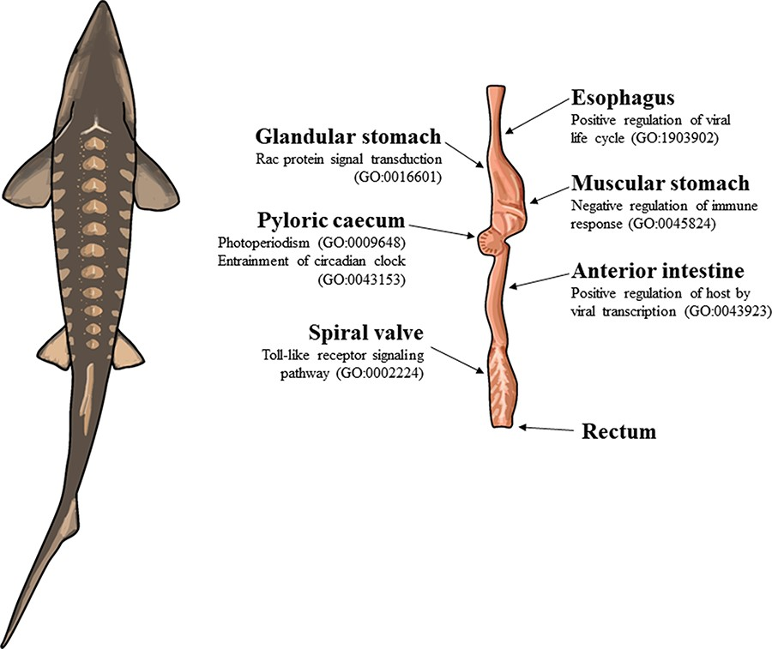
Figure 1. The illustration of a lake sturgeon (Acipenser fulvescens) and the gut tissues used for transcriptome ...
Notes:
Figure 1. The illustration of a lake sturgeon (Acipenser fulvescens) and the gut tissues used for transcriptome assemblies in the present study. Beneath most gut tissues are representative, significant (q < 0.05), GO terms unique to the tissue identified with enrichR. The GO terms present in the esophagus, glandular stomach, muscular stomach, anterior intestine and spiral valve represent possible innate immune system processes specific to each gut tissue in the present transcriptomes. The GO terms present in the pyloric cecum were processes related to circadian rhythms, unique to the tissue among the transcriptomes analyzed.
Unless provided in the caption above, the following copyright applies to the content of this slide: © The Author(s) 2023. Published by Oxford University Press.This is an Open Access article distributed under the terms of the Creative Commons Attribution License (https://creativecommons.org/licenses/by/4.0/), which permits unrestricted reuse, distribution, and reproduction in any medium, provided the original work is properly cited.

Slide 2
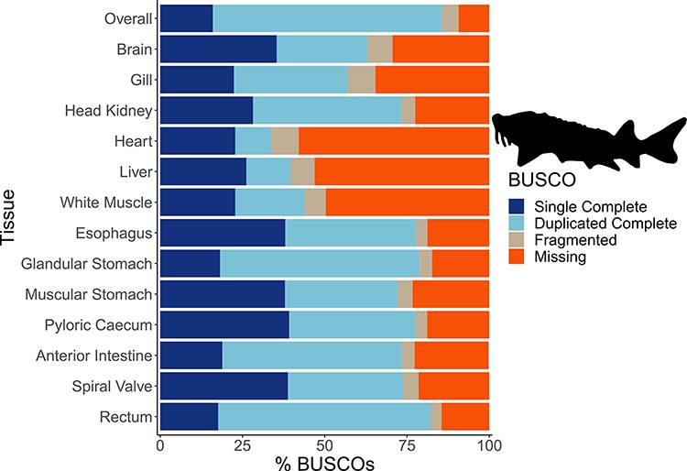
Figure 2. The transcriptome completeness assessed with BUSCO. Single complete represents orthologs that were present ...
Notes:
Figure 2. The transcriptome completeness assessed with BUSCO. Single complete represents orthologs that were present singly in a transcriptome, while duplicated complete represents orthologs duplicated in the transcriptome that matched the BUSCO profile. Fragmented orthologs were present in the transcriptomes, but not within the expected range of alignments in the BUSCO profile. Missing orthologs were those present in the BUSCO profile but missing in the transcriptome completely. The tissue-specific transcriptomes are labeled by tissue, while the transcriptome labeled ‘Overall’ refers to an assembly that included all data from the 13 tissues. The BUSCO profile used in the present analysis was the Actinopterygii odb10 dataset. The lake sturgeon icon and colors used were from the fishualize package in R.
Unless provided in the caption above, the following copyright applies to the content of this slide: © The Author(s) 2023. Published by Oxford University Press.This is an Open Access article distributed under the terms of the Creative Commons Attribution License (https://creativecommons.org/licenses/by/4.0/), which permits unrestricted reuse, distribution, and reproduction in any medium, provided the original work is properly cited.

Slide 3
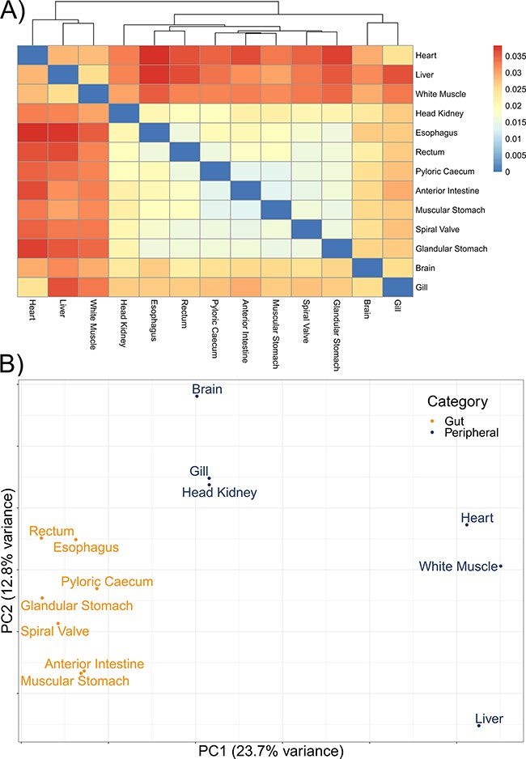
Figure 3. The divergence among 13 tissue-specific transcriptomes of the lake sturgeon (Acipenser fulvescens). (A) A ...
Notes:
Figure 3. The divergence among 13 tissue-specific transcriptomes of the lake sturgeon (Acipenser fulvescens). (A) A heatmap of pairwise distances between transcriptomes assessed with Mash, where higher Mash distances correspond to greater evolutionary divergence between the transcriptomes. Because no evolutionary divergence is expected for transcriptomes from one population of one species, these distances represent isoforms and paralogs of gene models. Higher values indicate more divergence. (B) A PCA of the present and absent genes in the 13 transcriptomes, performed with prcomp in R. Gut and peripheral tissues were distinguished for visualization, where gut tissues were the esophagus, glandular stomach, muscular stomach, anterior intestine, spiral valve and rectum, while peripheral tissues were the brain, gill, head kidney, heart, white muscle and liver. The distinction in color between gut and peripheral tissues is only for visualization and was not used to categorize data a priori in the PCA.
Unless provided in the caption above, the following copyright applies to the content of this slide: © The Author(s) 2023. Published by Oxford University Press.This is an Open Access article distributed under the terms of the Creative Commons Attribution License (https://creativecommons.org/licenses/by/4.0/), which permits unrestricted reuse, distribution, and reproduction in any medium, provided the original work is properly cited.

Slide 4
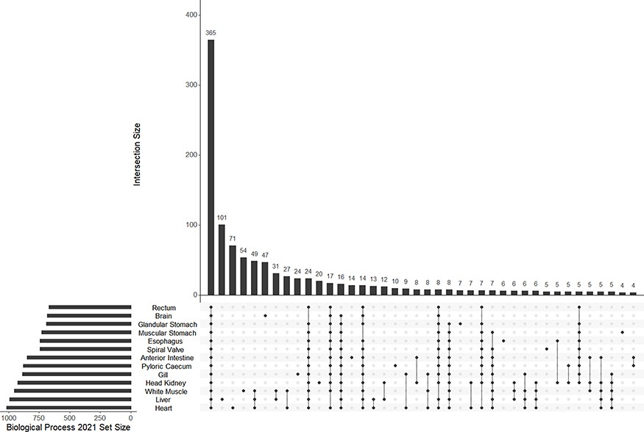
Figure 4. The UpSet plot of shared and unique GO terms from each of 13 tissue-specific transcriptomes of the lake ...
Notes:
Figure 4. The UpSet plot of shared and unique GO terms from each of 13 tissue-specific transcriptomes of the lake sturgeon (Acipenser fulvescens). The GO terms presented here are from the Biological Process 2021 database, significant at q < 0.05. The R package UpSetR was used to visualize these data.
Unless provided in the caption above, the following copyright applies to the content of this slide: © The Author(s) 2023. Published by Oxford University Press.This is an Open Access article distributed under the terms of the Creative Commons Attribution License (https://creativecommons.org/licenses/by/4.0/), which permits unrestricted reuse, distribution, and reproduction in any medium, provided the original work is properly cited.

Slide 5
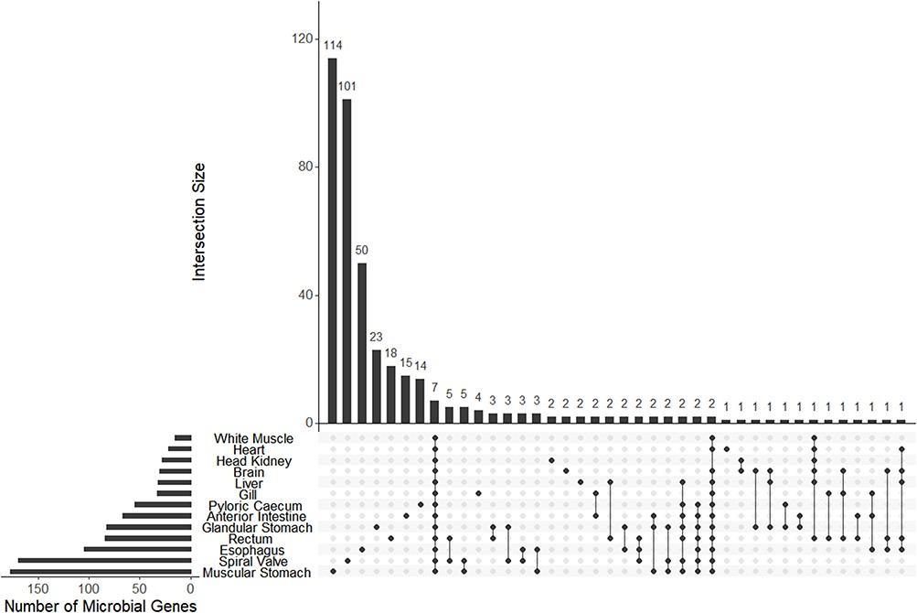
Figure 5. The UpSet plot of shared and unique genes annotated to microbes (bacteria or archaea) from each of 13 ...
Notes:
Figure 5. The UpSet plot of shared and unique genes annotated to microbes (bacteria or archaea) from each of 13 tissue-specific transcriptomes of the lake sturgeon (Acipenser fulvescens). Annotations were performed with Trinotate, and bacterial or archaeal genes were identified by filtering for those groups among filtered transcriptome annotation reports.
Unless provided in the caption above, the following copyright applies to the content of this slide: © The Author(s) 2023. Published by Oxford University Press.This is an Open Access article distributed under the terms of the Creative Commons Attribution License (https://creativecommons.org/licenses/by/4.0/), which permits unrestricted reuse, distribution, and reproduction in any medium, provided the original work is properly cited.

