Slide 1
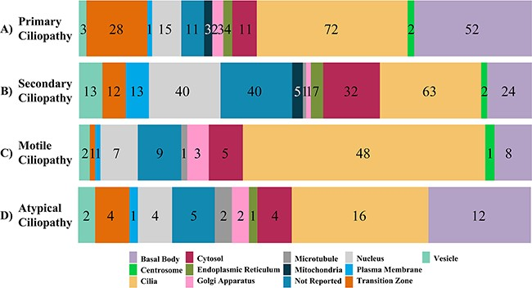
Figure 2. The subcellular localization of ciliopathy disease genes within cells is displayed. Numbers in the bar graph ...
Notes:
Figure 2. The subcellular localization of ciliopathy disease genes within cells is displayed. Numbers in the bar graph demonstrate how the proteins encoded by the primary, secondary and atypical ciliopathies-causing genes are localized throughout the cell.
Unless provided in the caption above, the following copyright applies to the content of this slide: © The Author(s) 2023. Published by Oxford University Press.This is an Open Access article distributed under the terms of the Creative Commons Attribution License (https://creativecommons.org/licenses/by/4.0/), which permits unrestricted reuse, distribution, and reproduction in any medium, provided the original work is properly cited.

Slide 2
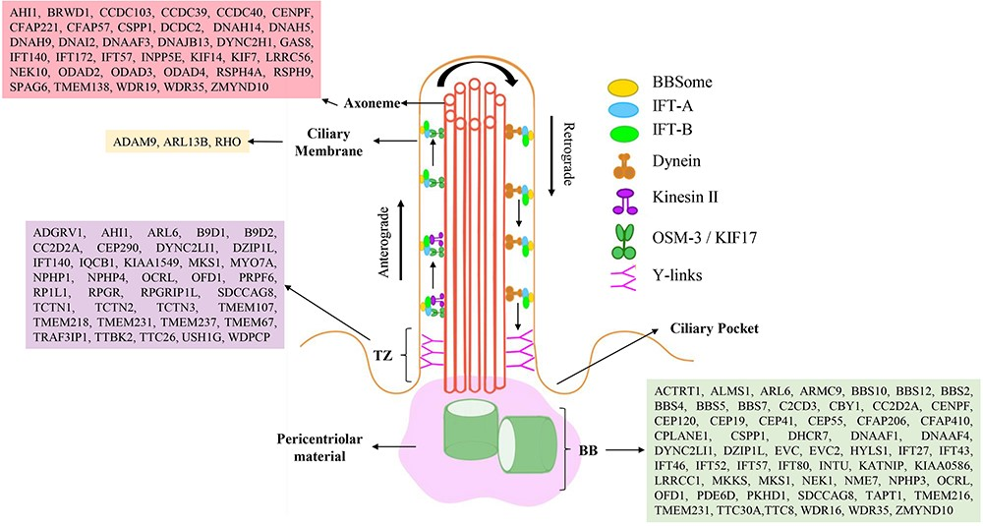
Figure 1. The primary cilium is depicted, with a 9 + 0 microtubular axoneme surrounded by a ciliary membrane. Two ...
Notes:
Figure 1. The primary cilium is depicted, with a 9 + 0 microtubular axoneme surrounded by a ciliary membrane. Two ciliary subcompartments, including the basal body (BB) and transition zone (Y-shaped linkers) are shown. Intraflagellar transport (IFT), including motor proteins (kinesin and dynein), IFT-A, IFT-B and Bardet-Biedl syndrome proteins (BBSome) move in both directions (anterograde and retrograde) along cilia. Ciliary localization of proteins encoded by primary and secondary ciliopathy-causing genes is shown in a representative cilia structure.
Unless provided in the caption above, the following copyright applies to the content of this slide: © The Author(s) 2023. Published by Oxford University Press.This is an Open Access article distributed under the terms of the Creative Commons Attribution License (https://creativecommons.org/licenses/by/4.0/), which permits unrestricted reuse, distribution, and reproduction in any medium, provided the original work is properly cited.

Slide 3
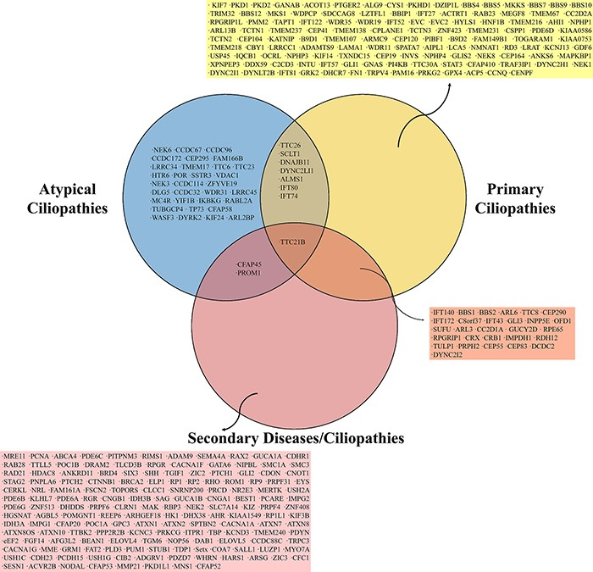
Figure 3. The Venn diagram shows shared genes among ciliopathy-related genes of primary, secondary and atypical ...
Notes:
Figure 3. The Venn diagram shows shared genes among ciliopathy-related genes of primary, secondary and atypical ciliopathies.
Unless provided in the caption above, the following copyright applies to the content of this slide: © The Author(s) 2023. Published by Oxford University Press.This is an Open Access article distributed under the terms of the Creative Commons Attribution License (https://creativecommons.org/licenses/by/4.0/), which permits unrestricted reuse, distribution, and reproduction in any medium, provided the original work is properly cited.

Slide 4
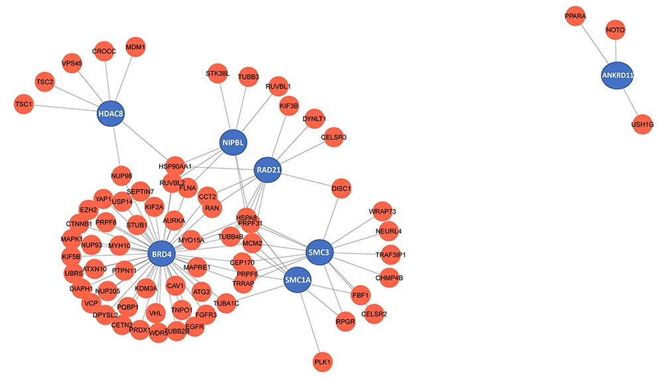
Figure 4. Genes that cause Cornelia de Lange syndrome (CdLS) were analysed using a network. Red represents the ciliary ...
Notes:
Figure 4. Genes that cause Cornelia de Lange syndrome (CdLS) were analysed using a network. Red represents the ciliary genes, while blue points CdLS associated genes.
Unless provided in the caption above, the following copyright applies to the content of this slide: © The Author(s) 2023. Published by Oxford University Press.This is an Open Access article distributed under the terms of the Creative Commons Attribution License (https://creativecommons.org/licenses/by/4.0/), which permits unrestricted reuse, distribution, and reproduction in any medium, provided the original work is properly cited.

