Slide 1
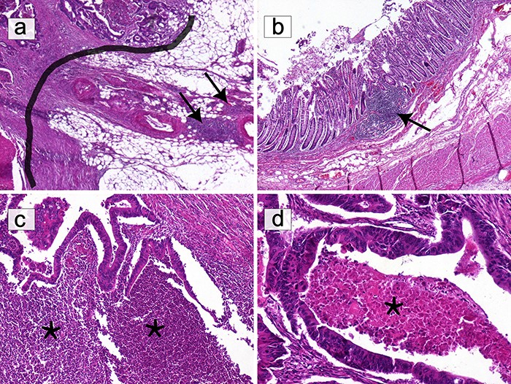
Figure 3. Selection of areas for T-cell quantification on HE slides. (a) Only T lymphocytes in direct contact with the ...
Notes:
Figure 3. Selection of areas for T-cell quantification on HE slides. (a) Only T lymphocytes in direct contact with the IM (black border) were quantified. Lymphocytic infiltration beyond the IM, including lymphoid nodules (black arrows), was excluded (HE ×40). (b) Submucosal lymphoid follicles (black arrows) were not included in the count (HE ×40). (c) The infiltrate composed of granulocytes in abscessed areas (*) was not considered (HE ×100). (d) Areas of ‘necrosis’ (*) were not taken into consideration (HE ×200). Alt text: HE slides highlighting areas to select or avoid for T-cell quantification.
Unless provided in the caption above, the following copyright applies to the content of this slide: © The Author(s) 2023. Published by Oxford University Press.This is an Open Access article distributed under the terms of the Creative Commons Attribution License (https://creativecommons.org/licenses/by/4.0/), which permits unrestricted reuse, distribution, and reproduction in any medium, provided the original work is properly cited.

