Slide 1
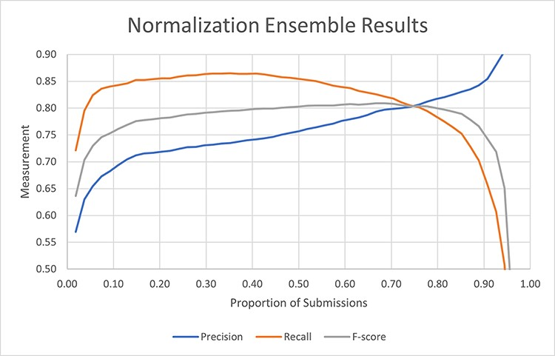
Figure 2. Performance of the ensemble of all submissions using the strict normalization measures as a function of the ...
Notes:
Figure 2. Performance of the ensemble of all submissions using the strict normalization measures as a function of the proportion of submissions containing the mention.
Unless provided in the caption above, the following copyright applies to the content of this slide: Published by Oxford University Press 2023. This work is written by (a) US Government employee(s) and is in the public domain in the US.This work is written by (a) US Government employee(s) and is in the public domain in the US.

