Slide 1
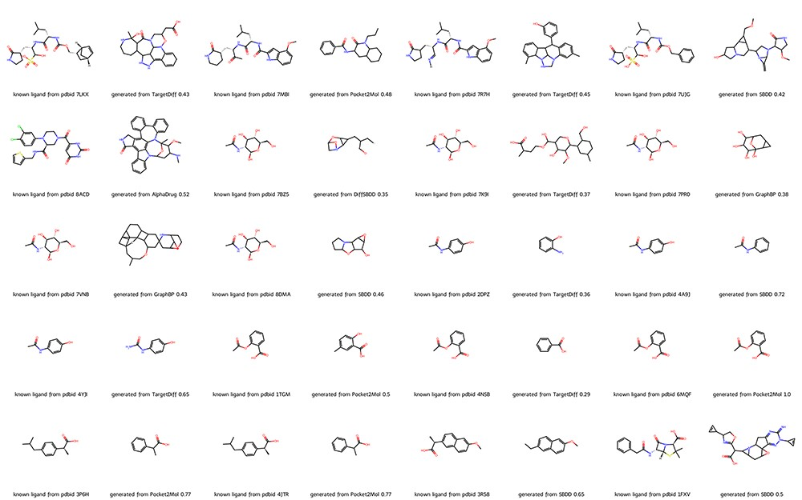
Figure 2. Molecules from DrugGen database with the highest similarity to the original ligands on 20 disease-related ...
Notes:
Figure 2. Molecules from DrugGen database with the highest similarity to the original ligands on 20 disease-related protein targets. The even-numbered columns showcase the original ligand molecules, while the odd-numbered columns display the generated molecules with the highest similarity. The values in the odd-numbered columns indicate the Tanimoto similarity to the original ligand. Alt text: The image depicts a collection of molecular structures, showcasing a comparison between known ligands from PDB entries and those generated by computational models such as TargetDiff, AlphaDrug, Pocket2Mol, GraphBP, DiffSBDD and SBDD. Each row presents a pair of molecules, with the known ligand on the left and the generated ligand on the right, along with the associated PDB codes and model performance metrics, i.e. the Tanimoto similarity.
Unless provided in the caption above, the following copyright applies to the content of this slide: © The Author(s) 2023. Published by Oxford University Press.This is an Open Access article distributed under the terms of the Creative Commons Attribution License (https://creativecommons.org/licenses/by/4.0/), which permits unrestricted reuse, distribution, and reproduction in any medium, provided the original work is properly cited.

