Slide 1
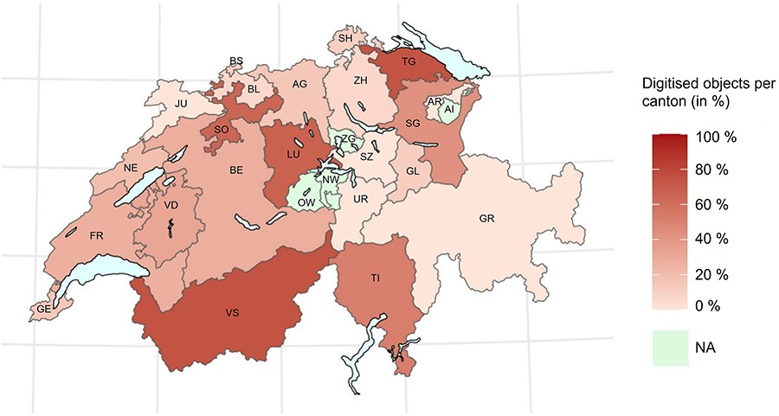
Figure 1. This heat map shows the percentage of digitised objects in natural history collections per canton. There is ...
Notes:
Figure 1. This heat map shows the percentage of digitised objects in natural history collections per canton. There is no available data for four cantons (i.e. Appenzell Innerrhoden, Nidwalden, Obwalden and Zug) (2).
Unless provided in the caption above, the following copyright applies to the content of this slide: © The Author(s) 2023. Published by Oxford University Press.This is an Open Access article distributed under the terms of the Creative Commons Attribution License (https://creativecommons.org/licenses/by/4.0/), which permits unrestricted reuse, distribution, and reproduction in any medium, provided the original work is properly cited.

