Slide 1
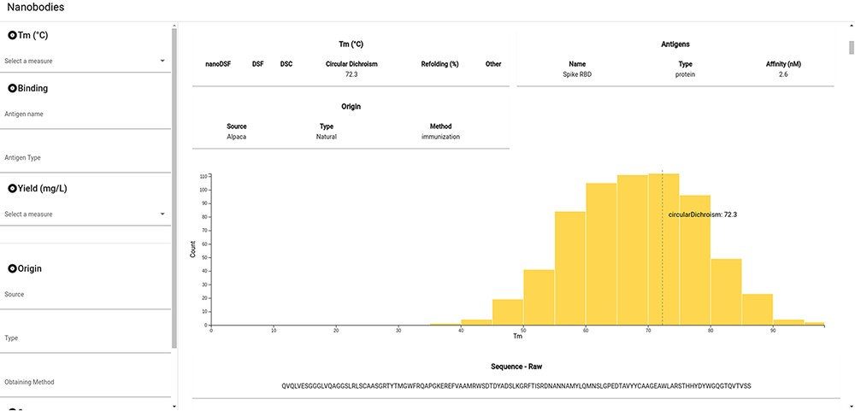
Figure 4. Snapshot of the NbThermo database interface. The left panel contains the annotation filters, while the right ...
Notes:
Figure 4. Snapshot of the NbThermo database interface. The left panel contains the annotation filters, while the right panel displays the selection list and the annotated information corresponding to the selected Nbs.
Unless provided in the caption above, the following copyright applies to the content of this slide: © The Author(s) 2023. Published by Oxford University Press.This is an Open Access article distributed under the terms of the Creative Commons Attribution License (https://creativecommons.org/licenses/by/4.0/), which permits unrestricted reuse, distribution, and reproduction in any medium, provided the original work is properly cited.

