Slide 1
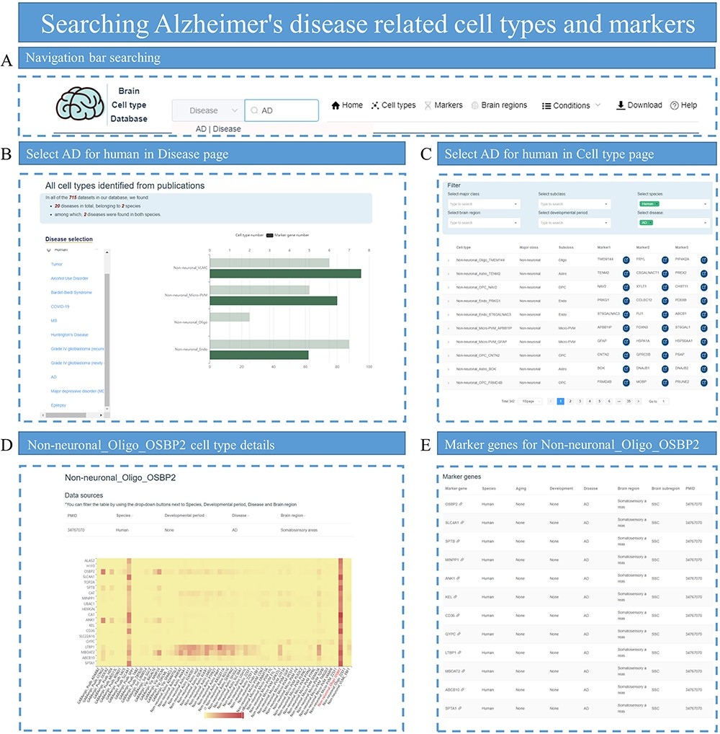
Figure 8. Searching for AD-related cell types and markers. (A) Enter ‘Alzheimer’s disease’ in the search box of the ...
Notes:
Figure 8. Searching for AD-related cell types and markers. (A) Enter ‘Alzheimer’s disease’ in the search box of the homepage. (B) Select AD on the Disease page to view related cell types, which are displayed with the number of identified marker genes. (C) Select species, disease and subclass conditions on the Cell type page to display all eligible cell types. (D) Display the heatmap plot for the expression distribution of top DEGs in cell-type Non-neuronal_Oligo_OSBP2. (E) Provide all marker genes for cell-type Non-neuronal_Oligo_OSBP2.
Unless provided in the caption above, the following copyright applies to the content of this slide: © The Author(s) 2023. Published by Oxford University Press.This is an Open Access article distributed under the terms of the Creative Commons Attribution License (https://creativecommons.org/licenses/by/4.0/), which permits unrestricted reuse, distribution, and reproduction in any medium, provided the original work is properly cited.

