Slide 1
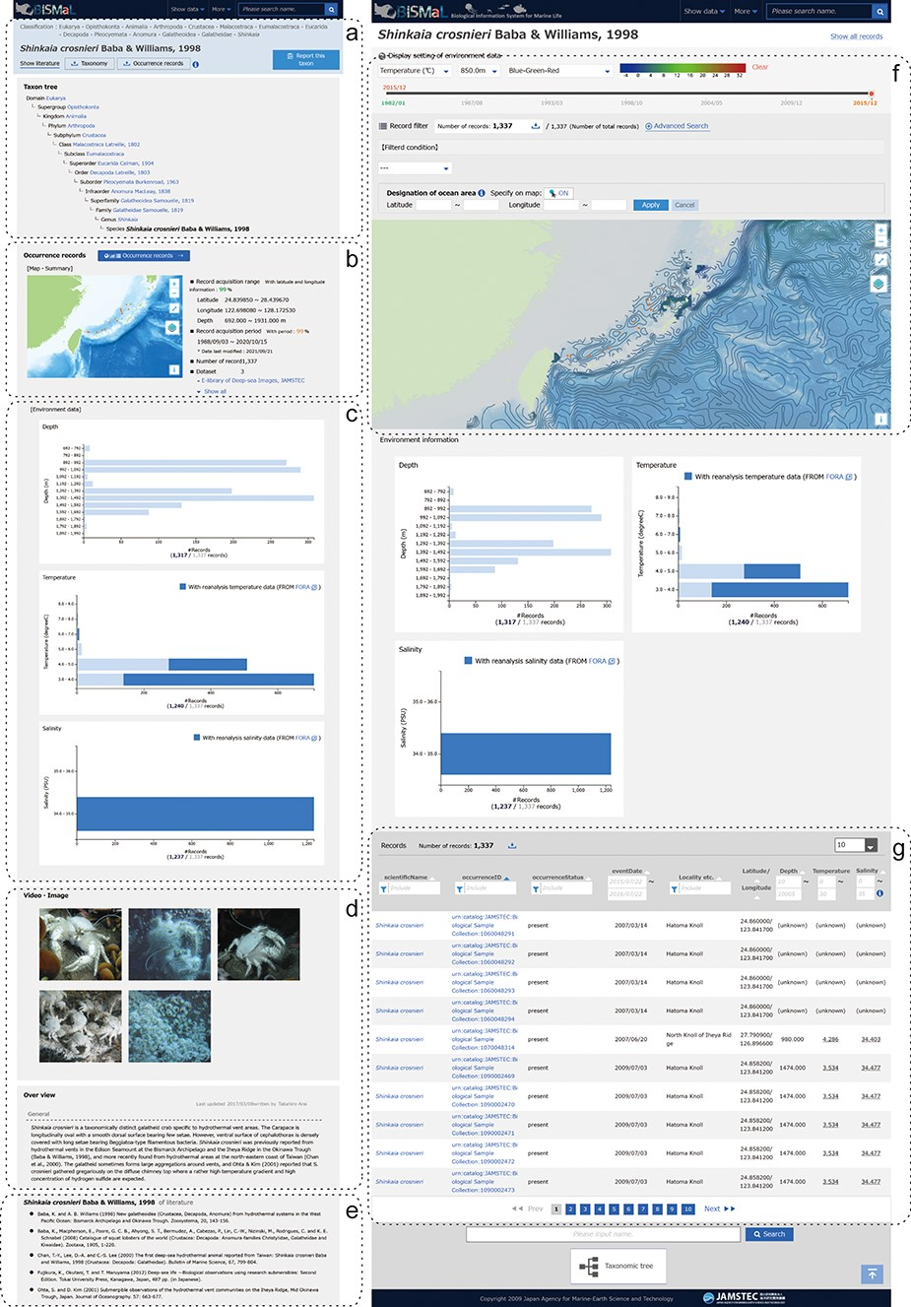
Figure 1. Screenshots of the BISMaL web page for S. crosnieri. Left panel: a taxonomic information page ...
Notes:
Figure 1. Screenshots of the BISMaL web page for S. crosnieri. Left panel: a taxonomic information page (https://www.godac.jamstec.go.jp/bismal/e/view/9000078) composed of taxonomic tree (a), map view of biological observation records (b), histograms of environmental conditions (c), related images and notes (d) and references (e). Right panel: a biological observation record page (https://www.godac.jamstec.go.jp/bismal/e/occurrences?taxon=9000078) composed of map view with estimated environmental contours (f) and observation records (g). Estimated salinity or temperature for observation records is shown as underlined values.
Unless provided in the caption above, the following copyright applies to the content of this slide: © The Author(s) 2023. Published by Oxford University Press.This is an Open Access article distributed under the terms of the Creative Commons Attribution License (https://creativecommons.org/licenses/by/4.0/), which permits unrestricted reuse, distribution, and reproduction in any medium, provided the original work is properly cited.

Slide 2
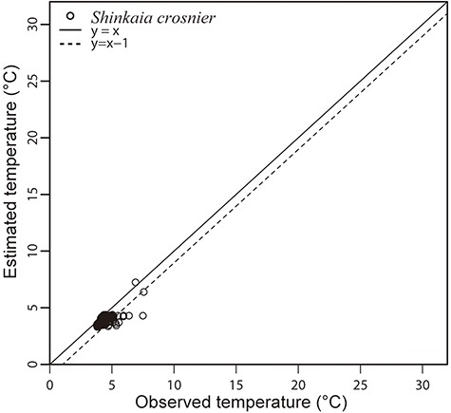
Figure 2. Observed in situ temperatures by CTD of S. crosnieri habitat and estimated temperatures by BISMaL based on ...
Notes:
Figure 2. Observed in situ temperatures by CTD of S. crosnieri habitat and estimated temperatures by BISMaL based on FORA. When the observed in situ temperature corresponds to the estimated temperature, data are plotted along the solid line (y = x).
Unless provided in the caption above, the following copyright applies to the content of this slide: © The Author(s) 2023. Published by Oxford University Press.This is an Open Access article distributed under the terms of the Creative Commons Attribution License (https://creativecommons.org/licenses/by/4.0/), which permits unrestricted reuse, distribution, and reproduction in any medium, provided the original work is properly cited.

Slide 3
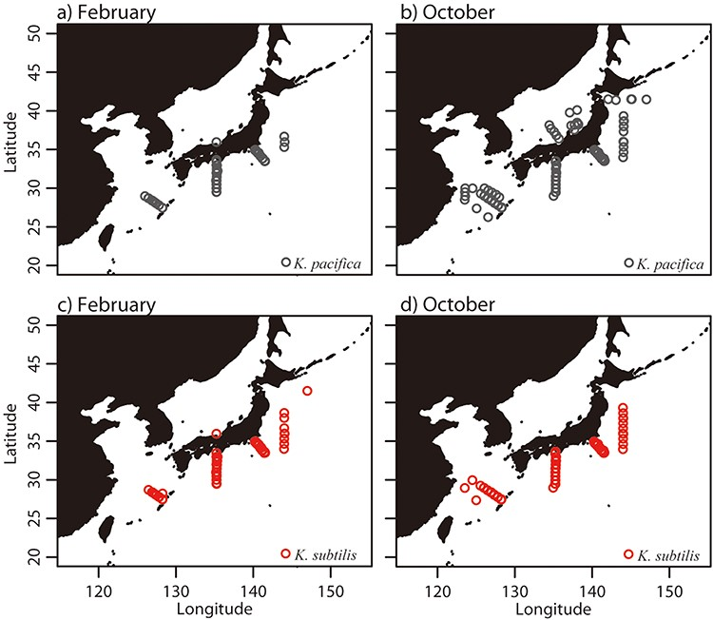
Figure 3. Distribution of biological observation records of K. pacifica in February (a) and October (b) and K. subtilis ...
Notes:
Figure 3. Distribution of biological observation records of K. pacifica in February (a) and October (b) and K. subtilis in February (c) and October (d). Data are pooled over 11 years (1982–1992).
Unless provided in the caption above, the following copyright applies to the content of this slide: © The Author(s) 2023. Published by Oxford University Press.This is an Open Access article distributed under the terms of the Creative Commons Attribution License (https://creativecommons.org/licenses/by/4.0/), which permits unrestricted reuse, distribution, and reproduction in any medium, provided the original work is properly cited.

Slide 4
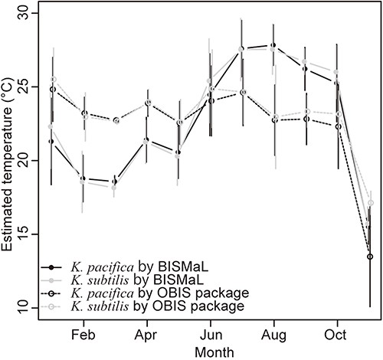
Figure 4. Monthly mean temperatures for the two Krohnitta species, which were estimated by BISMaL with FORA (solid ...
Notes:
Figure 4. Monthly mean temperatures for the two Krohnitta species, which were estimated by BISMaL with FORA (solid lines) and the OBIS package ‘obistools’ (dashed lines) with WOA. Vertical bars indicate standard deviation.
Unless provided in the caption above, the following copyright applies to the content of this slide: © The Author(s) 2023. Published by Oxford University Press.This is an Open Access article distributed under the terms of the Creative Commons Attribution License (https://creativecommons.org/licenses/by/4.0/), which permits unrestricted reuse, distribution, and reproduction in any medium, provided the original work is properly cited.

Slide 5
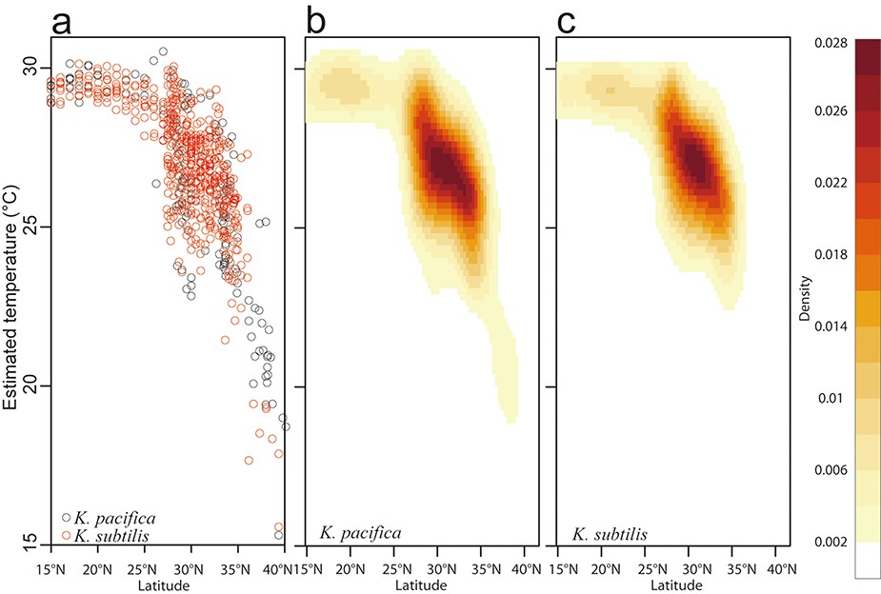
Figure 5. Visualization of estimated thermal habitat across latitude for the two Krohnitta species, scatterplot of ...
Notes:
Figure 5. Visualization of estimated thermal habitat across latitude for the two Krohnitta species, scatterplot of estimated temperatures (a) and 2D kernel density fitting for K. pacifica (b) and K. subtilis (c).
Unless provided in the caption above, the following copyright applies to the content of this slide: © The Author(s) 2023. Published by Oxford University Press.This is an Open Access article distributed under the terms of the Creative Commons Attribution License (https://creativecommons.org/licenses/by/4.0/), which permits unrestricted reuse, distribution, and reproduction in any medium, provided the original work is properly cited.

