Slide 1
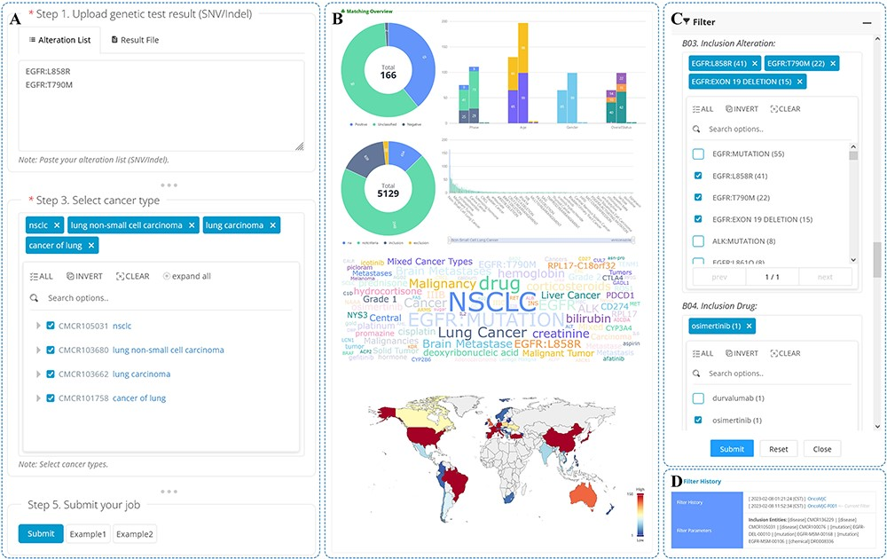
Figure 6. Trials matching.
Notes:
Figure 6. Trials matching. An overview of the trial matching and pre-screening function is shown. A) On the trial matching page, users can enter genetic test results, select cancer types and submit a matching job. B) The matching report displays jobs that have been matched or filtered and provides a permanent URL for users to access the report at any time. C) Users can set filters on the matching report page to screen trials based on the list of matches. D) The filter history can be viewed from the matching report page.
Unless provided in the caption above, the following copyright applies to the content of this slide: © The Author(s) 2023. Published by Oxford University Press.This is an Open Access article distributed under the terms of the Creative Commons Attribution License (https://creativecommons.org/licenses/by/4.0/), which permits unrestricted reuse, distribution, and reproduction in any medium, provided the original work is properly cited.

