Slide 1
Figure 1. Overview of the CORE architecture. The system consists of five main modules and three processes. The modules ...
Notes:
Figure 1. Overview of the CORE architecture. The system consists of five main modules and three processes. The modules represent the data acquisition and NERD components (1), the manual annotation activities (2), the training of the RE models (3), the subsequent automatic annotation (4), and the KB population (5). The processes reflect the different workflows: bootstrapping (orange) sets up the KBC process via expert involvement; deployment (blue) scales it through automated RE methods; and active learning (purple) allows refining the process through subsequent iterations.
Unless provided in the caption above, the following copyright applies to the content of this slide: © The Author(s) 2023. Published by Oxford University Press.This is an Open Access article distributed under the terms of the Creative Commons Attribution License (https://creativecommons.org/licenses/by/4.0/), which permits unrestricted reuse, distribution, and reproduction in any medium, provided the original work is properly cited.

Slide 2
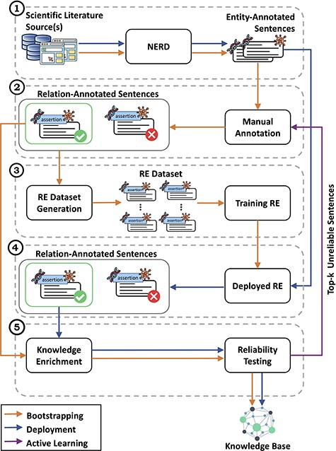
Figure 2. Detailed view of the CORE architecture. In module (1), CORE acquires text from biomedical literature and then ...
Notes:
Figure 2. Detailed view of the CORE architecture. In module (1), CORE acquires text from biomedical literature and then performs NERD to generate entity-annotated sentences. These sentences are then manually annotated by experts in module (2) to produce relation-annotated sentences, which are used to generate the datasets for training RE methods in module (3). Once trained, in module (4), the RE methods are deployed over entity-annotated sentences to automatically generate relation-annotated sentences. Finally, in module (5), relation-annotated sentences undergo a knowledge enrichment component, which generates facts, and a reliability testing component, which tags facts as ‘reliable’ or ‘unreliable’. Facts tagged as ‘reliable’ are used to populate the KB, whereas ‘unreliable’ facts are returned to experts for re-annotation.
Unless provided in the caption above, the following copyright applies to the content of this slide: © The Author(s) 2023. Published by Oxford University Press.This is an Open Access article distributed under the terms of the Creative Commons Attribution License (https://creativecommons.org/licenses/by/4.0/), which permits unrestricted reuse, distribution, and reproduction in any medium, provided the original work is properly cited.

Slide 3
Figure 3. The ten most involved genes (and their roles) in cancer diseases. From left to right, the figures present the ...
Notes:
Figure 3. The ten most involved genes (and their roles) in cancer diseases. From left to right, the figures present the ten most involved oncogenes, biomarkers and tumor suppressor genes, respectively. AKT1 is the most prominent oncogene, with wide expression in various tissues. Other known oncogenes include MAPK1, MAPK3 and STAT3. Proto-oncogenes such as ERBB2, EGFR and BCL2 show altered expression levels in cancer, but lack sufficient evidence to be identified as oncogenes, thus fitting our definition of biomarkers. TP53 represents an interesting case, as it functions as a biomarker and a tumor suppressor gene for several diseases, with its classification evolving over time.
Unless provided in the caption above, the following copyright applies to the content of this slide: © The Author(s) 2023. Published by Oxford University Press.This is an Open Access article distributed under the terms of the Creative Commons Attribution License (https://creativecommons.org/licenses/by/4.0/), which permits unrestricted reuse, distribution, and reproduction in any medium, provided the original work is properly cited.

Slide 4
Figure 4. The ten most discussed genes, cancer diseases, and facts within the literature. The most discussed genes are ...
Notes:
Figure 4. The ten most discussed genes, cancer diseases, and facts within the literature. The most discussed genes are those most involved in cancer diseases, with a focus on breast, colorectal, prostate, and lung cancer—i.e., the most common cancer types worldwide. Consequently, the most discussed facts refer to gene expression-cancer associations involving these specific genes and diseases.
Unless provided in the caption above, the following copyright applies to the content of this slide: © The Author(s) 2023. Published by Oxford University Press.This is an Open Access article distributed under the terms of the Creative Commons Attribution License (https://creativecommons.org/licenses/by/4.0/), which permits unrestricted reuse, distribution, and reproduction in any medium, provided the original work is properly cited.

Slide 5
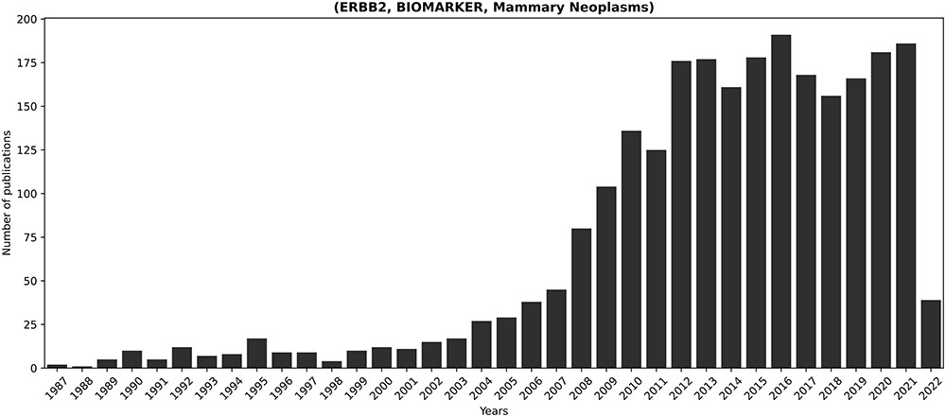
Figure 5. Temporal progression of publications concerning the longest-discussed fact in literature: (ERBB2, BIOMARKER, ...
Notes:
Figure 5. Temporal progression of publications concerning the longest-discussed fact in literature: (ERBB2, BIOMARKER, Mammary Neoplasms). ERBB2 is a known proto-oncogene, amplified or overexpressed in around 30% of human breast cancers (73). Its relevance in breast cancer justifies the prominent presence of the corresponding fact in the scientific discourse.
Unless provided in the caption above, the following copyright applies to the content of this slide: © The Author(s) 2023. Published by Oxford University Press.This is an Open Access article distributed under the terms of the Creative Commons Attribution License (https://creativecommons.org/licenses/by/4.0/), which permits unrestricted reuse, distribution, and reproduction in any medium, provided the original work is properly cited.

Slide 6
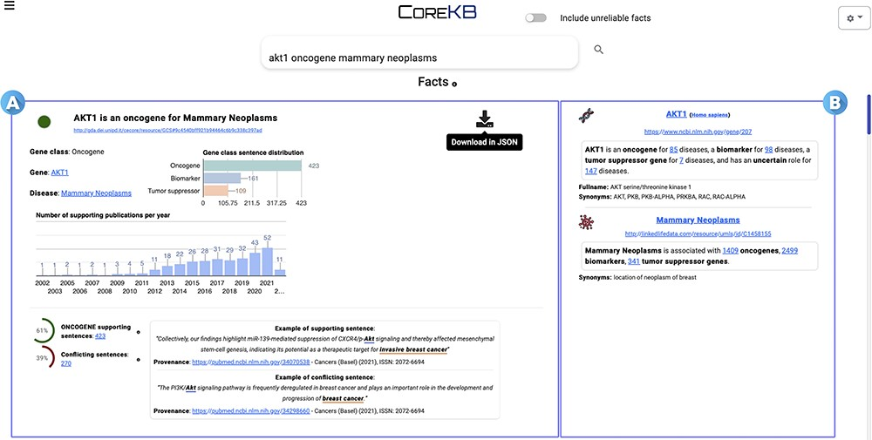
Figure 6. COREKB Search Engine Result Page first result for the query ‘AKT1 oncogene mammary neoplasms’. The retrieved ...
Notes:
Figure 6. COREKB Search Engine Result Page first result for the query ‘AKT1 oncogene mammary neoplasms’. The retrieved facts are organized as cards providing several information concerning (A) the gene, cancer and their relationship and (B) specific information concerning the entities—i.e. gene and the related cancer expression—involved in the association. In addition, card (A) includes infometrics and bibliometrics information to provide further insights. The contents of the cards are available for download in JSON format through the dedicated download button.
Unless provided in the caption above, the following copyright applies to the content of this slide: © The Author(s) 2023. Published by Oxford University Press.This is an Open Access article distributed under the terms of the Creative Commons Attribution License (https://creativecommons.org/licenses/by/4.0/), which permits unrestricted reuse, distribution, and reproduction in any medium, provided the original work is properly cited.

