Slide 1
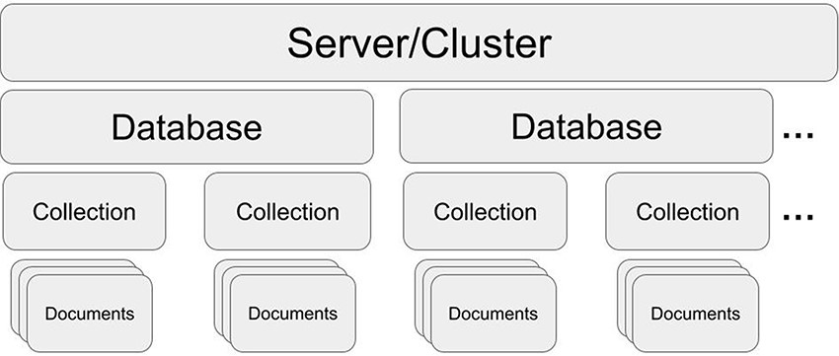
Figure 1. MongoDB structure. One server/cluster can store several databases. Each database can contain collections that ...
Notes:
Figure 1. MongoDB structure. One server/cluster can store several databases. Each database can contain collections that store multiple and separate records as documents (in JSON style).
Unless provided in the caption above, the following copyright applies to the content of this slide: © The Author(s) 2023. Published by Oxford University Press.This is an Open Access article distributed under the terms of the Creative Commons Attribution License (https://creativecommons.org/licenses/by/4.0/), which permits unrestricted reuse, distribution, and reproduction in any medium, provided the original work is properly cited.

