Slide 1
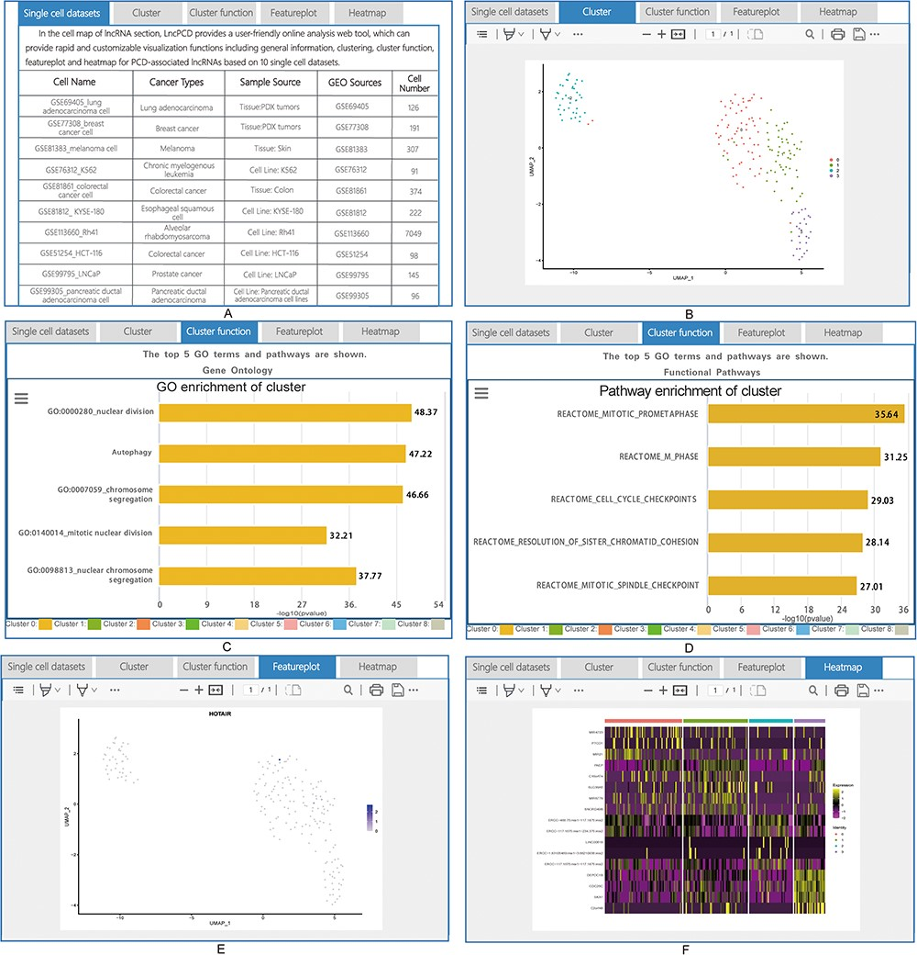
Figure 6. Detailed information for cell map of lncRNA. (A) General information for the single-cell sequencing data. (B) ...
Notes:
Figure 6. Detailed information for cell map of lncRNA. (A) General information for the single-cell sequencing data. (B) Cluster plot of lncRNAs based on single-cell sequencing data. (C) A plot of the GO enrichment of cluster. (D) A plot of the pathway enrichment of cluster. (E) Feature plot of lncRNAs based on single-cell sequencing data. (F) Heatmap plot of lncRNAs based on single-cell sequencing data.
Unless provided in the caption above, the following copyright applies to the content of this slide: © The Author(s) 2023. Published by Oxford University Press.This is an Open Access article distributed under the terms of the Creative Commons Attribution License (https://creativecommons.org/licenses/by/4.0/), which permits unrestricted reuse, distribution, and reproduction in any medium, provided the original work is properly cited.

Slide 2
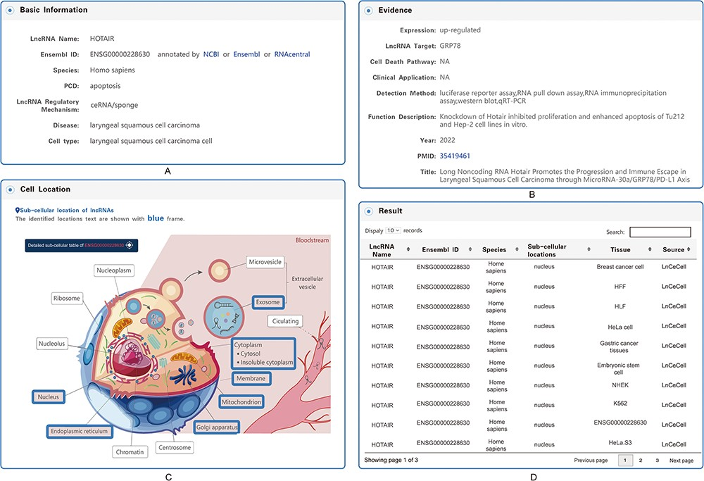
Figure 5. Detailed information for each entry. (A) Basic information on the associations between lncRNA-mediated PCD ...
Notes:
Figure 5. Detailed information for each entry. (A) Basic information on the associations between lncRNA-mediated PCD and diseases. (B) Evidence of the associations between lncRNA-mediated PCD and diseases. (C) Subcellular locations of lncRNAs. (D) Table of the detailed information on subcellular locations.
Unless provided in the caption above, the following copyright applies to the content of this slide: © The Author(s) 2023. Published by Oxford University Press.This is an Open Access article distributed under the terms of the Creative Commons Attribution License (https://creativecommons.org/licenses/by/4.0/), which permits unrestricted reuse, distribution, and reproduction in any medium, provided the original work is properly cited.

Slide 3
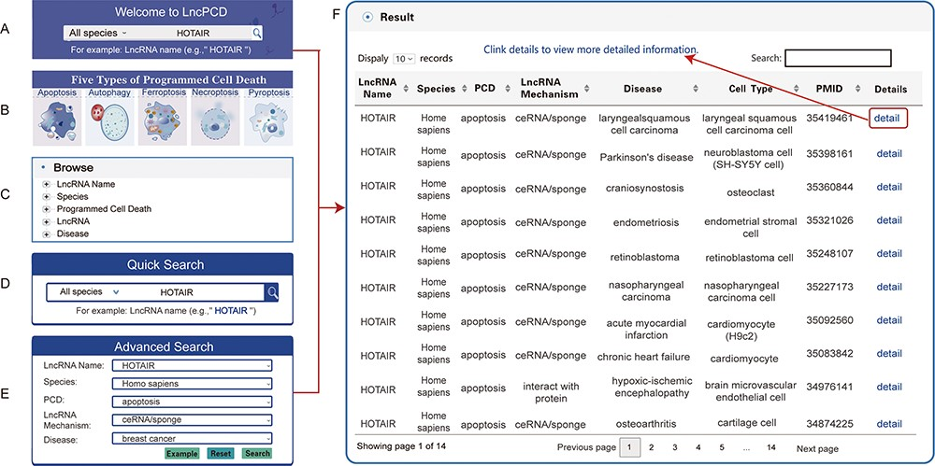
Figure 4. Search methods and results in the LncPCD database. There are five methods to obtain related information. (A) ...
Notes:
Figure 4. Search methods and results in the LncPCD database. There are five methods to obtain related information. (A) Quick search function on the Home page. (B) Image links to the five types of PCD on the home page. (C) Tree view function on the left side of the Browse page. (D) Quick Search function on the Search page. (E) Advanced Search function on the Search page. Through each of the above methods, a result table is obtained. (F) LncPCD results are organized in a data table, with a single association record on each line.
Unless provided in the caption above, the following copyright applies to the content of this slide: © The Author(s) 2023. Published by Oxford University Press.This is an Open Access article distributed under the terms of the Creative Commons Attribution License (https://creativecommons.org/licenses/by/4.0/), which permits unrestricted reuse, distribution, and reproduction in any medium, provided the original work is properly cited.

Slide 4
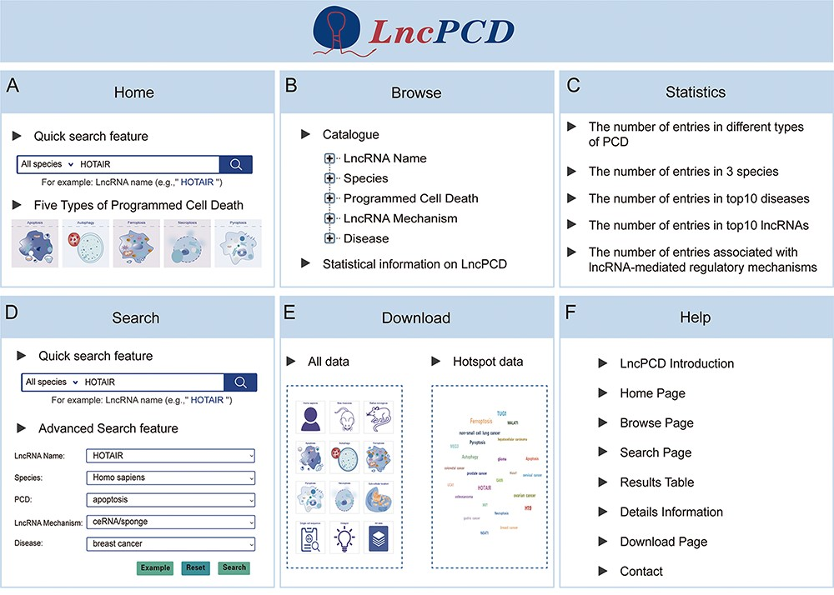
Figure 3. Overview of the LncPCD web interface. (A) Overview of the Home page. (B) Overview of the Browse page. (C) ...
Notes:
Figure 3. Overview of the LncPCD web interface. (A) Overview of the Home page. (B) Overview of the Browse page. (C) Overview of the Statistics page. (D) Overview of the Search page. (E) Overview of the Download page. (F) Overview of the Help page.
Unless provided in the caption above, the following copyright applies to the content of this slide: © The Author(s) 2023. Published by Oxford University Press.This is an Open Access article distributed under the terms of the Creative Commons Attribution License (https://creativecommons.org/licenses/by/4.0/), which permits unrestricted reuse, distribution, and reproduction in any medium, provided the original work is properly cited.

Slide 5
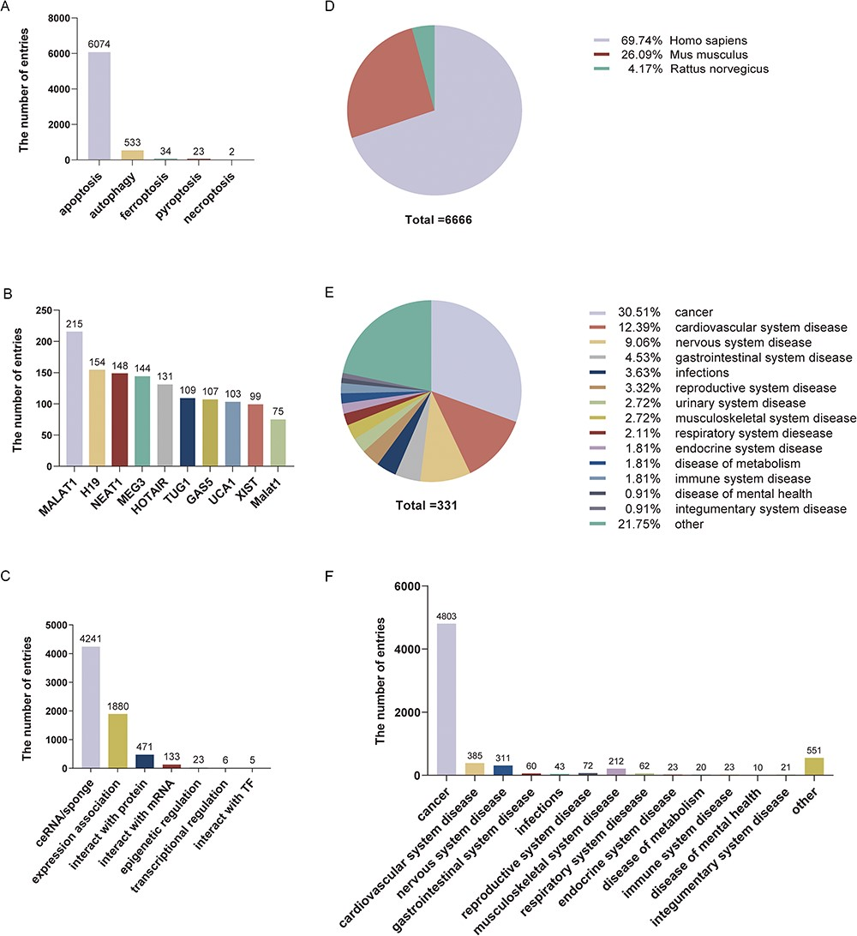
Figure 2. Statistical information on LncPCD. (A) Numbers of entries for different types of programmed cell death. (B) ...
Notes:
Figure 2. Statistical information on LncPCD. (A) Numbers of entries for different types of programmed cell death. (B) Numbers of entries for the top 10 lncRNAs. (C) Numbers of entries for lncRNA-mediated regulatory mechanisms. (D) Numbers of entries for three species. (E) Numbers of diseases for different classes. (F) Numbers of entries in different disease classes.
Unless provided in the caption above, the following copyright applies to the content of this slide: © The Author(s) 2023. Published by Oxford University Press.This is an Open Access article distributed under the terms of the Creative Commons Attribution License (https://creativecommons.org/licenses/by/4.0/), which permits unrestricted reuse, distribution, and reproduction in any medium, provided the original work is properly cited.

Slide 6
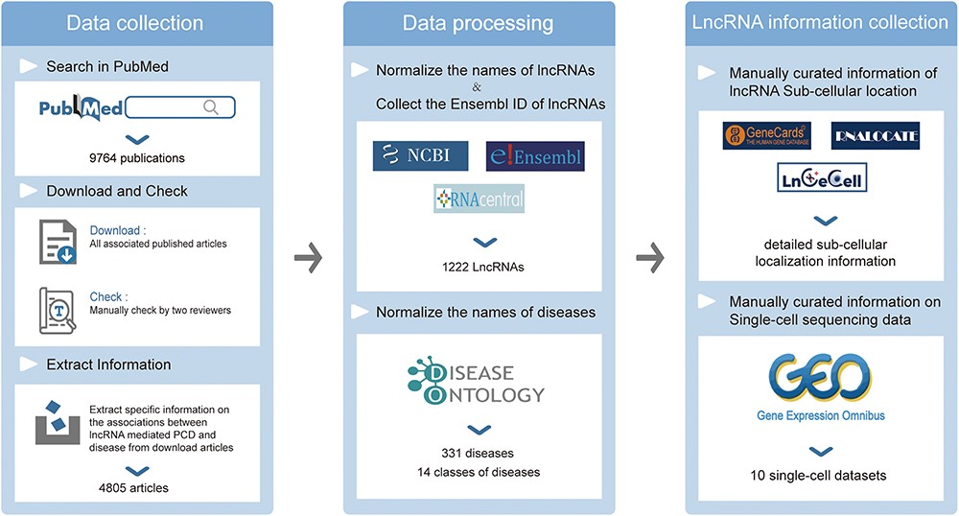
Figure 1. Data collection and processing of the LncPCD database.
Notes:
Figure 1. Data collection and processing of the LncPCD database.
Unless provided in the caption above, the following copyright applies to the content of this slide: © The Author(s) 2023. Published by Oxford University Press.This is an Open Access article distributed under the terms of the Creative Commons Attribution License (https://creativecommons.org/licenses/by/4.0/), which permits unrestricted reuse, distribution, and reproduction in any medium, provided the original work is properly cited.

