Slide 1
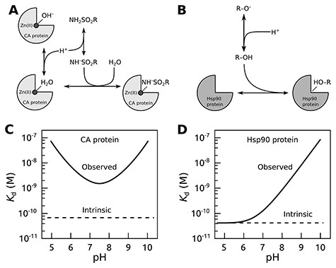
Figure 1. The concept of intrinsic binding parameters after accounting for ligand binding–linked protonation reactions. ...
Notes:
Figure 1. The concept of intrinsic binding parameters after accounting for ligand binding–linked protonation reactions. Upper panels show interactions occurring when carbonic anhydrase (CA; A) or Hsp90 (B) proteins bind sulfonamide or resorcinol-based ligands, respectively. The lower panels plot typical observed and intrinsic dissociation constants (affinities) as a function of pH. For the CA protein (C), it is usually impossible to find conditions where the observed and intrinsic values would coincide (17), while for Hsp90 ligands bearing the resorcinol group (D), the match was observed only at acidic pH (20, 21).
Unless provided in the caption above, the following copyright applies to the content of this slide: © The Author(s) 2023. Published by Oxford University Press.This is an Open Access article distributed under the terms of the Creative Commons Attribution License (https://creativecommons.org/licenses/by/4.0/), which permits unrestricted reuse, distribution, and reproduction in any medium, provided the original work is properly cited.

Slide 2
Figure 2. A schematic representation of PLBD. The database lists information about the structure, purification, actual ...
Notes:
Figure 2. A schematic representation of PLBD. The database lists information about the structure, purification, actual batches of proteins and compounds and thermodynamic and structural information on protein–compound interaction. Arrows indicate the direction of information exchange between major structural units of the PLBD. The database structure allows users to trace all relationships between the deposited data.
Unless provided in the caption above, the following copyright applies to the content of this slide: © The Author(s) 2023. Published by Oxford University Press.This is an Open Access article distributed under the terms of the Creative Commons Attribution License (https://creativecommons.org/licenses/by/4.0/), which permits unrestricted reuse, distribution, and reproduction in any medium, provided the original work is properly cited.

