Slide 1
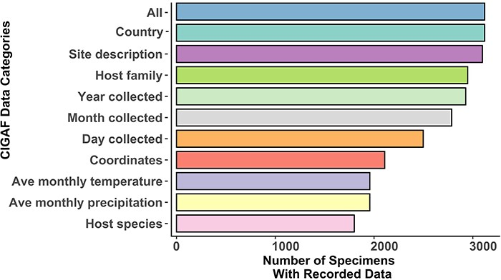
Figure 1. A bar chart of data associated with collection records within the CIGAF database. ‘All’ is the total number ...
Notes:
Figure 1. A bar chart of data associated with collection records within the CIGAF database. ‘All’ is the total number of records within the database, ‘Country’ includes records with a recorded country of collection and ‘Site description’ includes entries with a detailed collection site description. ‘Year collected’, ‘Month collected’ and ‘Day collected’ are entries with time of collection data recorded at each level of specificity. ‘Host family’ is the number of specimens with their host identified at the insect family level, while ‘Host species’ records have their host identification at the species level. ‘Coordinates’ is the number of entries with associated latitude and longitude (from the original publication, not extrapolated from the site description). ‘Ave monthly precipitation’ and ‘Ave monthly temperature’ are averages extrapolated from the WorldClim database (17) for records that have associated coordinates, year of collection and month of collection.
Unless provided in the caption above, the following copyright applies to the content of this slide: © The Author(s) 2023. Published by Oxford University Press.This is an Open Access article distributed under the terms of the Creative Commons Attribution License (https://creativecommons.org/licenses/by/4.0/), which permits unrestricted reuse, distribution, and reproduction in any medium, provided the original work is properly cited.

Slide 2
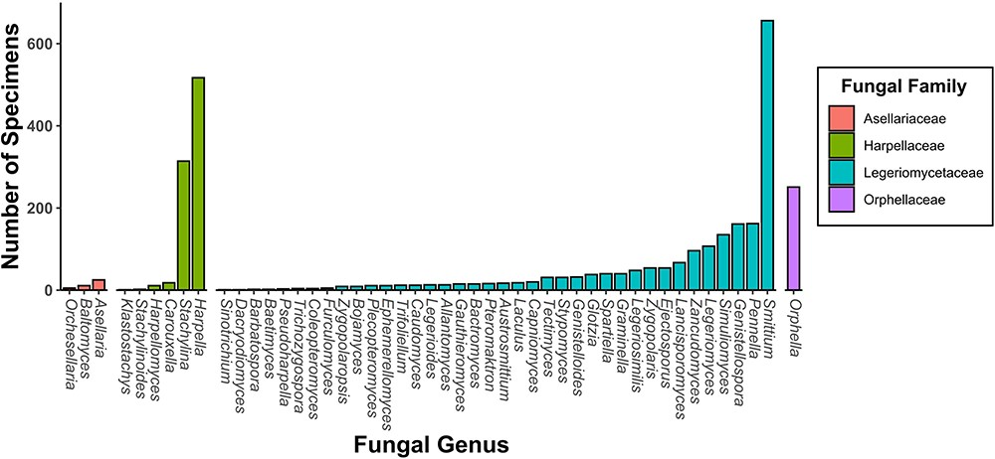
Figure 2. A bar chart of specimen records within the CIGAF database by genus. The bars are colored by fungal family and ...
Notes:
Figure 2. A bar chart of specimen records within the CIGAF database by genus. The bars are colored by fungal family and are ordered from lowest to highest prevalence within each category.
Unless provided in the caption above, the following copyright applies to the content of this slide: © The Author(s) 2023. Published by Oxford University Press.This is an Open Access article distributed under the terms of the Creative Commons Attribution License (https://creativecommons.org/licenses/by/4.0/), which permits unrestricted reuse, distribution, and reproduction in any medium, provided the original work is properly cited.

Slide 3
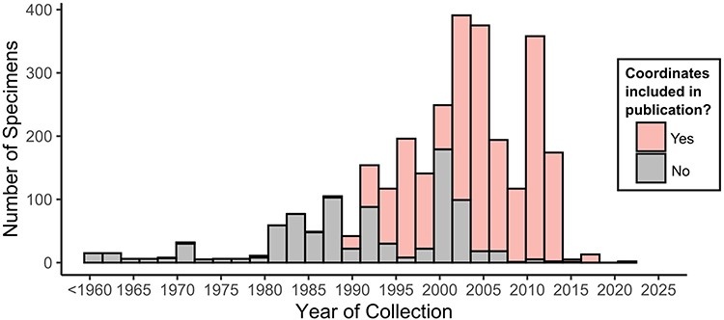
Figure 3. Histogram of specimens within the CIGAF database by year. Histogram bars are stacked and colored pink if ...
Notes:
Figure 3. Histogram of specimens within the CIGAF database by year. Histogram bars are stacked and colored pink if coordinates were recorded in the original publication for the associated specimens.
Unless provided in the caption above, the following copyright applies to the content of this slide: © The Author(s) 2023. Published by Oxford University Press.This is an Open Access article distributed under the terms of the Creative Commons Attribution License (https://creativecommons.org/licenses/by/4.0/), which permits unrestricted reuse, distribution, and reproduction in any medium, provided the original work is properly cited.

Slide 4
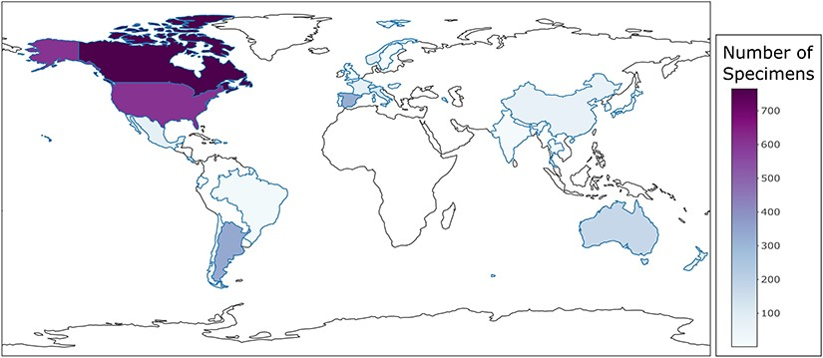
Figure 4. Country-level choropleth map of trichomycetes generated using the CIGAF user interface. The legend shows the ...
Notes:
Figure 4. Country-level choropleth map of trichomycetes generated using the CIGAF user interface. The legend shows the trichomycetes specimen intensity, with the darker purple color indicating the larger number of associated collection records. Countries that show a white color without a defined blue outline have zero collection records within the database.
Unless provided in the caption above, the following copyright applies to the content of this slide: © The Author(s) 2023. Published by Oxford University Press.This is an Open Access article distributed under the terms of the Creative Commons Attribution License (https://creativecommons.org/licenses/by/4.0/), which permits unrestricted reuse, distribution, and reproduction in any medium, provided the original work is properly cited.

Slide 5
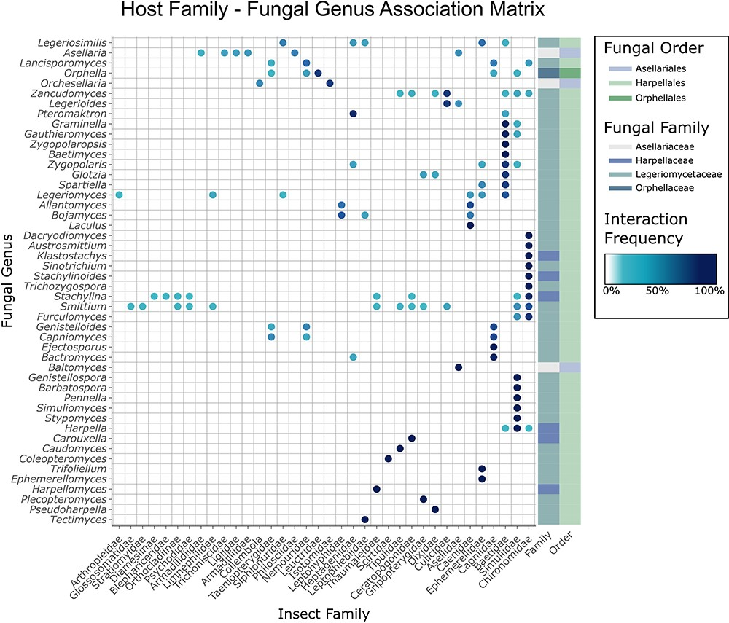
Figure 5. Matrix of trichomycetes–insect interactions generated using the CIGAF web application. Insect hosts at the ...
Notes:
Figure 5. Matrix of trichomycetes–insect interactions generated using the CIGAF web application. Insect hosts at the family level are shown along the x-axis, and fungal genera are shown along the y-axis. The darker the dot at any row–column intersection, the higher the prevalence (number of records containing the indicated trichomycetes–insect interaction). Fungal genera (rows) are clustered by interaction pattern similarity such that genera with similar interaction patterns are next to each other. Insect hosts are ordered alphabetically. The rectangle array at the end of each row indicates the fungal family and fungal order to which the corresponding fungal genus belongs.
Unless provided in the caption above, the following copyright applies to the content of this slide: © The Author(s) 2023. Published by Oxford University Press.This is an Open Access article distributed under the terms of the Creative Commons Attribution License (https://creativecommons.org/licenses/by/4.0/), which permits unrestricted reuse, distribution, and reproduction in any medium, provided the original work is properly cited.

Slide 6
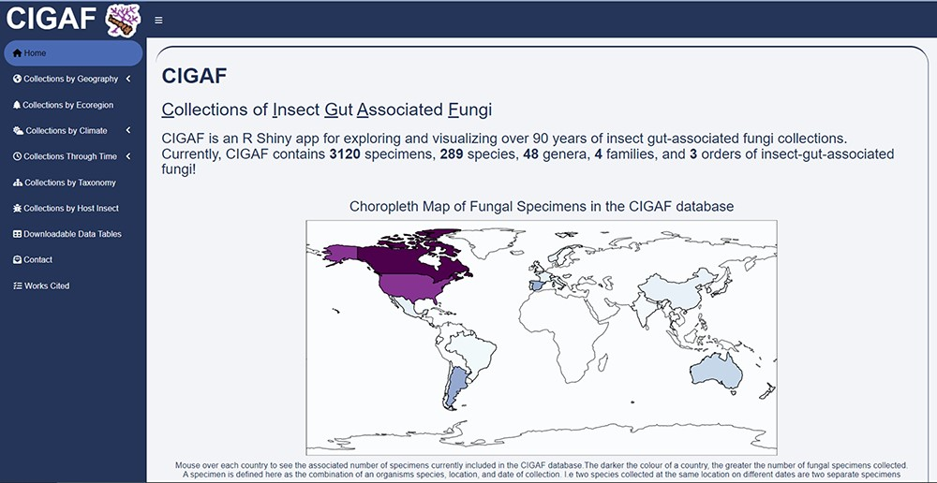
Figure 6. The CIGAF website homepage showing a descriptive overview of the site contents, with the expanding tab list ...
Notes:
Figure 6. The CIGAF website homepage showing a descriptive overview of the site contents, with the expanding tab list on the left.
Unless provided in the caption above, the following copyright applies to the content of this slide: © The Author(s) 2023. Published by Oxford University Press.This is an Open Access article distributed under the terms of the Creative Commons Attribution License (https://creativecommons.org/licenses/by/4.0/), which permits unrestricted reuse, distribution, and reproduction in any medium, provided the original work is properly cited.

