Slide 1
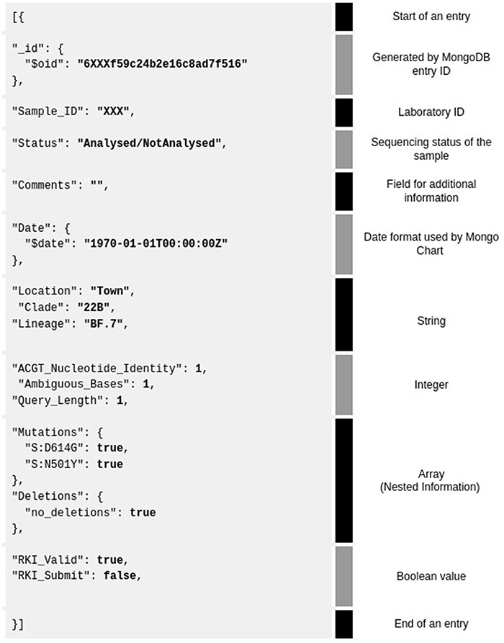
Figure 2. Example of a MongoDB JSON database entry for one sample (grey background). Shown are all the 3–4 data types ...
Notes:
Figure 2. Example of a MongoDB JSON database entry for one sample (grey background). Shown are all the 3–4 data types and their corresponding explanation on the right. The database entry is separated by category (text in black, called ‘key’) and value of data (bold—‘value’) for visualization purposes.
Unless provided in the caption above, the following copyright applies to the content of this slide: © The Author(s) 2023. Published by Oxford University Press.This is an Open Access article distributed under the terms of the Creative Commons Attribution License (https://creativecommons.org/licenses/by/4.0/), which permits unrestricted reuse, distribution, and reproduction in any medium, provided the original work is properly cited.

