Slide 1
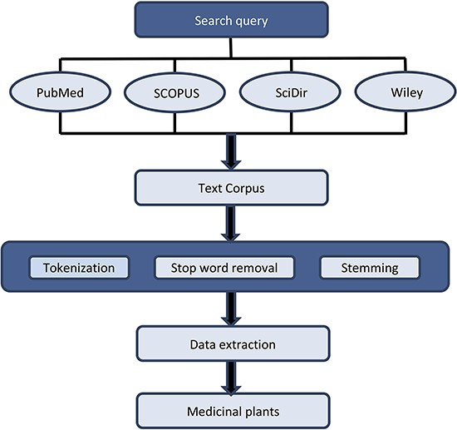
Figure 2. Flow chart of data preprocessing and extraction. Preprocessing involves three main steps: (i) Tokenization, ...
Notes:
Figure 2. Flow chart of data preprocessing and extraction. Preprocessing involves three main steps: (i) Tokenization, (ii) Stop word removal and (iii) Stemming. For data extraction, Python and Natural Language Toolkit were used.
Unless provided in the caption above, the following copyright applies to the content of this slide: © The Author(s) 2023. Published by Oxford University Press.This is an Open Access article distributed under the terms of the Creative Commons Attribution License (https://creativecommons.org/licenses/by/4.0/), which permits unrestricted reuse, distribution, and reproduction in any medium, provided the original work is properly cited.

