Slide 1
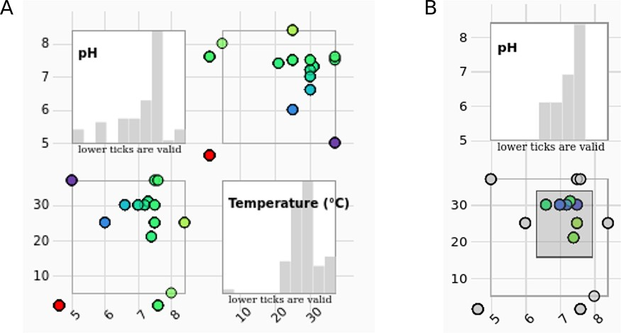
Figure 4. (A) The scatter plot matrix of the entry data with histograms is showing measurement conditions (pH values in ...
Notes:
Figure 4. (A) The scatter plot matrix of the entry data with histograms is showing measurement conditions (pH values in correlation with temperature) of the selected entries. (B) The data range can be selected by brushing on any of the scatter plots. Histograms change accordingly.
Unless provided in the caption above, the following copyright applies to the content of this slide: © The Author(s) 2023. Published by Oxford University Press.This is an Open Access article distributed under the terms of the Creative Commons Attribution License (https://creativecommons.org/licenses/by/4.0/), which permits unrestricted reuse, distribution, and reproduction in any medium, provided the original work is properly cited.

