Slide 1
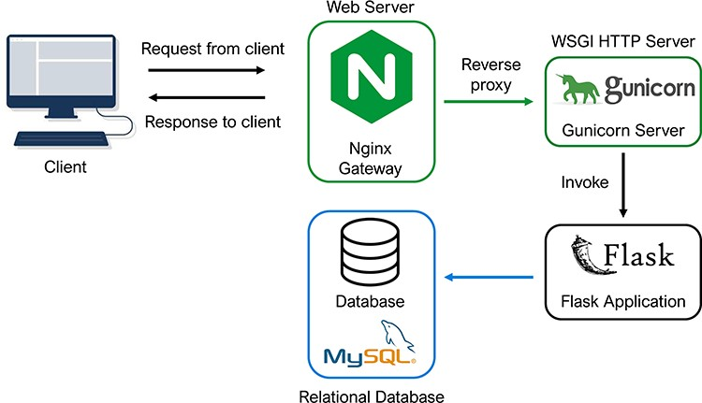
Figure 2. Database architecture and programming. The architectural flow of the PETCH-DB is shown. NGINX and Gunicorn ...
Notes:
Figure 2. Database architecture and programming. The architectural flow of the PETCH-DB is shown. NGINX and Gunicorn are used to provide a server gateway interface to the flask application, which transmits requests to the MySQL database, thus offering a flexible framework for future expansion of the database.
Unless provided in the caption above, the following copyright applies to the content of this slide: © The Author(s) 2023. Published by Oxford University Press.This is an Open Access article distributed under the terms of the Creative Commons Attribution License (https://creativecommons.org/licenses/by/4.0/), which permits unrestricted reuse, distribution, and reproduction in any medium, provided the original work is properly cited.

