Slide 1
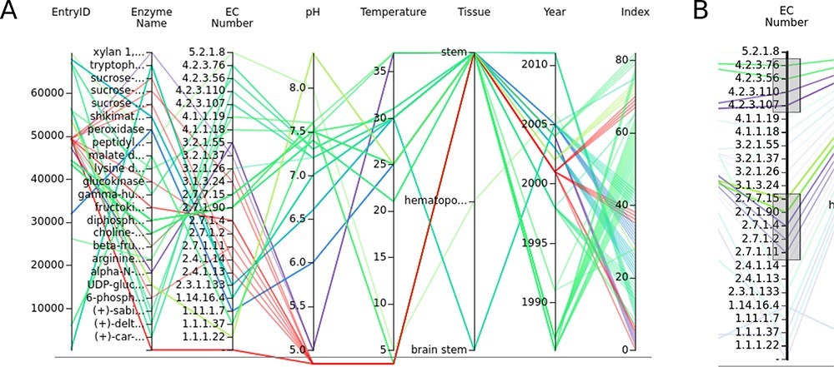
Figure 3. (A) The parallel coordinates graph of the entry data. Attribute names are given above the graph. One entry ...
Notes:
Figure 3. (A) The parallel coordinates graph of the entry data. Attribute names are given above the graph. One entry represents one line on the graph. Null values are under the lower line. (B) Data can be selected by brushing the axes.
Unless provided in the caption above, the following copyright applies to the content of this slide: © The Author(s) 2023. Published by Oxford University Press.This is an Open Access article distributed under the terms of the Creative Commons Attribution License (https://creativecommons.org/licenses/by/4.0/), which permits unrestricted reuse, distribution, and reproduction in any medium, provided the original work is properly cited.

