Slide 1
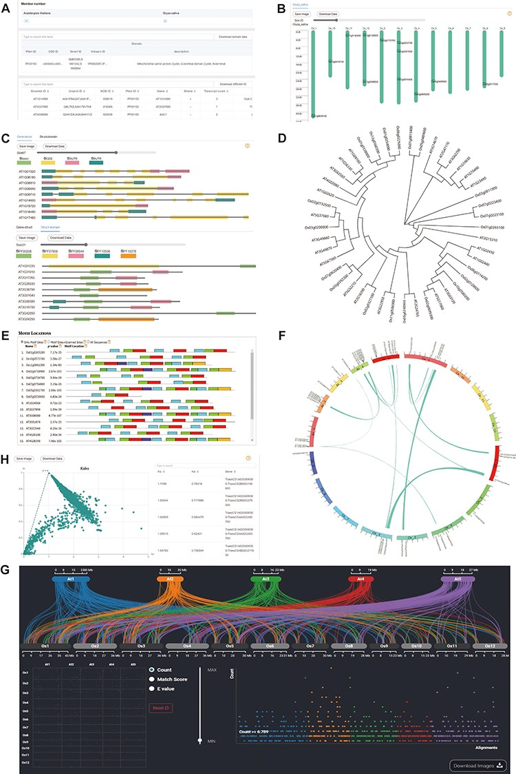
Figure 2. Downstream analysis modules at genome level. (A) Basic-info module. The top part indicates the number of ...
Notes:
Figure 2. Downstream analysis modules at genome level. (A) Basic-info module. The top part indicates the number of family members in each species. The middle section gives information about the domains (if any) in the gene family. The bottom part lists the specific information about the family members. (B) Chromosome Location module with members on each chromosome. (C) Gene-Structure module with visualized structures on gene and domains on protein. (D) Tree module with phylogenetic tree. (E) Motif module with motif locations. (F) Collinerity module with visualized collinerity gene on circle diagram. (G) Sythi module with parallel link plot and dot plot of collinerity gene plot. (H) KaKs module, scatterplot on the left and search table on the right.
Unless provided in the caption above, the following copyright applies to the content of this slide: © The Author(s) 2023. Published by Oxford University Press.This is an Open Access article distributed under the terms of the Creative Commons Attribution License (https://creativecommons.org/licenses/by/4.0/), which permits unrestricted reuse, distribution, and reproduction in any medium, provided the original work is properly cited.

