Slide 1
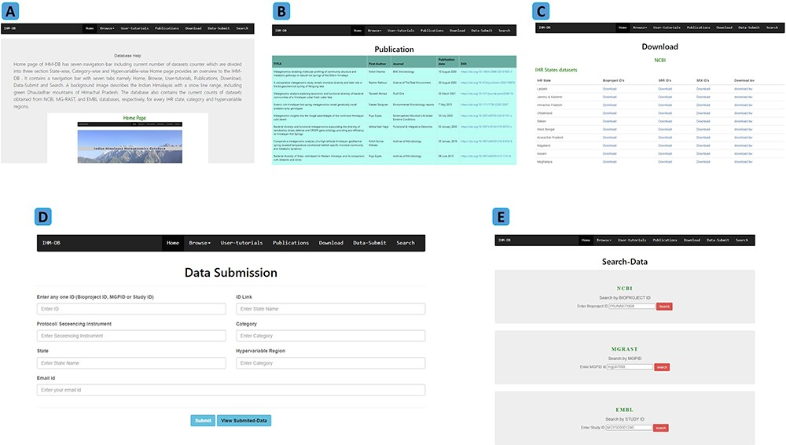
Figure 5. Explanation of navigation tabs in the IHM-DB. (A) Tutorial page with example usage of the IHM-DB. (B) List of ...
Notes:
Figure 5. Explanation of navigation tabs in the IHM-DB. (A) Tutorial page with example usage of the IHM-DB. (B) List of metagenomic publications from the IHR. (C) Download page for NCBI, EMBL, and, MG-RAST databases datasets of the IHR data. (D) Data-submit page. The users can submit their data through the Data-Submit page by submitting inputs like NCBI BioProject ID, MG-RAST MGPID, EMBL study ID), ID Link, Protocol/ Sequencing Instrument, Category, State, Hypervariable region, and user email ID. (E) Search page. The users can directly search the dataset by entering BioProject ID, MGPID, and Study ID of NCBI, MG-RAST, and EMBL databases, respectively.
Unless provided in the caption above, the following copyright applies to the content of this slide: © The Author(s) 2023. Published by Oxford University Press.This is an Open Access article distributed under the terms of the Creative Commons Attribution License (https://creativecommons.org/licenses/by/4.0/), which permits unrestricted reuse, distribution, and reproduction in any medium, provided the original work is properly cited.

