Slide 1
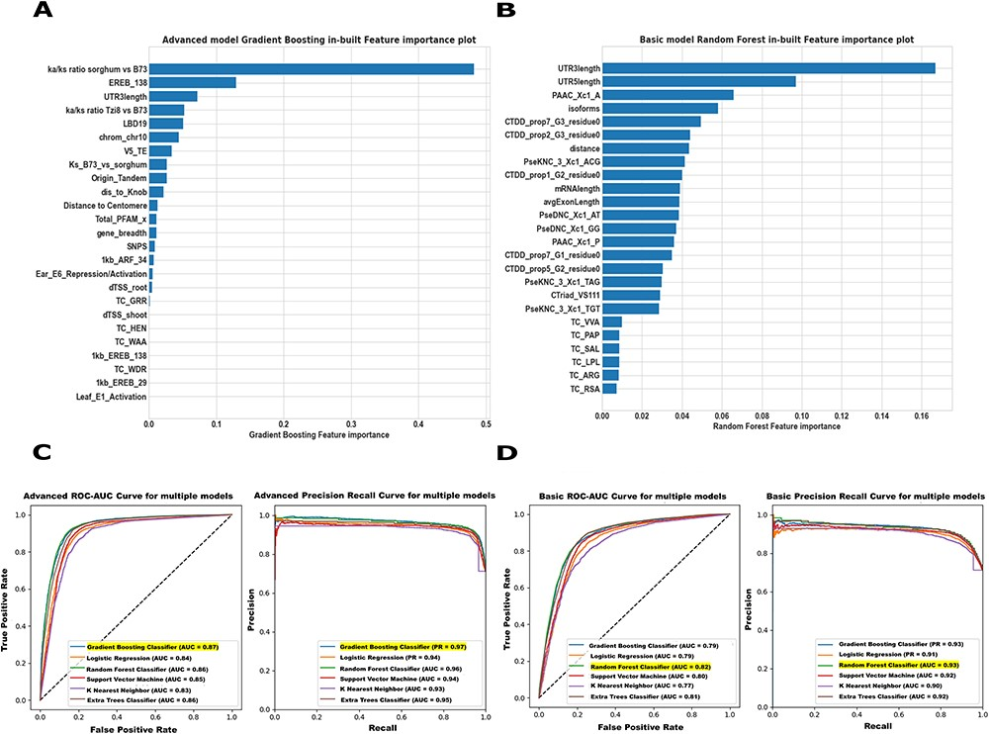
Figure 3. Maize Feature Store example Basic and Advanced models. (A) In our Advanced model, both intrinsic and ...
Notes:
Figure 3. Maize Feature Store example Basic and Advanced models. (A) In our Advanced model, both intrinsic and extrinsic features contributed substantially to the core/non-core gene predictions in maize B73v5. The 25 omics features were ranked based on how useful the model found each feature in predicting the target (core/non-core genes). (B) The Basic model feature importance plot displays only the structural and sequence features most predictive of identifying the core and non-core genes in B73v5. Higher scores indicate that a specific feature has a larger impact on the model used to predict a specific variable (core/non-core). (C, D) The prediction performance of both the ‘Advanced’ model and the ‘Basic’ model was evaluated across all classifiers on the test set using AUC-ROC (left) and the area under the Precision-Recall Curve AUC-PR (right) metrics. For detailed model evaluation and performance analysis, see the Supplementary Figure S17-S18.
Unless provided in the caption above, the following copyright applies to the content of this slide: Published by Oxford University Press 2023. This work is written by (a) US Government employee(s) and is in the public domain in the US.This work is written by (a) US Government employee(s) and is in the public domain in the US.

Slide 2
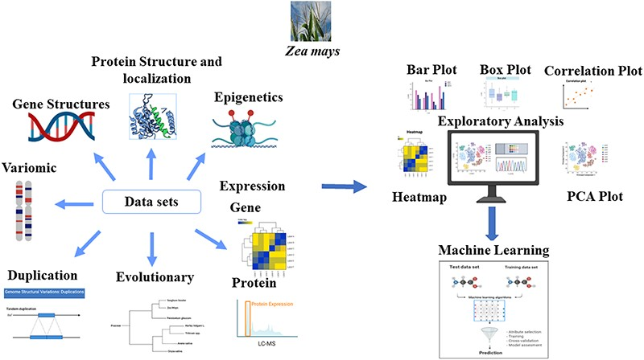
Figure 1. Module description: The MFS consists of three main modules: Features, Downstream Analysis, and Modeling. We ...
Notes:
Figure 1. Module description: The MFS consists of three main modules: Features, Downstream Analysis, and Modeling. We assembled the omics features associated with each gene model in Zea mays (B73v5) based on various sources as indicated by the ‘Data sets’ arrows of the figure. Many preliminary and advanced exploratory analyses can be performed on the generated features as indicated by the ‘Exploratory analysis’ module of the figure. Systematic evaluation of machine learning (ML) approaches is used in the Modeling section to solve complex biological problems, such as pan-genome prediction. The Graphical Overview was created using BioRender.com.
Unless provided in the caption above, the following copyright applies to the content of this slide: Published by Oxford University Press 2023. This work is written by (a) US Government employee(s) and is in the public domain in the US.This work is written by (a) US Government employee(s) and is in the public domain in the US.

Slide 3
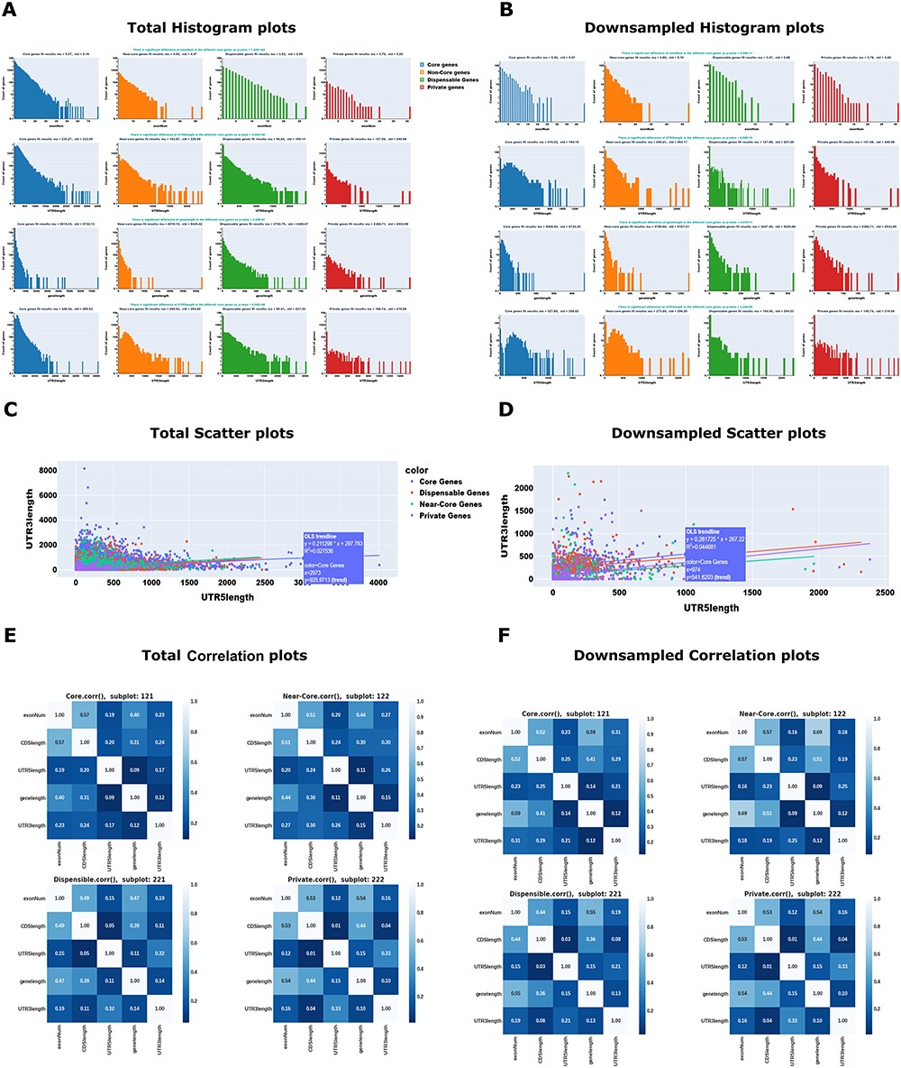
Figure 2. Example Maize Feature Store outputs. The MFS provides users with options to carry out several univariate, ...
Notes:
Figure 2. Example Maize Feature Store outputs. The MFS provides users with options to carry out several univariate, bivariate, and multivariate analyses for both the total and downsampled omics data. Univariate analysis example: (A) Total Histogram; (B) Downsampled Histogram; Bivariate analysis example: (C) Total Scatter plot; (D) Downsampled Scatter plot; Multivariate analysis example: (E) Total Correlation plot; (F) Downsampled Correlation plot. These plots were generated from the selected Gene Structures such as Gene length, Exon number, three-prime UTR length, five-prime UTR length, and the selected label (‘Pan-genome’: core/near-core/dispensable/private). The plot’s colors and legends indicate the multiple ‘Pan-genome’ categories. In addition to the graph, to increase the interpretability of the data, we have also included p-values, mean and standard deviations of the selected datasets. For details on the interpretation of the plots, see (https://mfs.maizegdb.org/Structure).
Unless provided in the caption above, the following copyright applies to the content of this slide: Published by Oxford University Press 2023. This work is written by (a) US Government employee(s) and is in the public domain in the US.This work is written by (a) US Government employee(s) and is in the public domain in the US.

