Slide 1
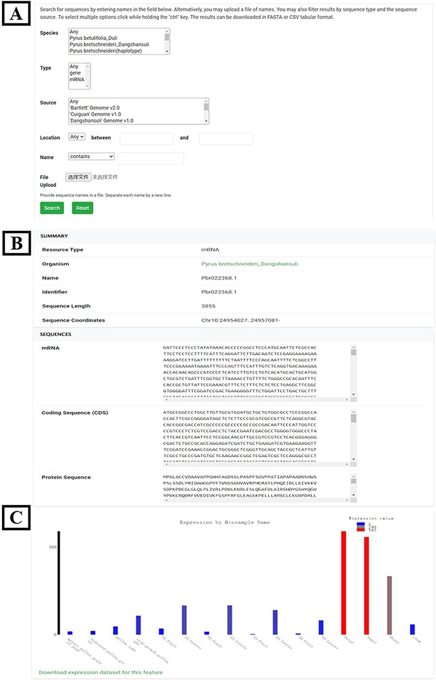
Figure 3. Gene search tool. (A) Gene search page. (B) Chromosomal location and sequences of the target gene. (C) ...
Notes:
Figure 3. Gene search tool. (A) Gene search page. (B) Chromosomal location and sequences of the target gene. (C) Spatiotemporal expression profile of target gene.
Unless provided in the caption above, the following copyright applies to the content of this slide: © The Author(s) 2023. Published by Oxford University Press.This is an Open Access article distributed under the terms of the Creative Commons Attribution License (https://creativecommons.org/licenses/by/4.0/), which permits unrestricted reuse, distribution, and reproduction in any medium, provided the original work is properly cited.

Slide 2
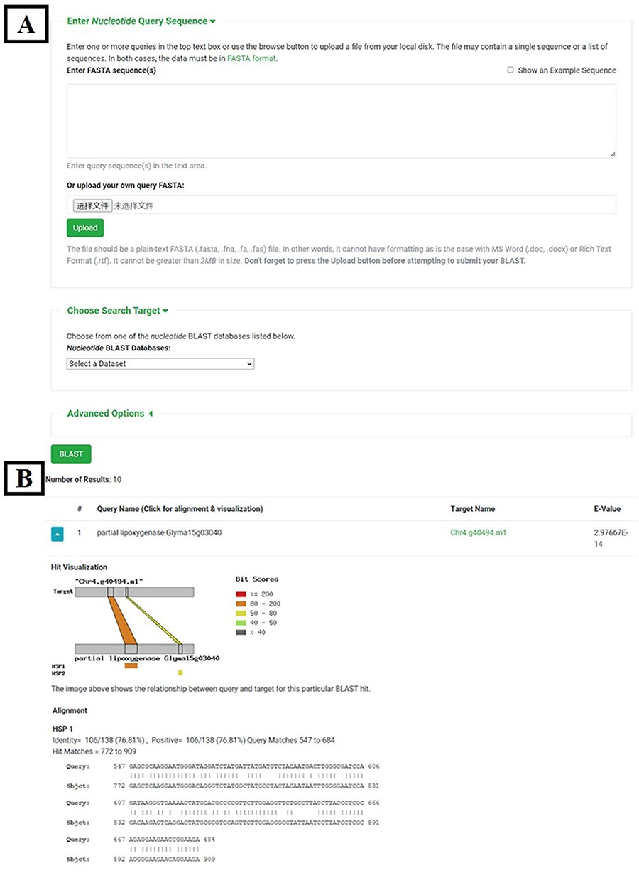
Figure 4. BLAST tool. (A) BLAST search page. (B) BLAST result page.
Notes:
Figure 4. BLAST tool. (A) BLAST search page. (B) BLAST result page.
Unless provided in the caption above, the following copyright applies to the content of this slide: © The Author(s) 2023. Published by Oxford University Press.This is an Open Access article distributed under the terms of the Creative Commons Attribution License (https://creativecommons.org/licenses/by/4.0/), which permits unrestricted reuse, distribution, and reproduction in any medium, provided the original work is properly cited.

Slide 3
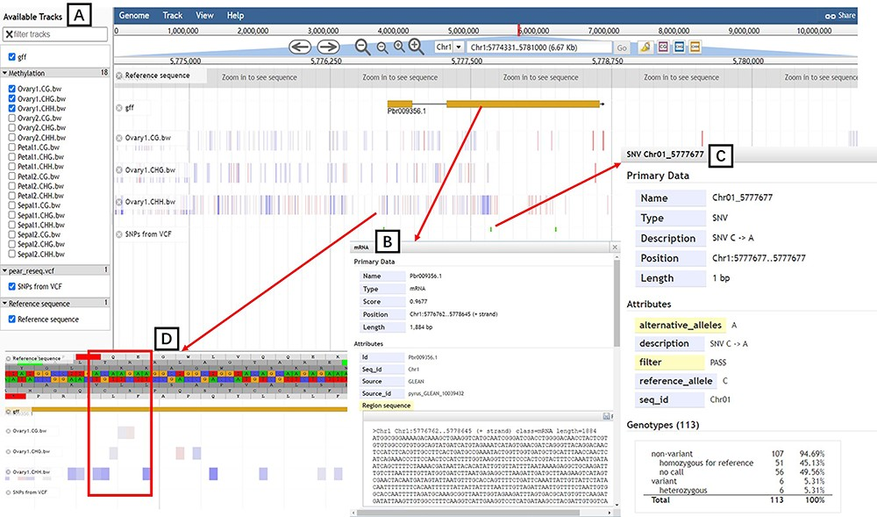
Figure 5. JBrowse tool. (A) Available tracks for different types of genomic features. (B) A window showing detailed ...
Notes:
Figure 5. JBrowse tool. (A) Available tracks for different types of genomic features. (B) A window showing detailed information of the target gene model. (C) SNPs information for 113 pear accessions. (D) Tracks of three types of DNA methylation.
Unless provided in the caption above, the following copyright applies to the content of this slide: © The Author(s) 2023. Published by Oxford University Press.This is an Open Access article distributed under the terms of the Creative Commons Attribution License (https://creativecommons.org/licenses/by/4.0/), which permits unrestricted reuse, distribution, and reproduction in any medium, provided the original work is properly cited.

Slide 4
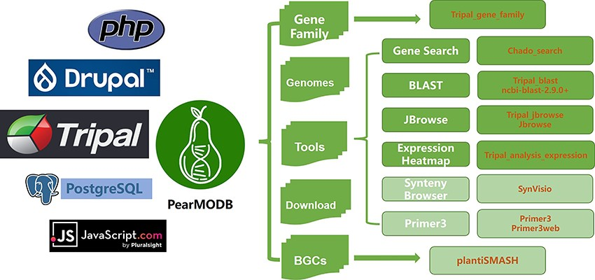
Figure 1. The framework and available function modules of PearMODB. Core system and programming language, logo, main ...
Notes:
Figure 1. The framework and available function modules of PearMODB. Core system and programming language, logo, main functional modules, corresponding core programs of PearMODB are shown from left to right.
Unless provided in the caption above, the following copyright applies to the content of this slide: © The Author(s) 2023. Published by Oxford University Press.This is an Open Access article distributed under the terms of the Creative Commons Attribution License (https://creativecommons.org/licenses/by/4.0/), which permits unrestricted reuse, distribution, and reproduction in any medium, provided the original work is properly cited.

Slide 5
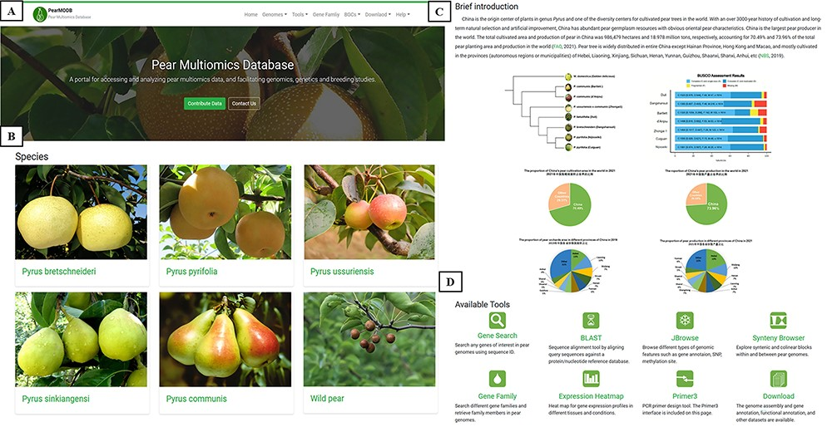
Figure 2. The home page of PearMODB. (A) Drop-down menus to explore different function modules and brief introduction. ...
Notes:
Figure 2. The home page of PearMODB. (A) Drop-down menus to explore different function modules and brief introduction. (B) Representative cultivars of five major cultivated species and wild pear species. (C) Brief introduction about pear cultivation and yield. (D) Available tools on PearMODB.
Unless provided in the caption above, the following copyright applies to the content of this slide: © The Author(s) 2023. Published by Oxford University Press.This is an Open Access article distributed under the terms of the Creative Commons Attribution License (https://creativecommons.org/licenses/by/4.0/), which permits unrestricted reuse, distribution, and reproduction in any medium, provided the original work is properly cited.

Slide 6
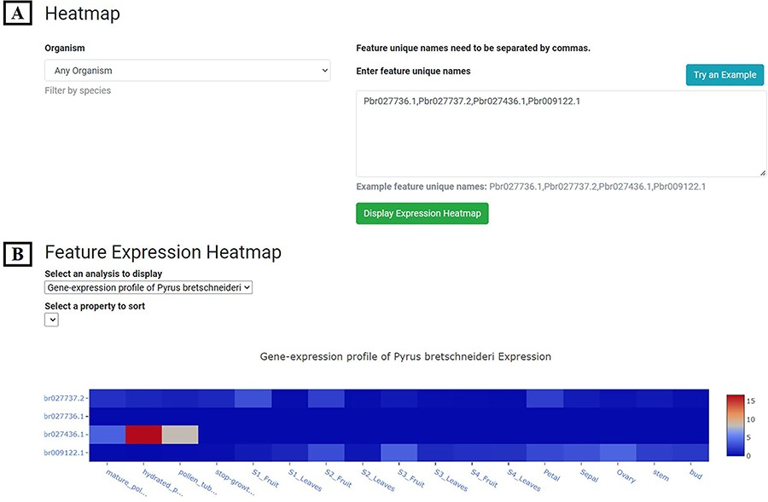
Figure 6. Expression Heatmap page. (A) The block for organism selection and gene id input. (B) Gene expression profile ...
Notes:
Figure 6. Expression Heatmap page. (A) The block for organism selection and gene id input. (B) Gene expression profile of example genes in 17 tissues or development stages of P. bretschneideri cv. ‘Dangshansuli’.
Unless provided in the caption above, the following copyright applies to the content of this slide: © The Author(s) 2023. Published by Oxford University Press.This is an Open Access article distributed under the terms of the Creative Commons Attribution License (https://creativecommons.org/licenses/by/4.0/), which permits unrestricted reuse, distribution, and reproduction in any medium, provided the original work is properly cited.

Slide 7
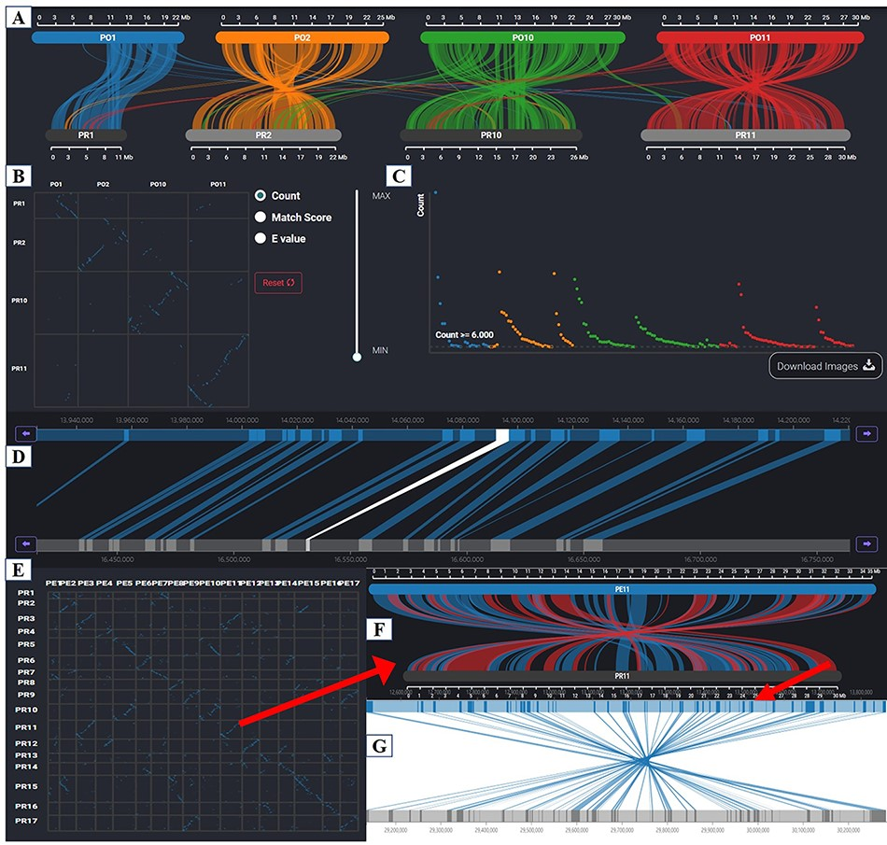
Figure 7. Synteny Browser page. (A) Macrosynteny visualization between the two pear variety genomes. (B) Dot plot ...
Notes:
Figure 7. Synteny Browser page. (A) Macrosynteny visualization between the two pear variety genomes. (B) Dot plot corresponding to the macrosynteny visualization. (C) Distribution of the number of syntenic blocks with different lengths. (D) Microsynteny visualization of the target gene. (E) Dot plot of collinearity relationships of 17 chromosomes between ‘Dangshansuli’ and ‘Duli’. (F) Macrosynteny visualization of Chr11 between ‘Dangshansuli’ and ‘Duli’. (G) Microsynteny visualization of the selected syntenic block.
Unless provided in the caption above, the following copyright applies to the content of this slide: © The Author(s) 2023. Published by Oxford University Press.This is an Open Access article distributed under the terms of the Creative Commons Attribution License (https://creativecommons.org/licenses/by/4.0/), which permits unrestricted reuse, distribution, and reproduction in any medium, provided the original work is properly cited.

Slide 8
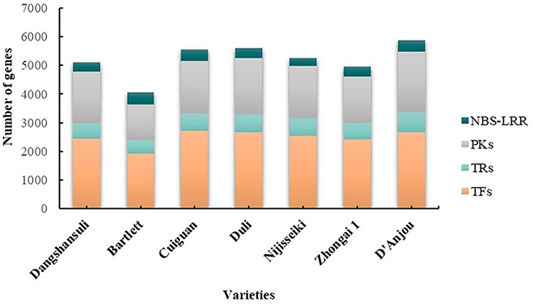
Figure 8. A comparison of gene number of different families in seven pear genomes.
Notes:
Figure 8. A comparison of gene number of different families in seven pear genomes.
Unless provided in the caption above, the following copyright applies to the content of this slide: © The Author(s) 2023. Published by Oxford University Press.This is an Open Access article distributed under the terms of the Creative Commons Attribution License (https://creativecommons.org/licenses/by/4.0/), which permits unrestricted reuse, distribution, and reproduction in any medium, provided the original work is properly cited.

Slide 9
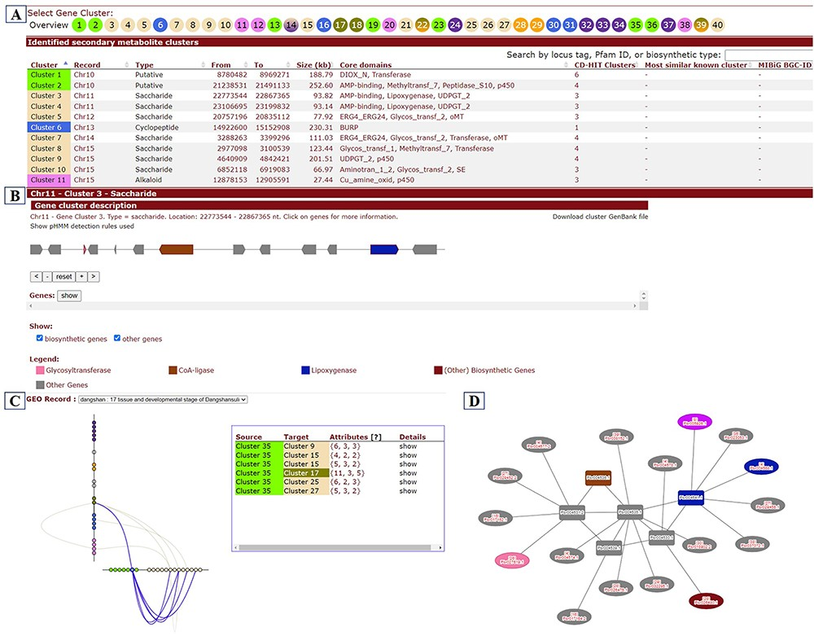
Figure 9. BGCs page. (A) Whole set of BGCs in a pear genome. (B) Gene members and functional characteristics of BGCs. ...
Notes:
Figure 9. BGCs page. (A) Whole set of BGCs in a pear genome. (B) Gene members and functional characteristics of BGCs. (C) Co-expression relationships between BGCs. (D) Co-expression network of genes within a selected cluster (rectangle) and their co-expression relationships with genes from other clusters (ellipse).
Unless provided in the caption above, the following copyright applies to the content of this slide: © The Author(s) 2023. Published by Oxford University Press.This is an Open Access article distributed under the terms of the Creative Commons Attribution License (https://creativecommons.org/licenses/by/4.0/), which permits unrestricted reuse, distribution, and reproduction in any medium, provided the original work is properly cited.

