Slide 1
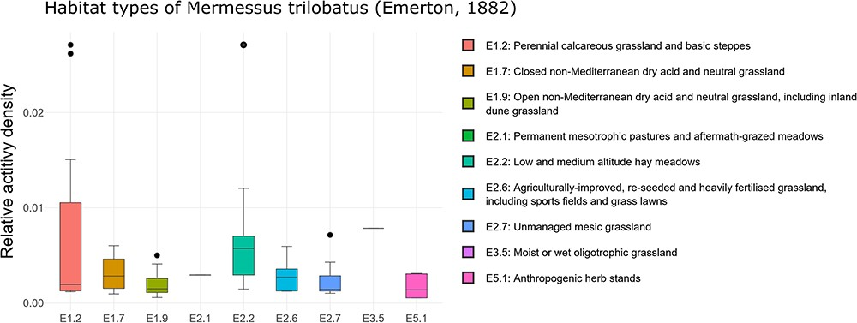
Figure 3. Habitat occurrence of M. trilobatus according to the EUNIS habitat classification at the third level within ...
Notes:
Figure 3. Habitat occurrence of M. trilobatus according to the EUNIS habitat classification at the third level within Class E: grasslands and lands dominated by forbs, mosses or lichens. The frequency data for the individual classes are as follows (sites with the presence of M. trilobatus/total sites in ARAMOB) E1.2: 12/86, E1.7: 6/14, E1.9: 15/26, E2.1: 1/6, E2.2: 13/28, E2.6: 14/24, E2.7: 8/35, E3.5: 1/12, E4.3: 7/69, E4.5: 3/46, and E5.1: 6/16. The graph was downloaded on 26 October 2023.
Unless provided in the caption above, the following copyright applies to the content of this slide: © The Author(s) 2024. Published by Oxford University Press.This is an Open Access article distributed under the terms of the Creative Commons Attribution License (https://creativecommons.org/licenses/by/4.0/), which permits unrestricted reuse, distribution, and reproduction in any medium, provided the original work is properly cited.

